Slide 1






The six key steps
Create
An overall picture
Perform
Feature mapping
Simplify
The content structure
Trash out
The integration
Finalize the
Deployment model
Plan for
Routine maintenance

Slide 2
THE OVERALL PICTURE
Get it right…

Slide 3
Getting the overall picture right
Its important to create an overall picture of the solution and finalize where AEM fits in this overall solution before proceeding further
Decide on the boundary of each of the system in the overall scope and finalize the responsibility of each
Analyze the system separately from authoring point of view and publish point of view. The overall layout you foresee for author might be very different from that of publish
The role of AEM in the overall system solution can fall into one of the following three categories

Slide 4
AEM as umbrella system
A standalone AEM implementation or AEM as the wrapper system that
integrates with other systems and delivers the site
AEM most often would be the umbrella system integrating with other systems to serve the functionality
In this configuration AEM takes the responsibility of integrating with other systems to provide integrated functionality
AEM
X
A
B
C
AEM as umbrella system

Slide 5
AEM as provider system
Beware of the impact on AEM internal functionalities when using AEM as
provider system
AEM would very well be one of the backend system providing services to other systems
Beware of the AEM internal working details when deploying AEM in this mode
E.g., how can AEM deliver targeted content as service???
System X
A
AEM
B
C
AEM as provider system

Slide 6

AEM as independent system in the stack
AEM could also be an independent system providing services to be consumed directly from the client devices
AJAX calls directly to AEM to pull content (becoming popular in sites implementing client MVC frameworks)
Beware of the security implications when deploying in this mode
AEM
System X
A
B
C
AEM as independent system

Slide 7
The de facto layers in the eco system
Always consider the de facto layers in the eco system
These are almost always there and has to be planned for in the overall layout
With AEM, these layers impacts some of the key decisions made
Remember AEM has dispatcher and make attempt to cache everything that goes out of AEM
Anything that’s cached in
dispatcher can be cached in CDN
Content Delivery Networks
Data centers
Load Balancers
Web servers
The de facto layers

Slide 8
FEATURE MAPPING
Product selection and mapping the features needed to the capabilities

Slide 9
AEM only vs. AEM + others
List out all the features needed and map it to the capabilities
Consider all the features required for the overall solution. Features include capabilities like Security, Multi-lingual, Analytics, Search, Targeting, so on…
AEM provides capabilities for most of these features which may or may not suffice for the given requirement
Beware leveraging some of these features from AEM might require additional licensing
Validate objectively
Adobe would try to goad you into using their stack. While using products from the same suite has its advantages, it might have serious limitations especially when your overall solution is a complex mix of multiple systems

Slide 10
Validate with POC’s
You might need few proof of concepts if you are choosing different products to
complete the feature requirements
Some of the functionalities within AEM are tightly integrated
For example, AEM targeting depends on campaign management and Profiles. In case you make a choice to use Profile from a different system and targeting from AEM, be sure that the fitment is correct
Work of the details to the most granular level possible at this stage
Its wise to plan few proof of concepts to validate any assumptions that are taken

Slide 11
CONTENT STRUCTURE
Almost all design aspects link back to the content structure

Slide 12
Content structure
Almost all minor design aspects link back to the content structure
The content structure impacts security design, template finalization, component visibility, content flow, …
Remember content stored in JCR in hierarchical
Keep the content structure as simple as possible and contain cross linking of content to the minimal
Keep the structure flexible… provide to maintain more languages, companies,
departments…
Some technical stuff to remember
There are no rigid primary keys in JCR storage. Do not depend on them
You cannot store null values. Property not present means value is null or empty or non-existent
Design to keep the queries to run on nodes nested as deep as possible in the JCR structure

Slide 13
INTEGRATION
Correct integration approach is the key to the success of the implementation

Slide 14
Integration approaches
Move the integration as close to the browser as possible
Integrate in the browser: Possible when the services to be integrated with are exposed over http and available for consumption from the browser
Integrate at the dispatcher: Possible when the services to be integrated with are available over http; but are not exposed to the browser
Integrate at the Sling layer: Maintain caution to avoid making this layer logic intensive. Simple REST end points can be consumed at sling layer
Integration at the OSGI: Use this for logic intensive integration. Create wrapper bundles to be consumed from multiple places

Slide 15
When AEM exposes services
Expose them as REST Services
Implementation
Exposing
Logic in OSGI Sling servlet as gateway
Make it RESTful Through dispatcher

Slide 16


Less frequently changing content
Use batch jobs to periodically pull content into AEM
Batch job to pull content periodically and store it within AEM
Expose content for AEM
consumption

Slide 17
DEPLOYMENT MODEL
Plan the deployment model well in advance…

Slide 18
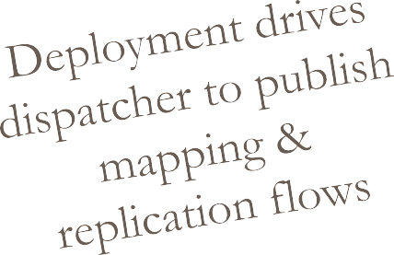




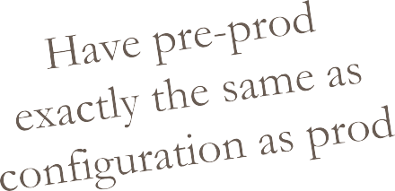
Deployment drives some design choices
The big Mongo vs. Tar war in AEM 6.1… and Tar wins hands down

Slide 19
MAINTENANCE
Remember: AEM will breakdown if maintenance activities are not carried out periodically

Slide 20
Backup, Purge, Compact
A lot happens inside AEM and is prone to corruption if not maintained
properly
AEM backup is copying the file system
Repository structure to align with backup policy
Provision additional systems to run backup on if preferred
Plan separate backups
for author and publish
Version, workflows and audit logs needs to be purged
Finalize purge policy and configure purge activities
The repository would quickly grow to a huge size if not for purging
This requires AEM downtime.
Best approach is to do it on one instance and clone that instance to other instances (publish)
Keep the publish instance homogenous (identical clones)
Backup
Purge
Compact

Slide 21
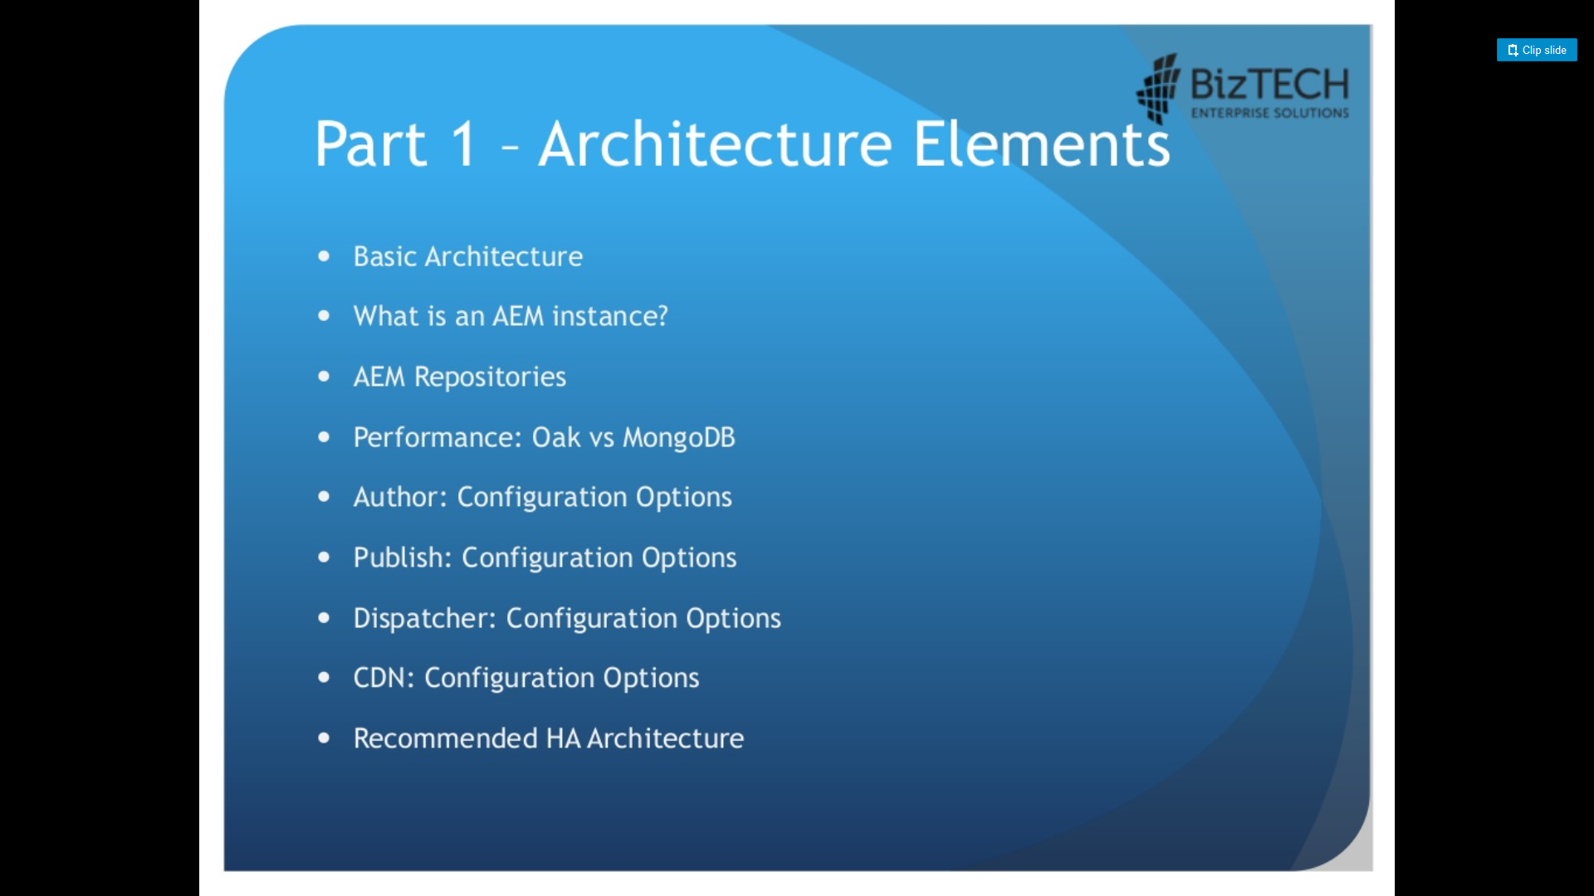

Slide 22
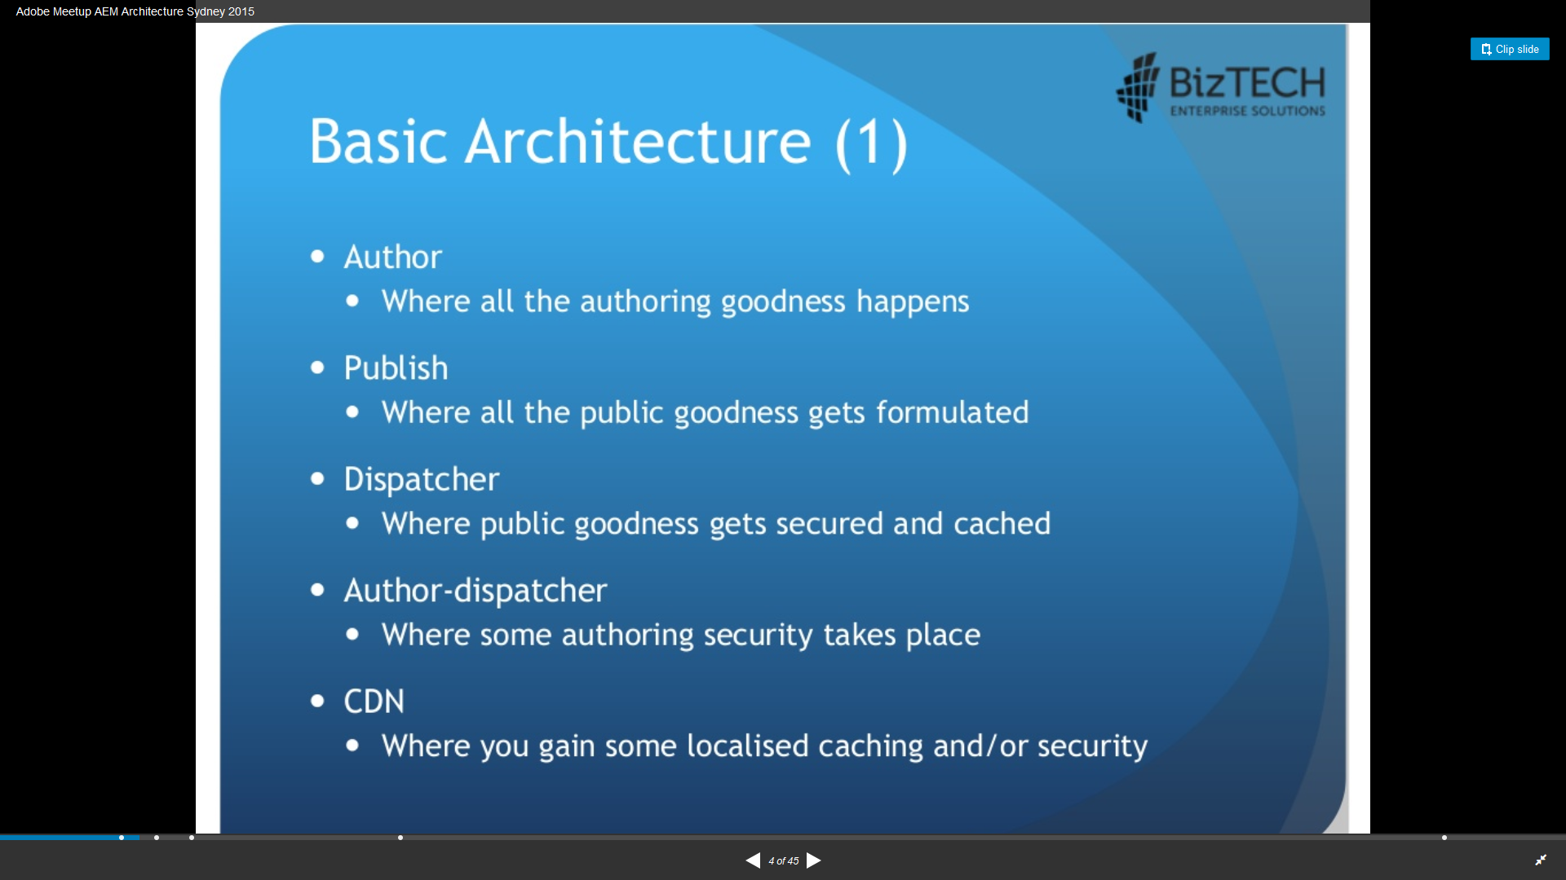

Slide 23
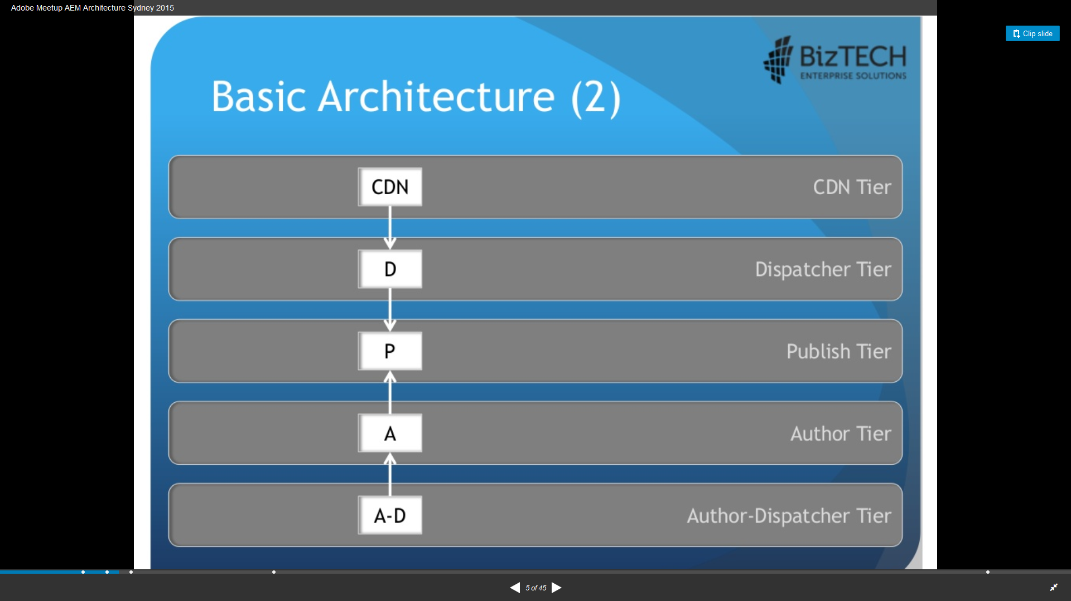

Slide 24
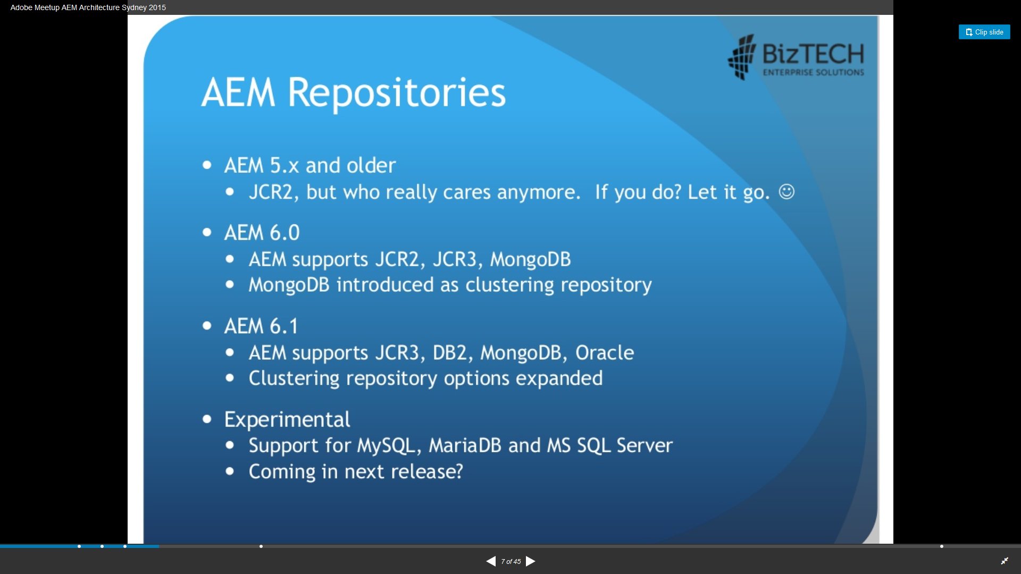

Slide 25
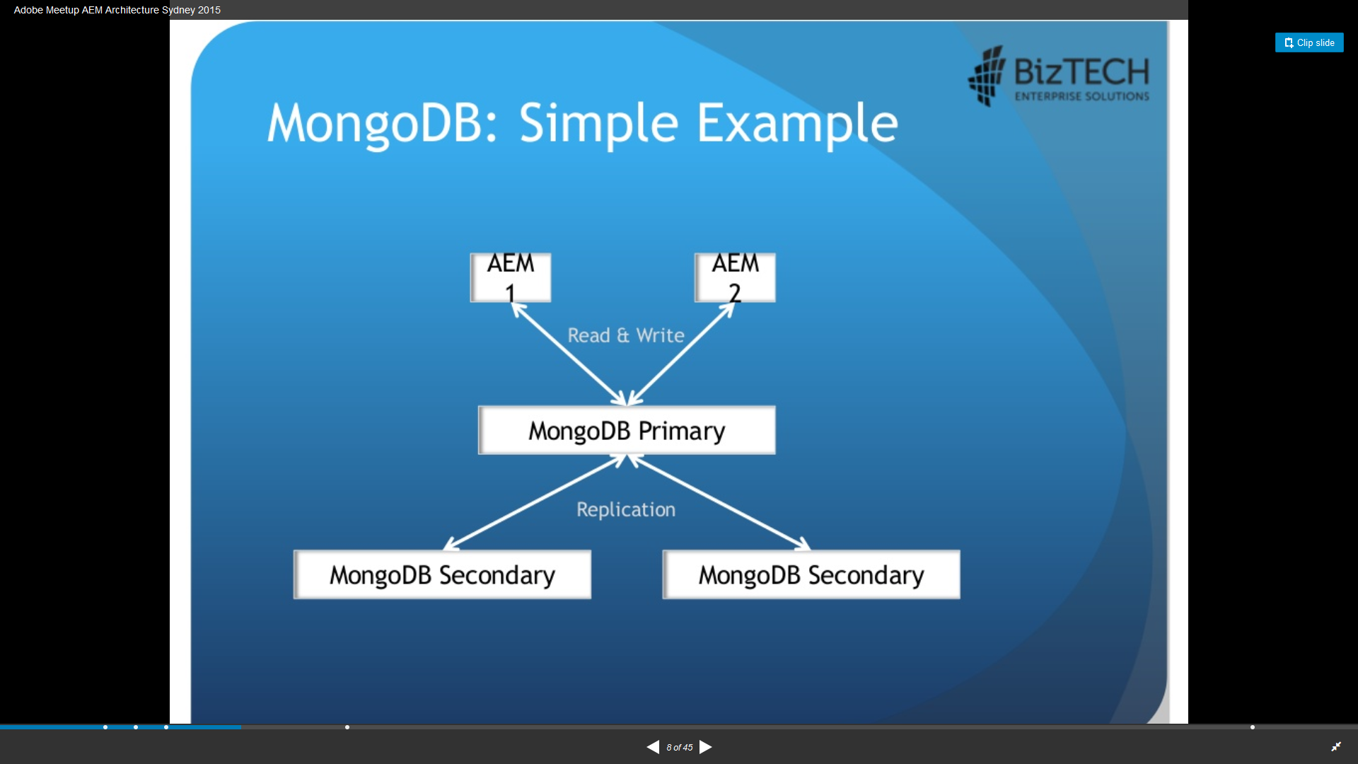

Slide 26
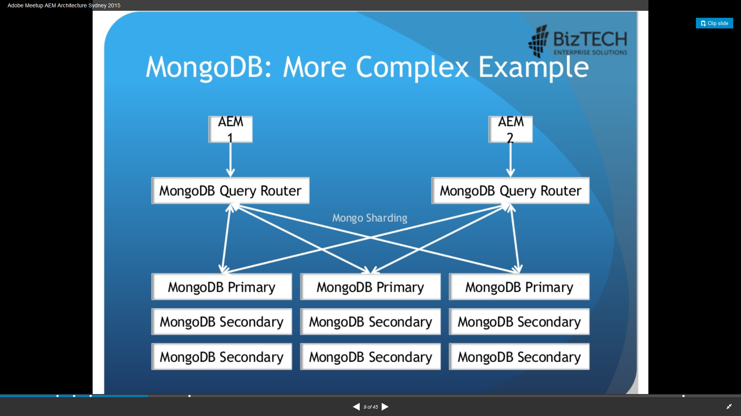

Slide 27
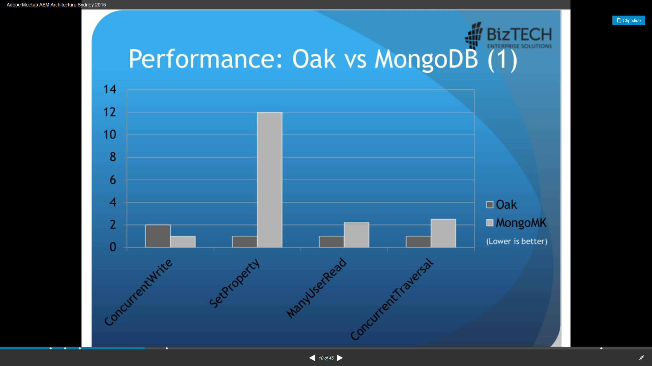

Slide 28
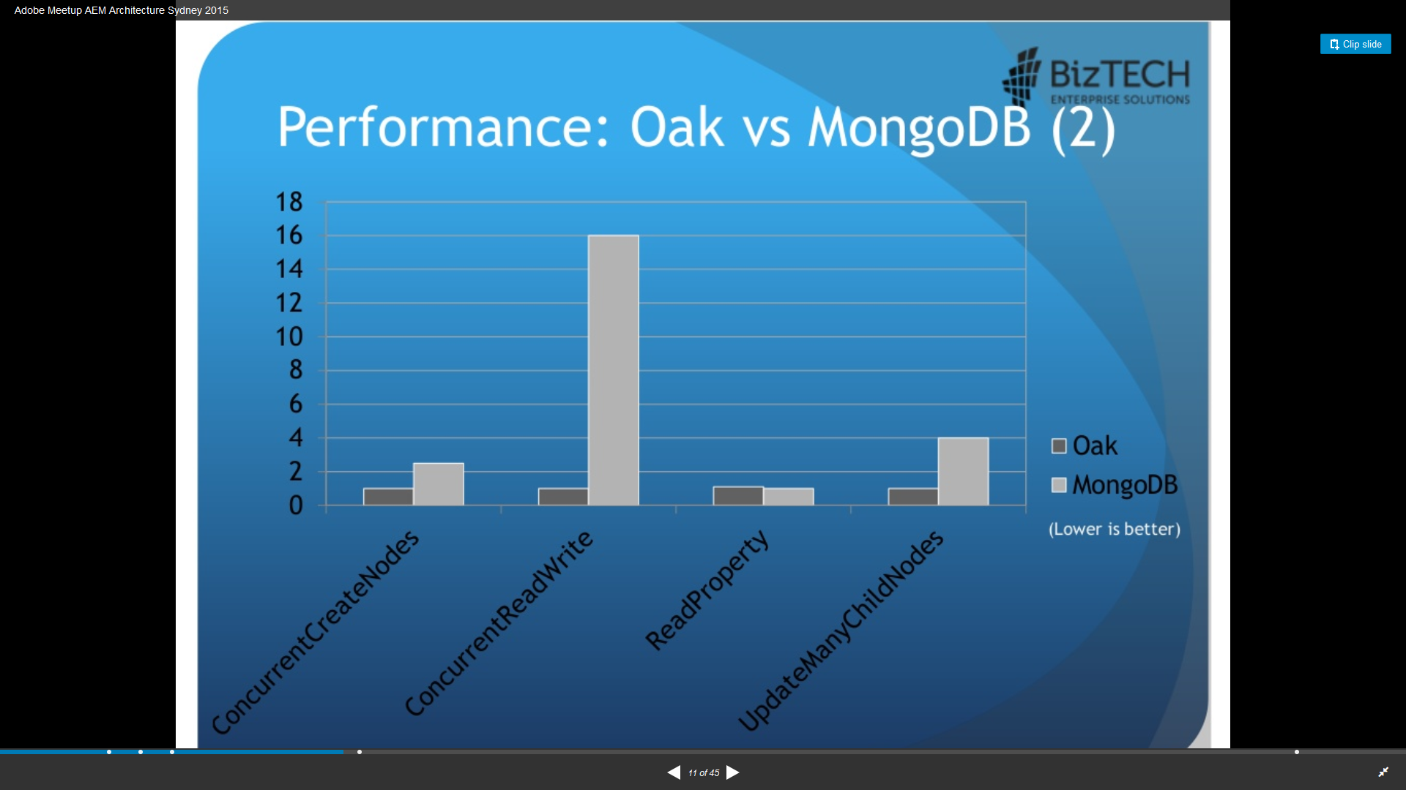

Slide 29
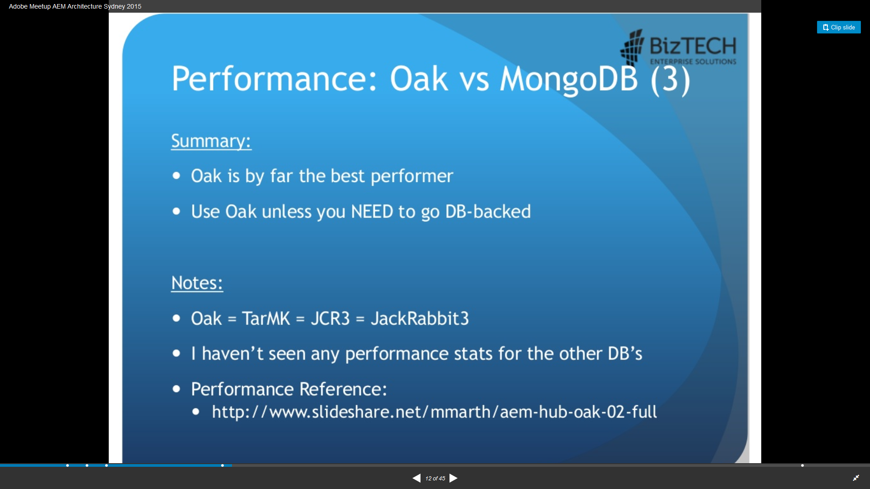

Slide 30
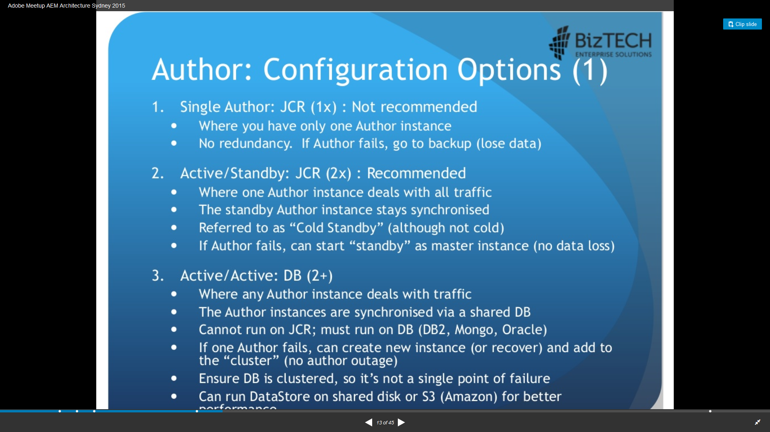

Slide 31
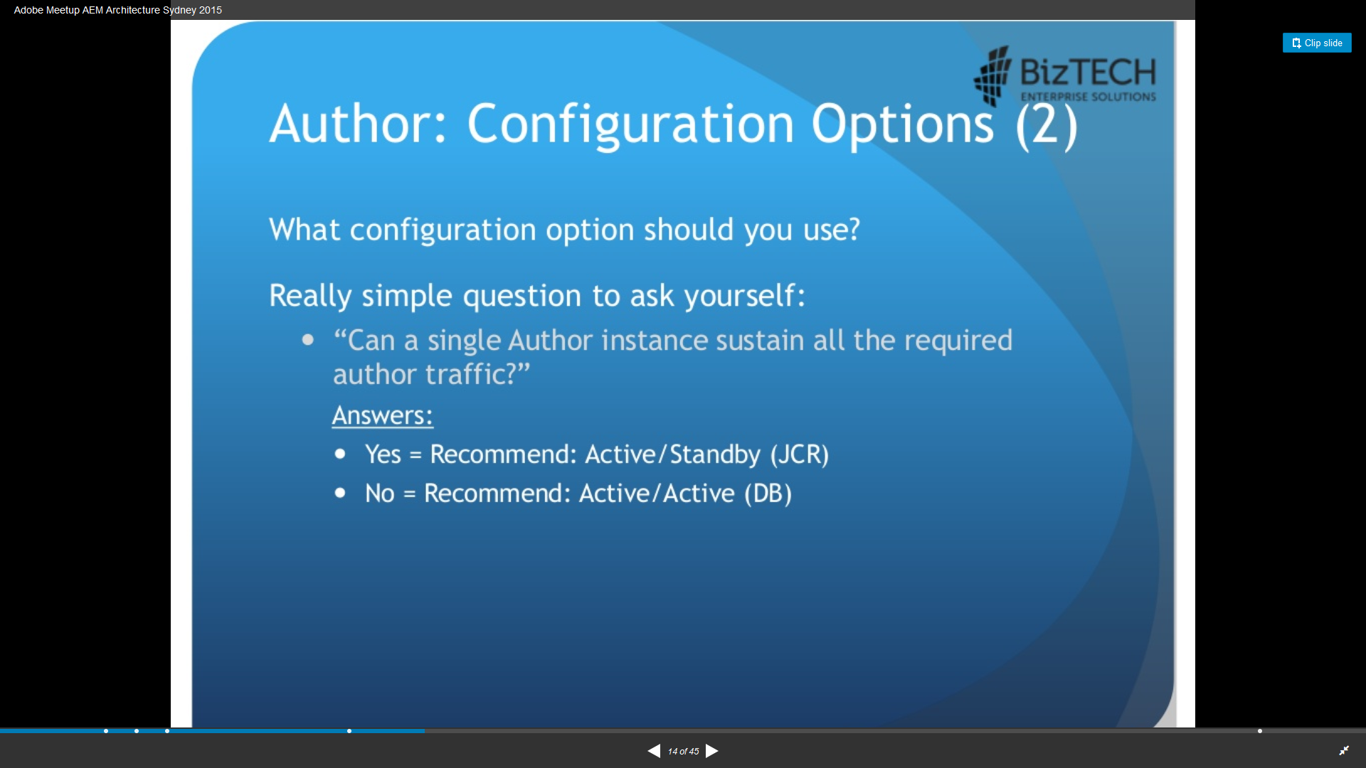

Slide 32
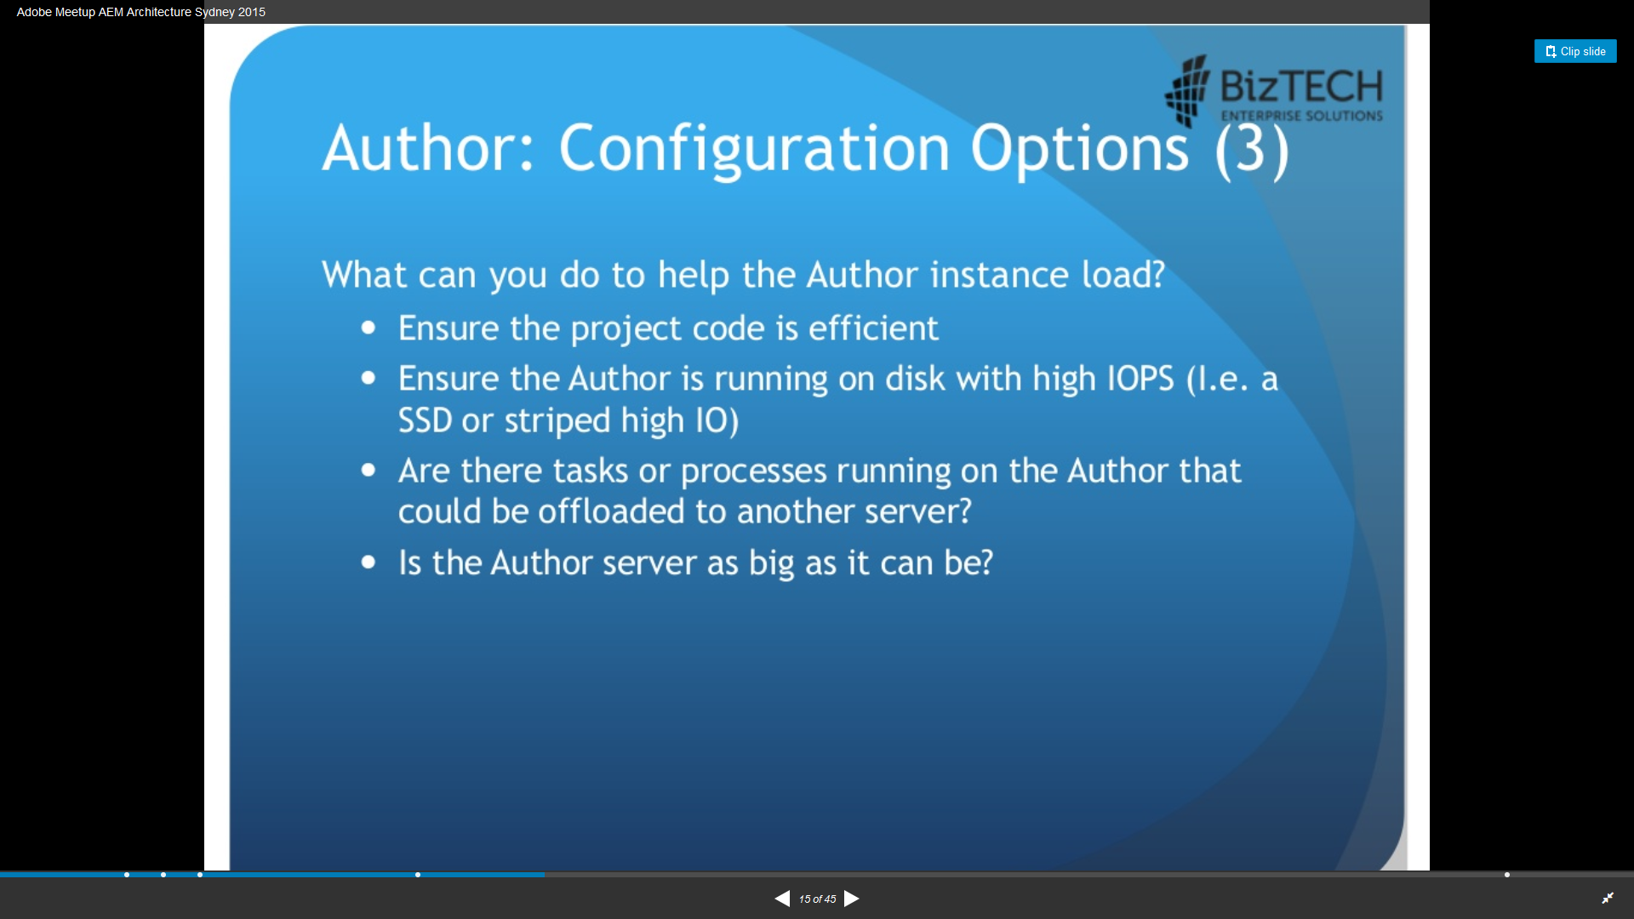

Slide 33
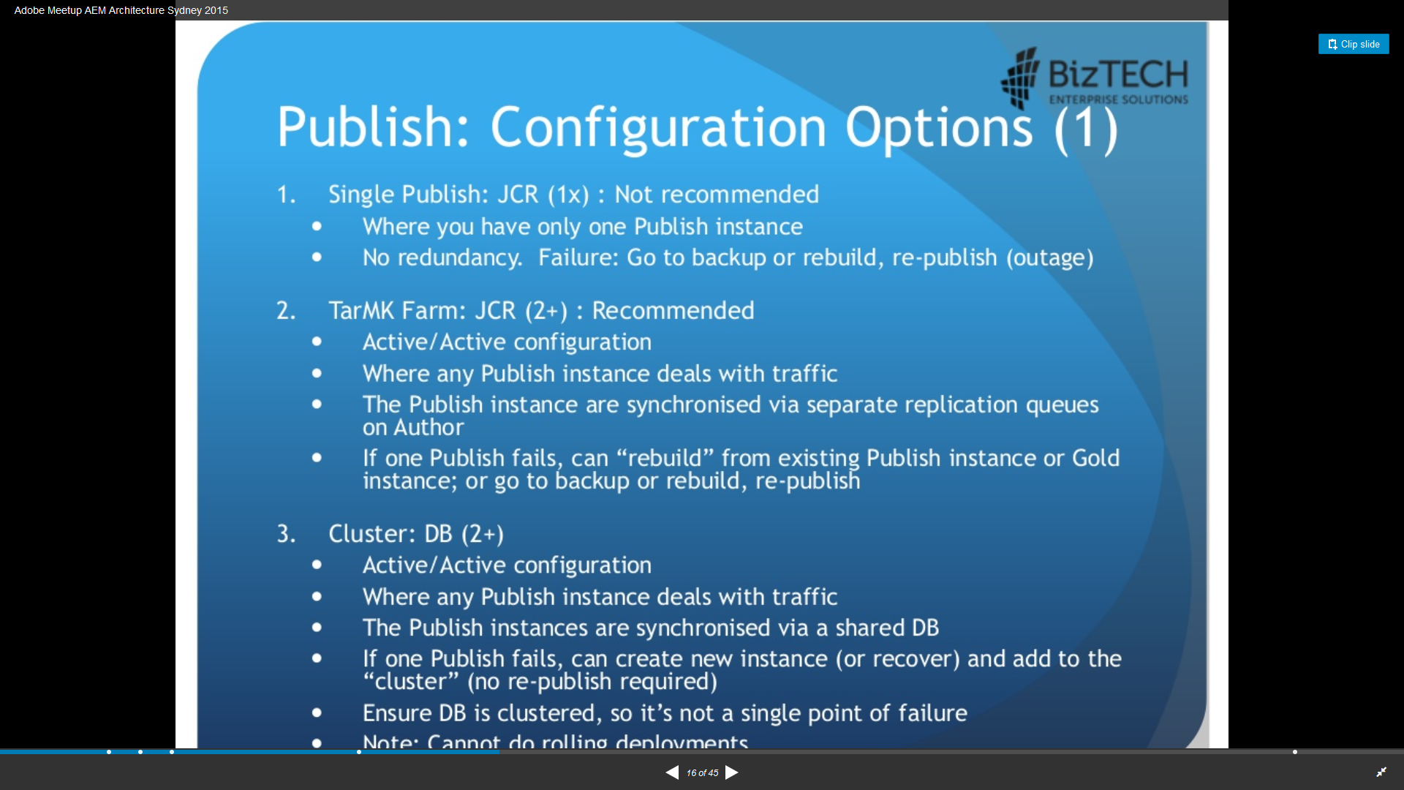

Slide 34
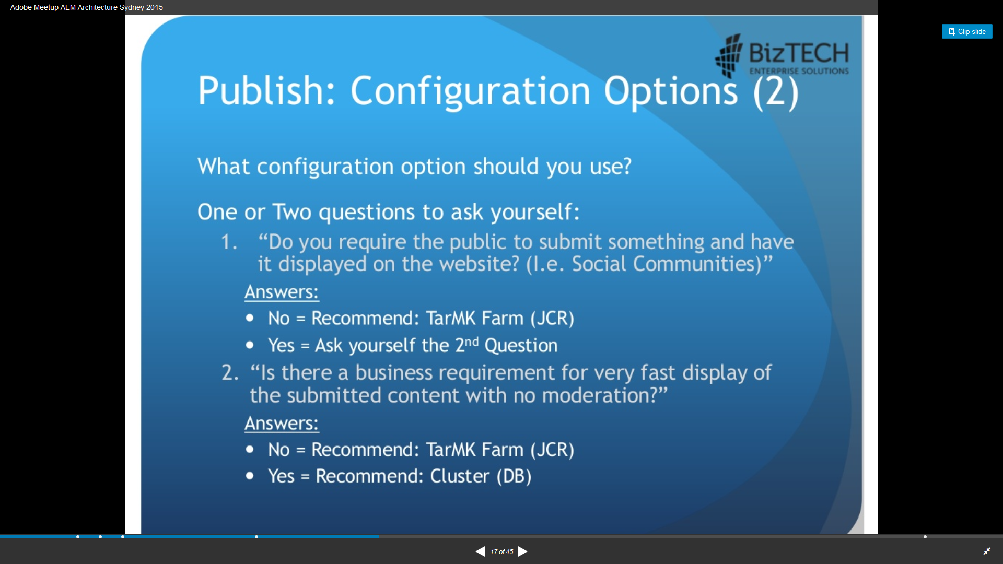

Slide 35
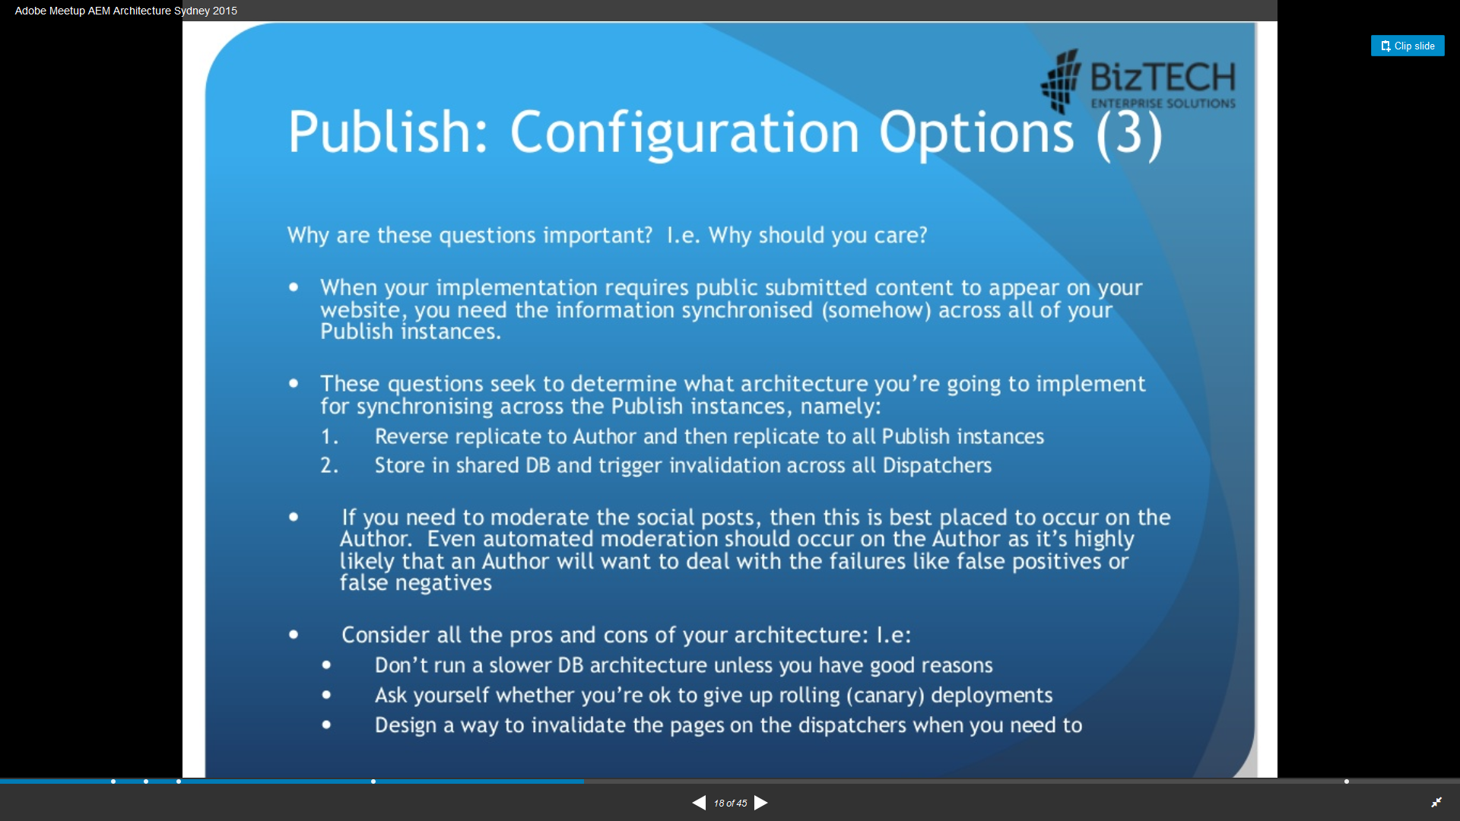

Slide 36
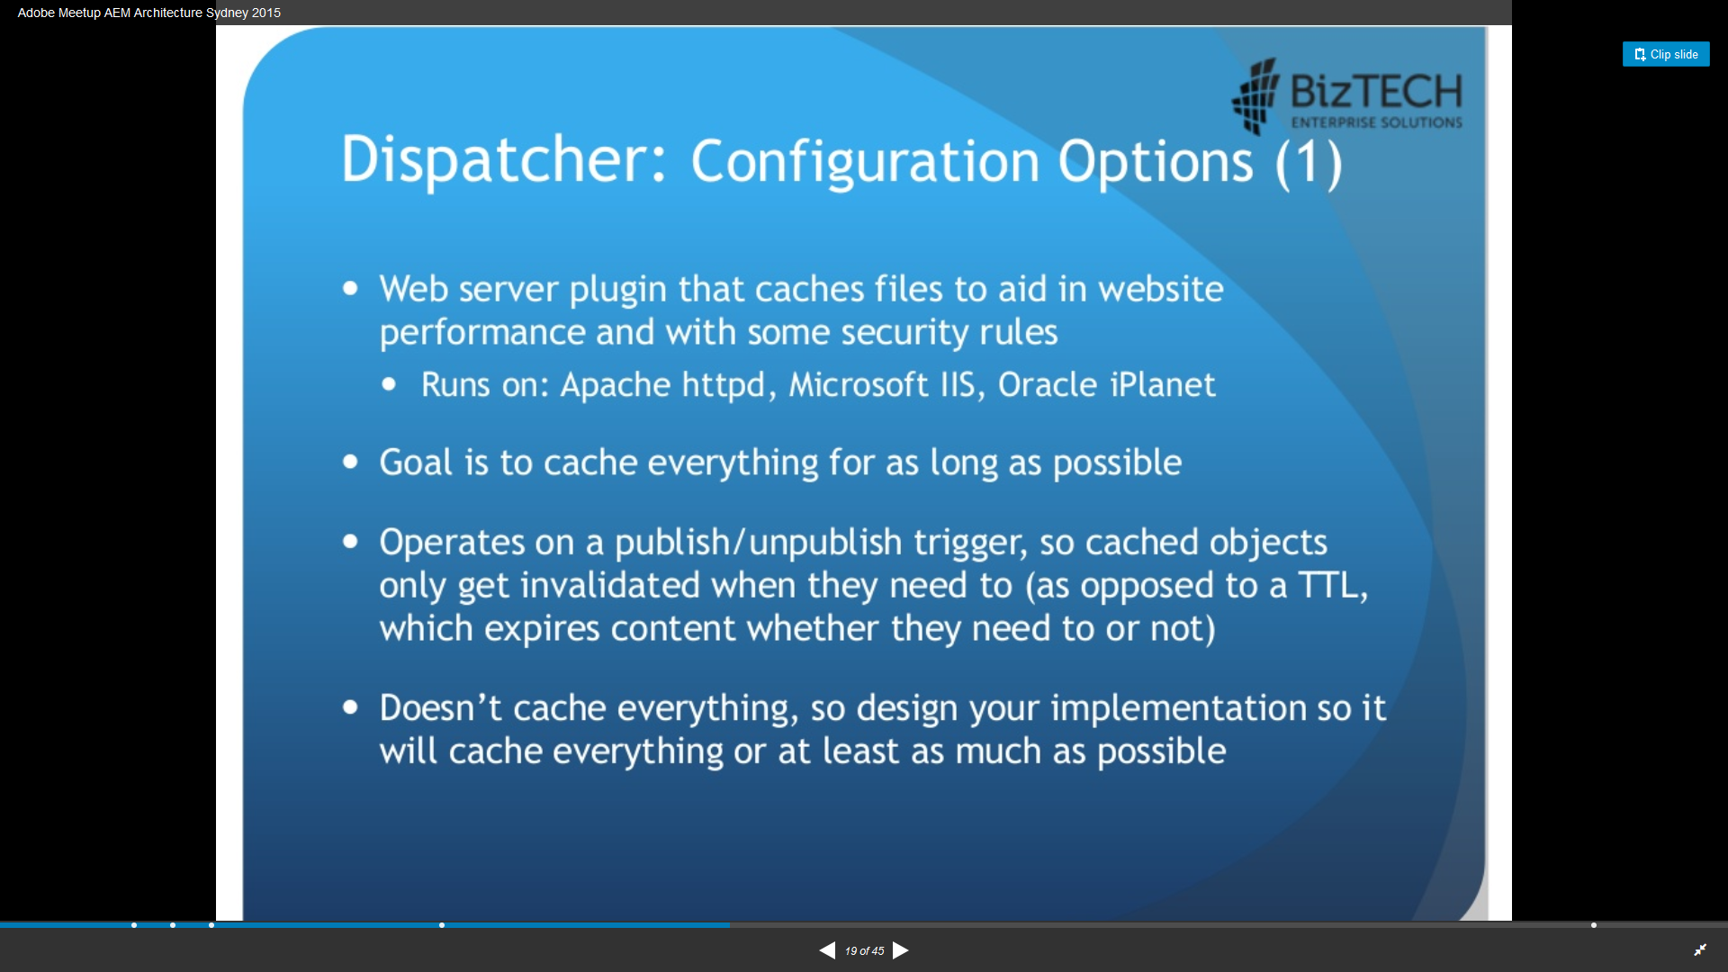

Slide 37
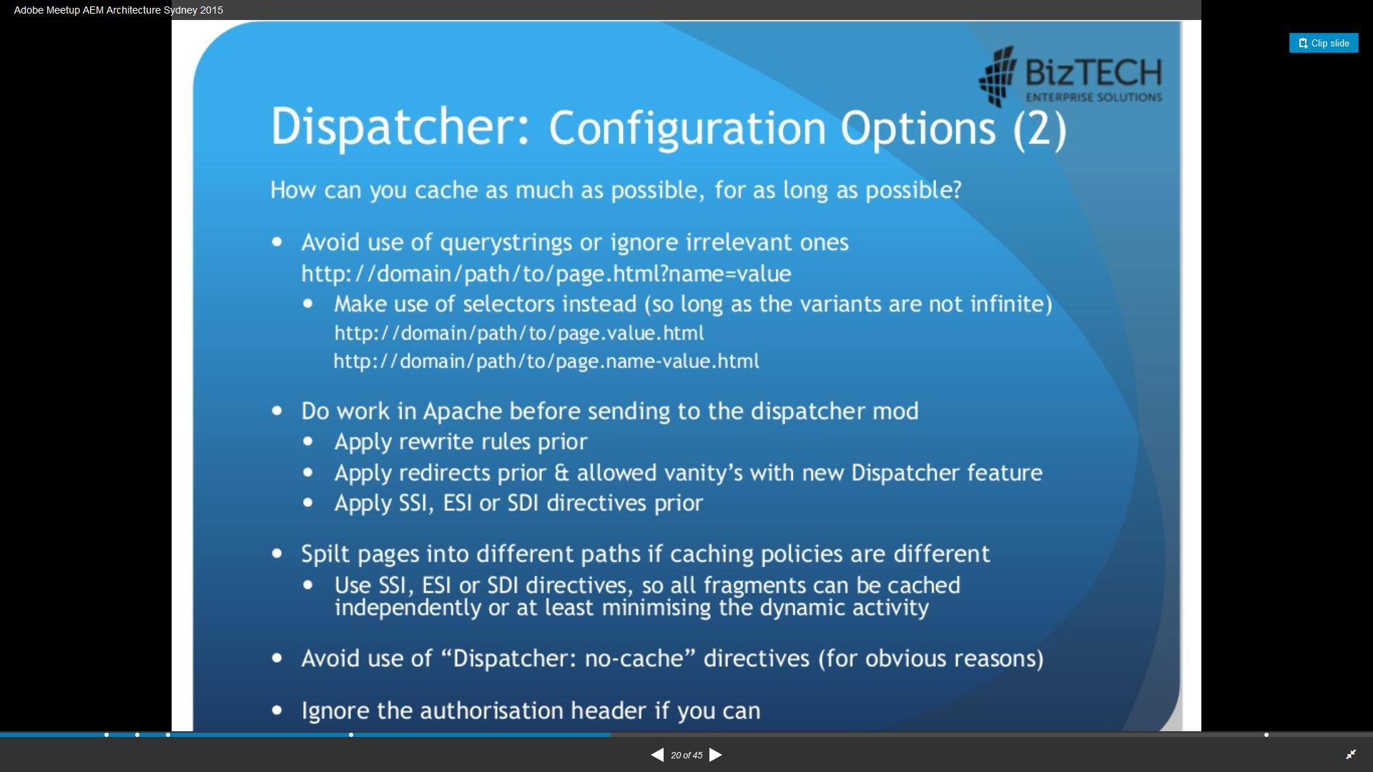

Slide 38
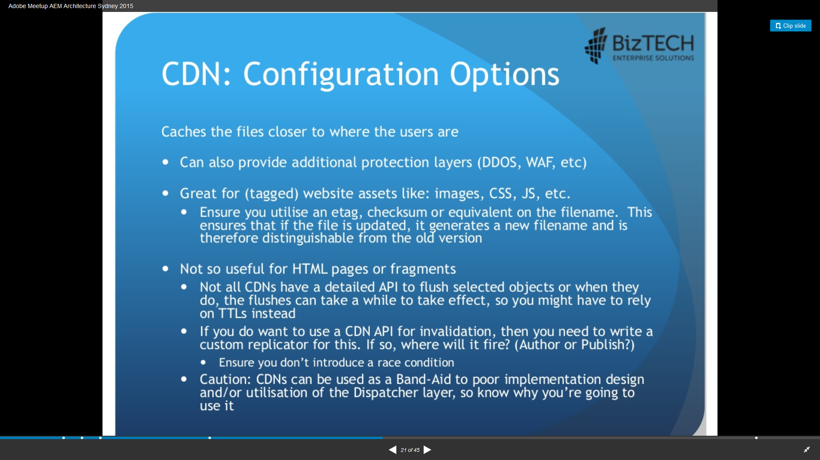

Slide 39
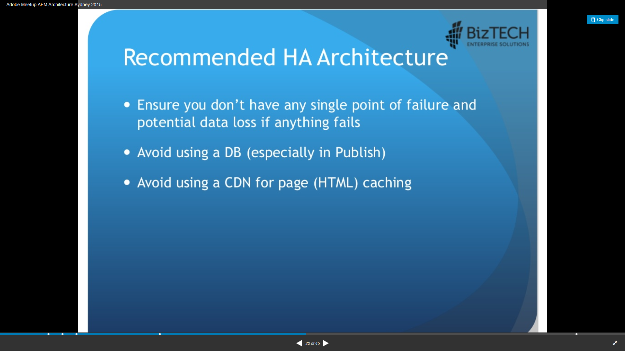

Slide 40
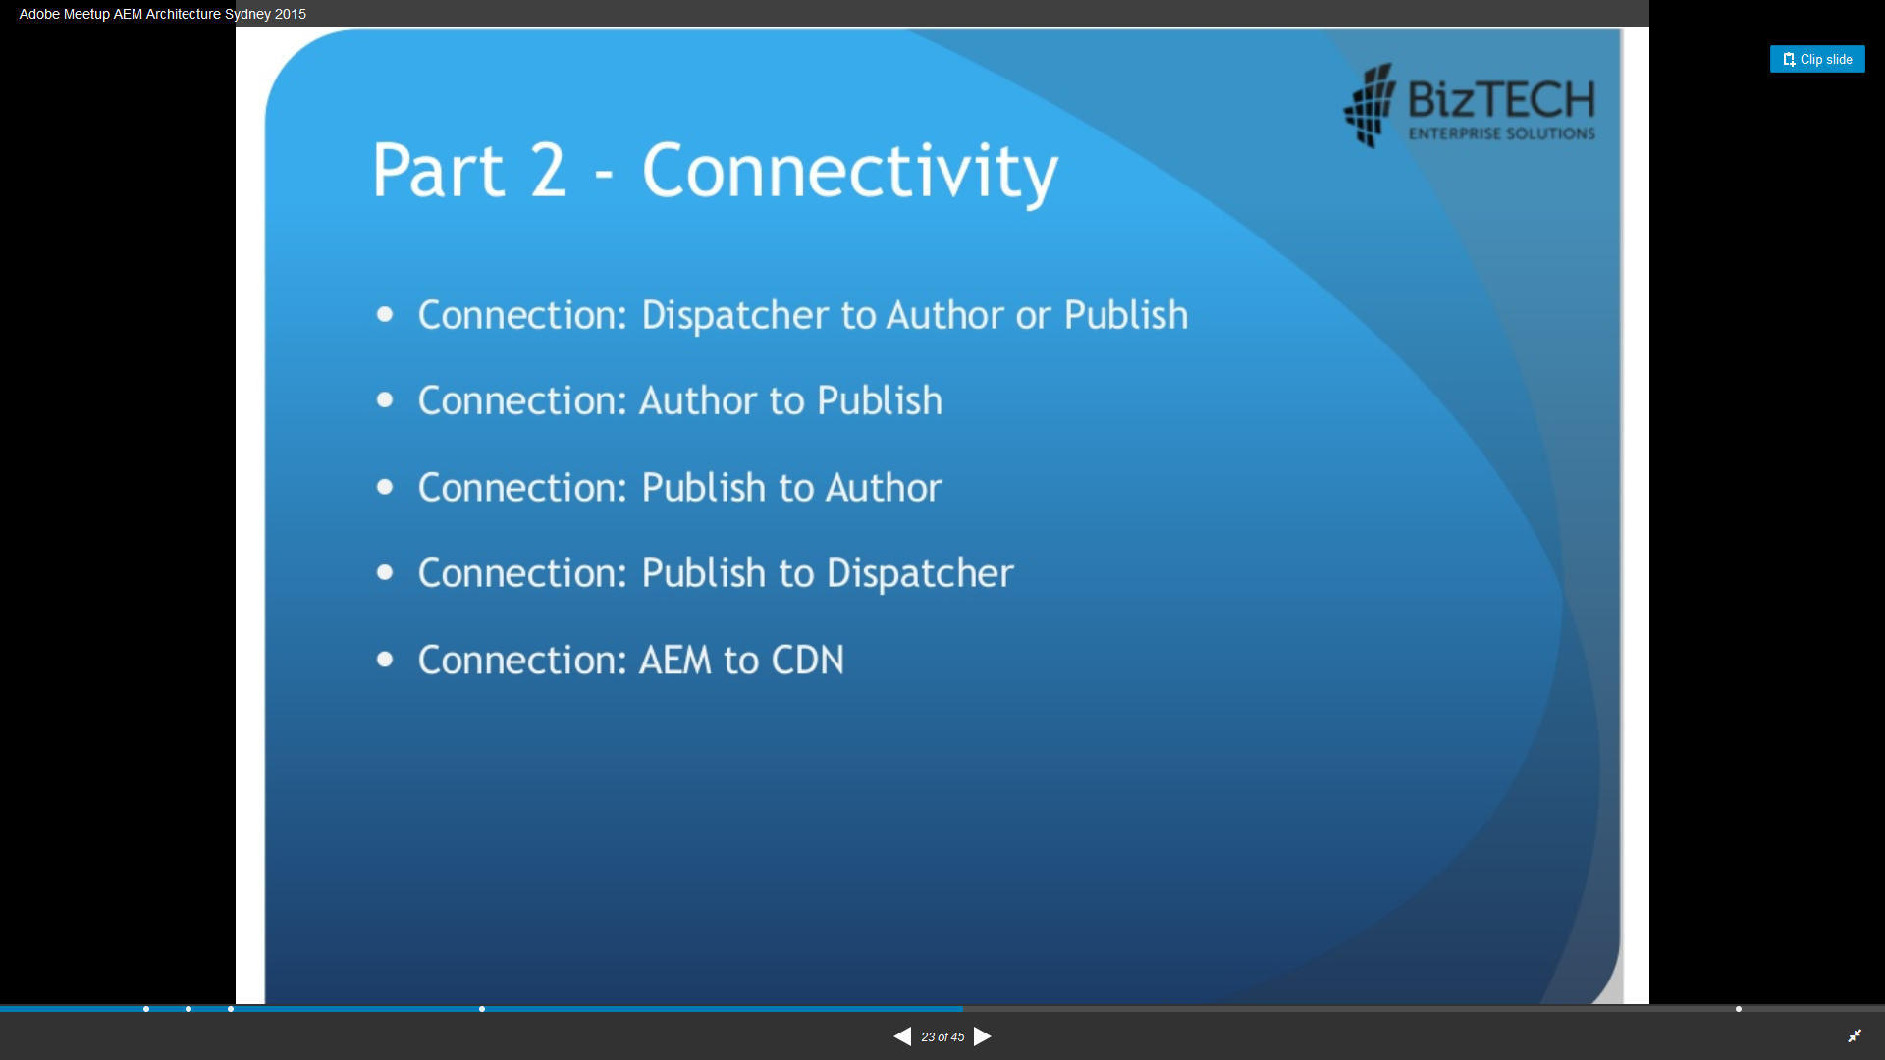

Slide 41
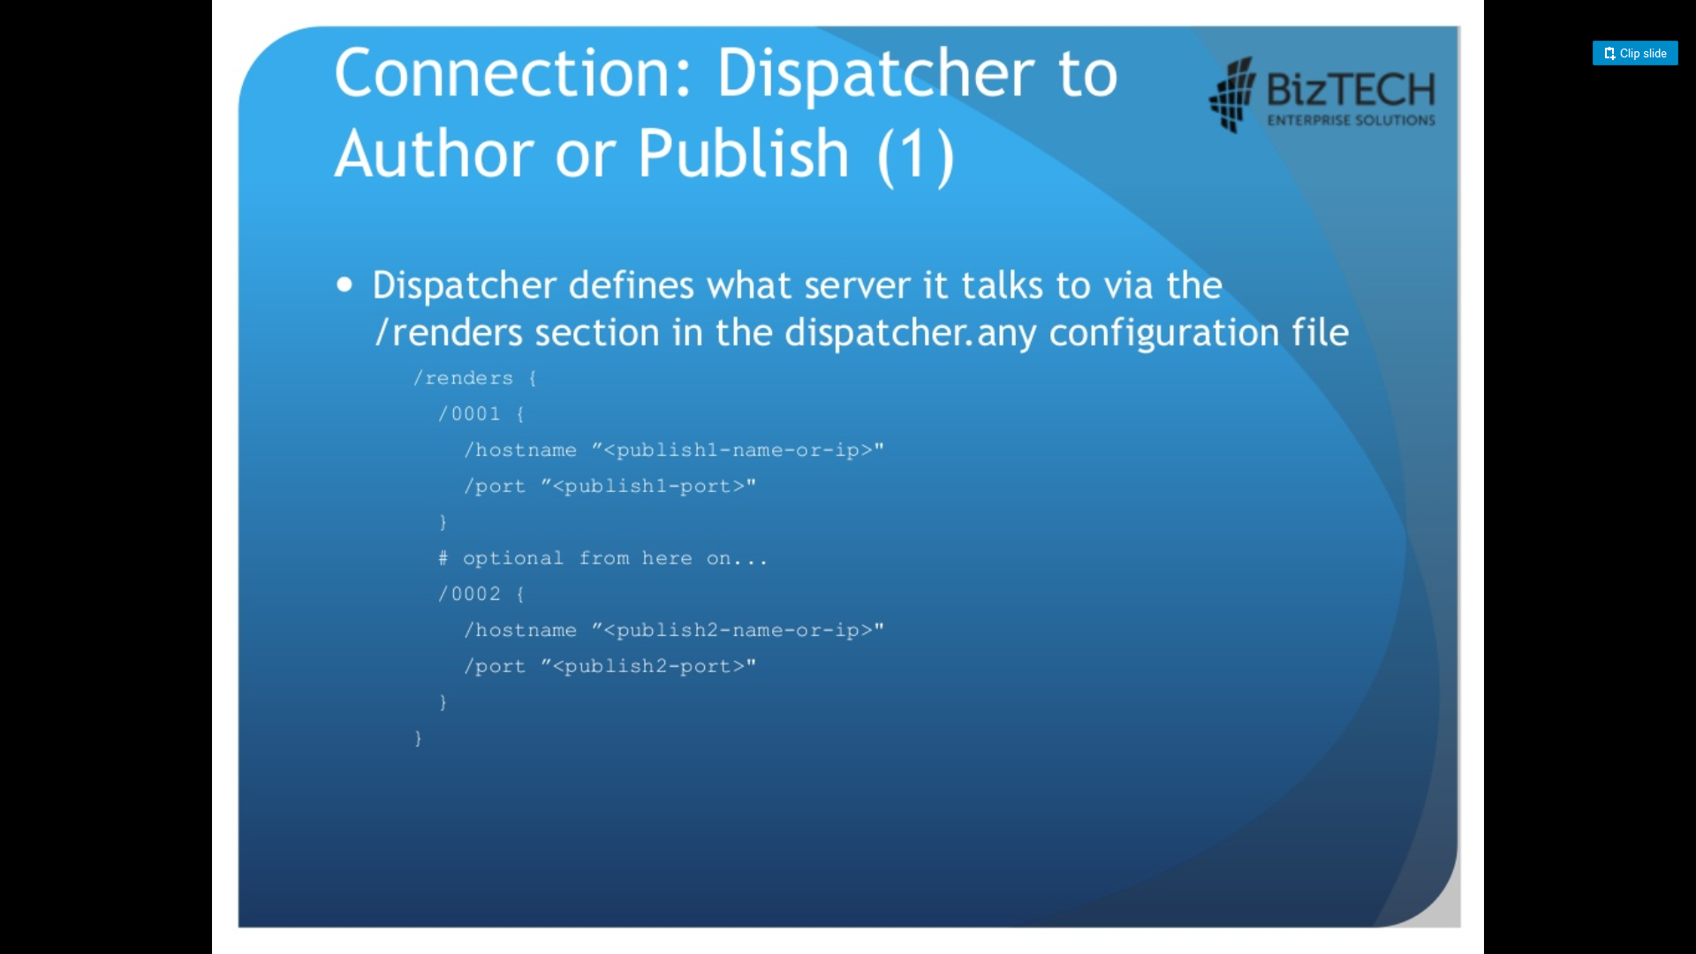

Slide 42
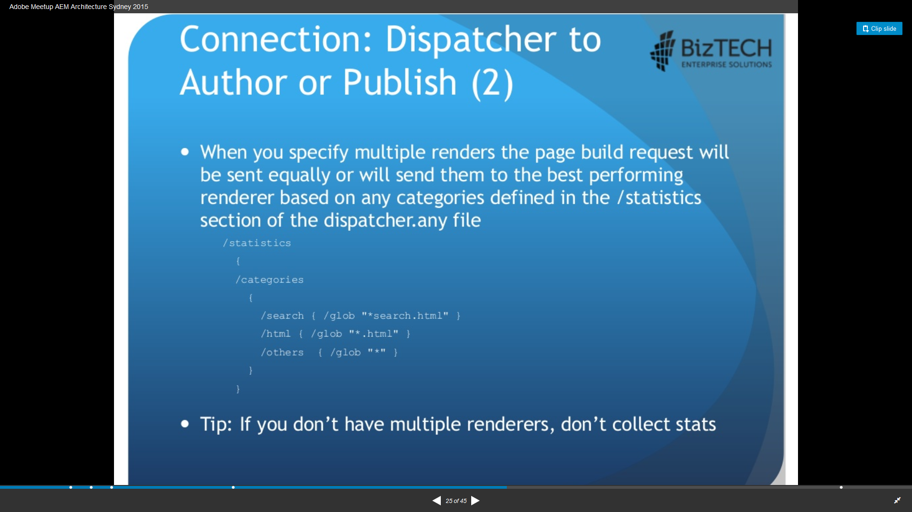

Slide 43
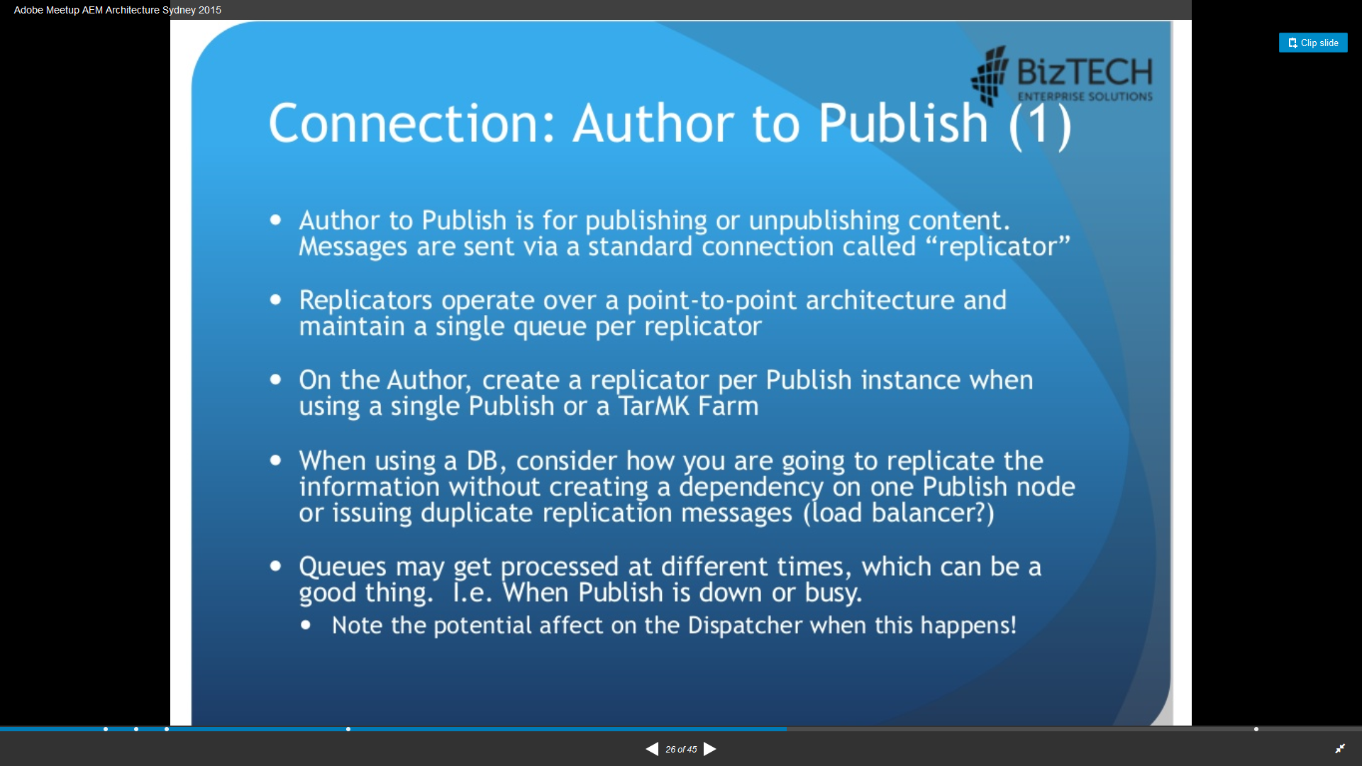

Slide 44
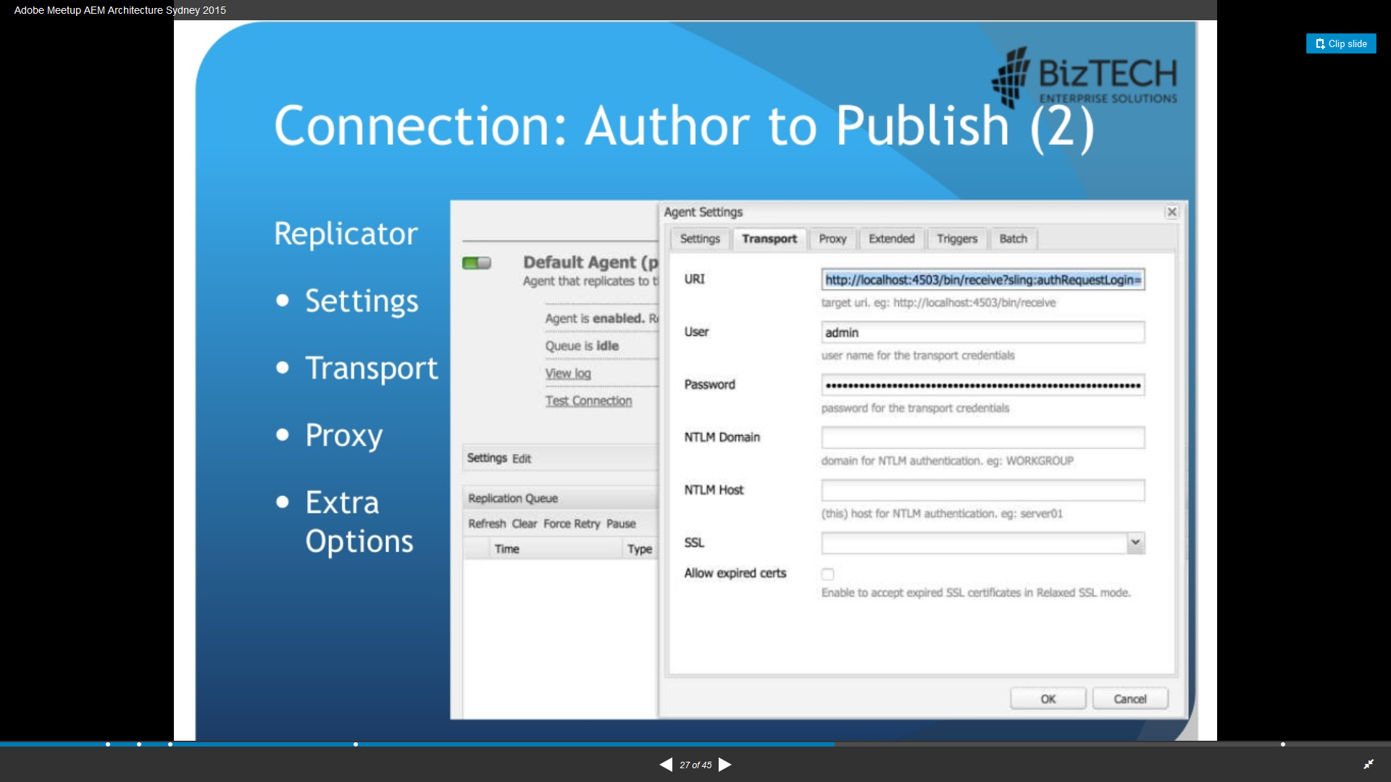

Slide 45
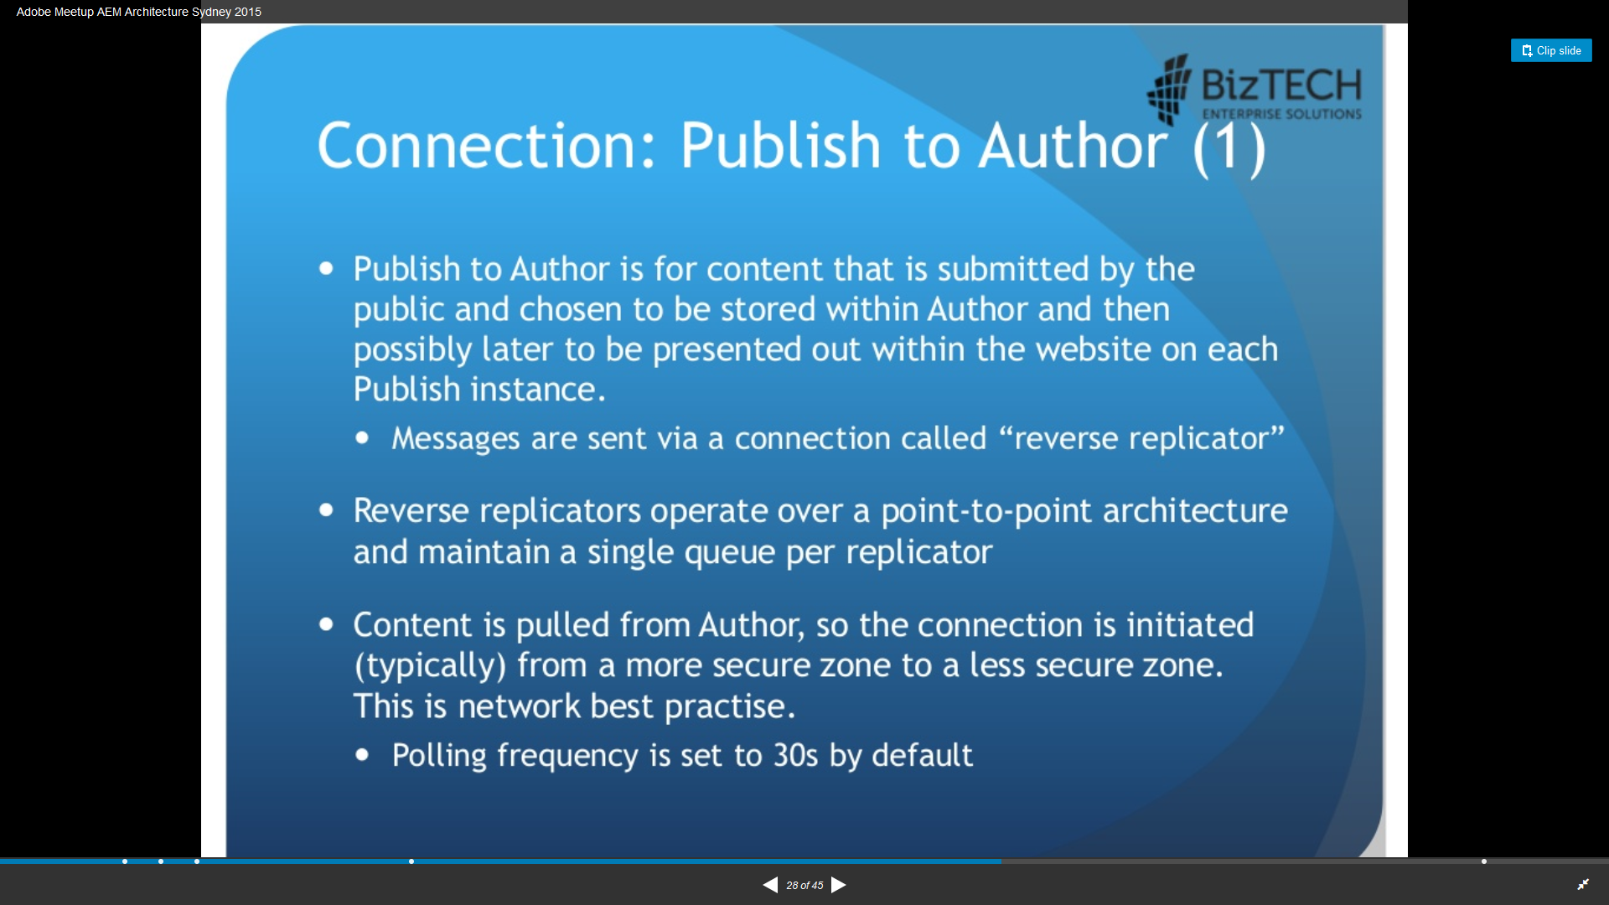

Slide 46
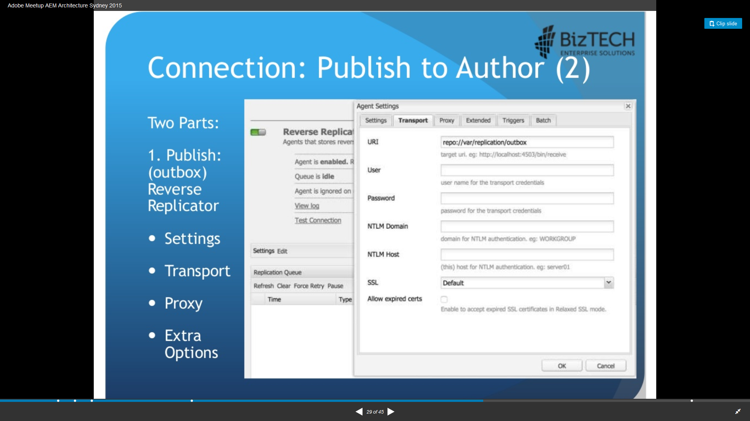

Slide 47
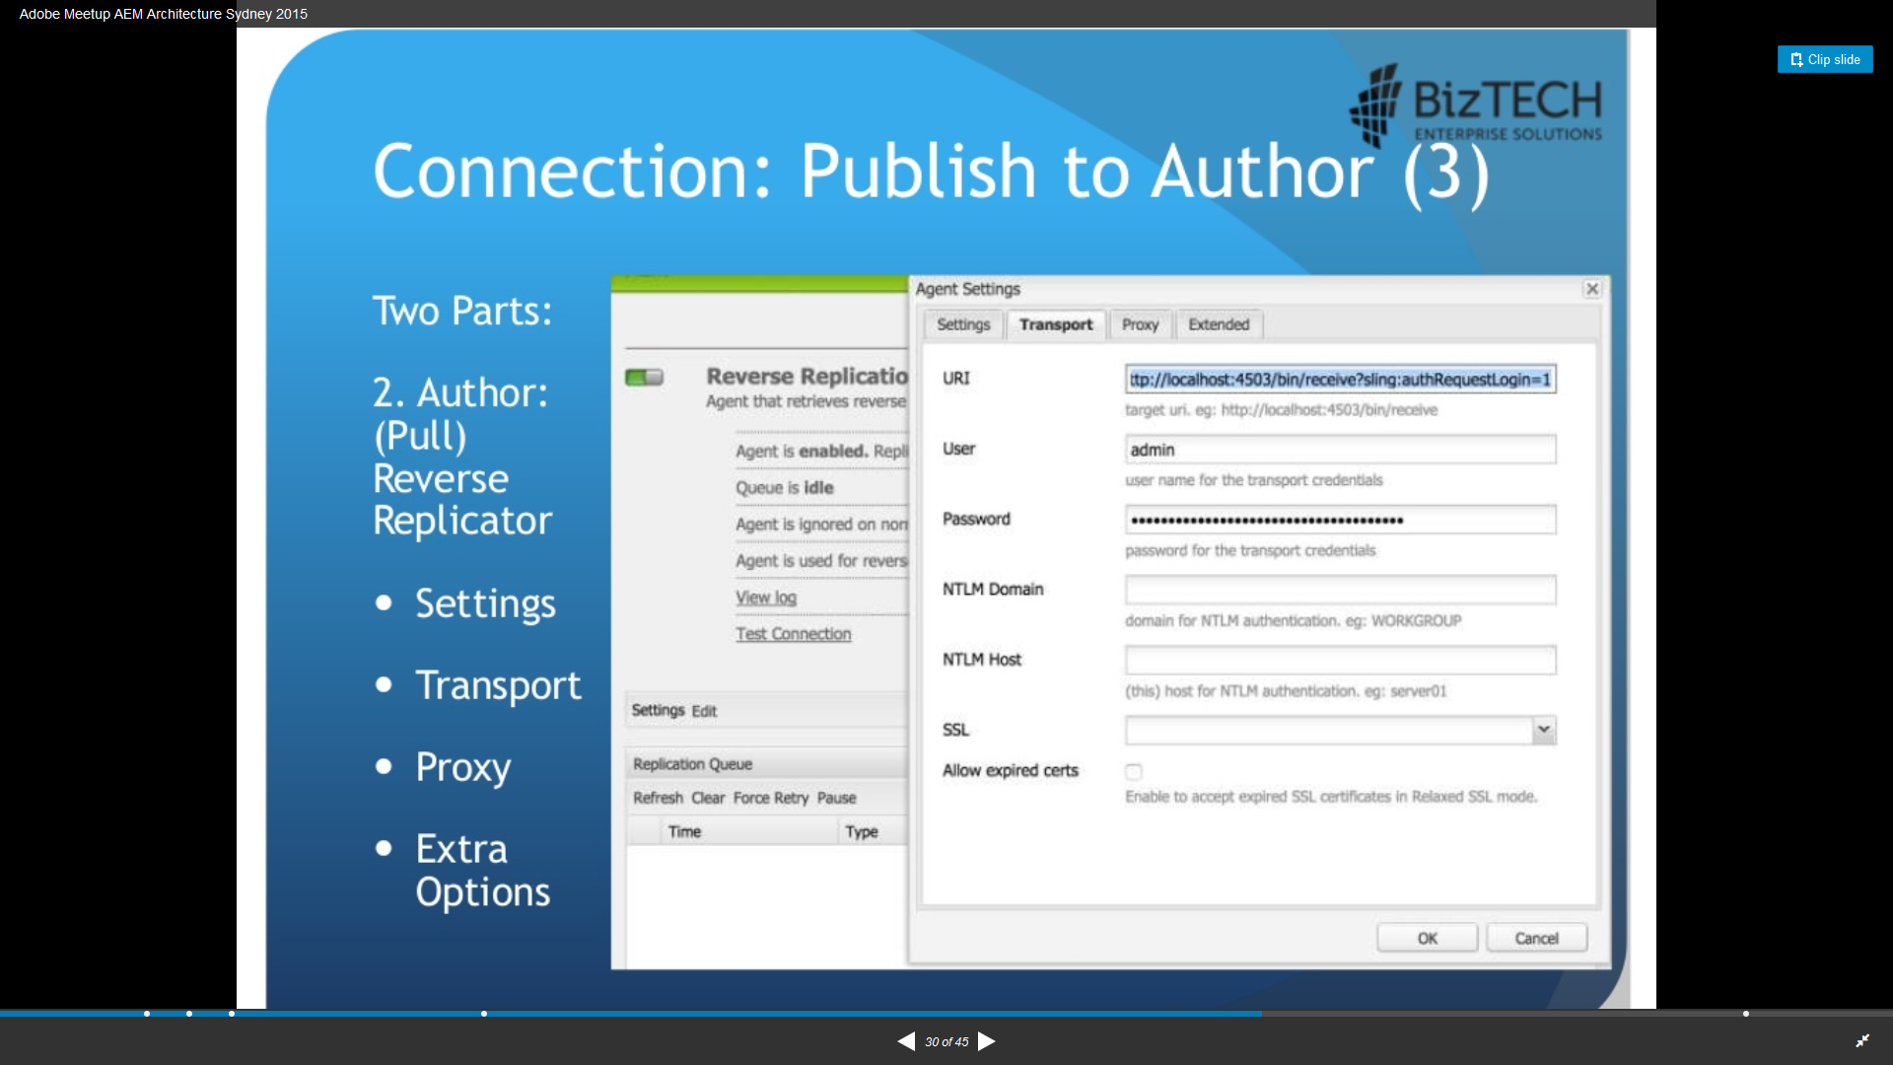

Slide 48
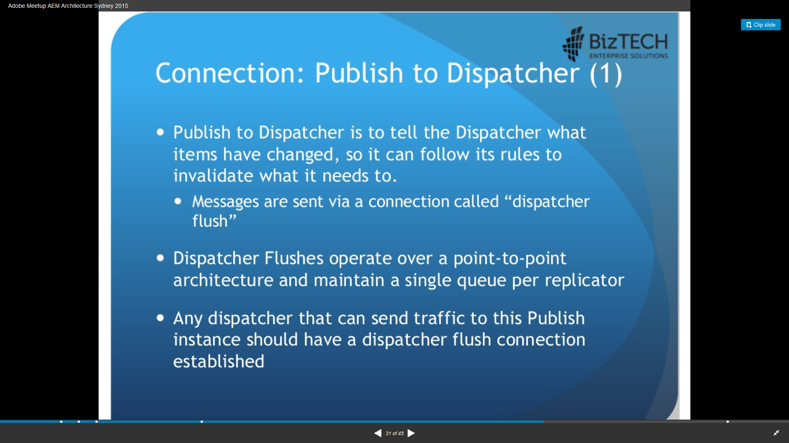

Slide 49
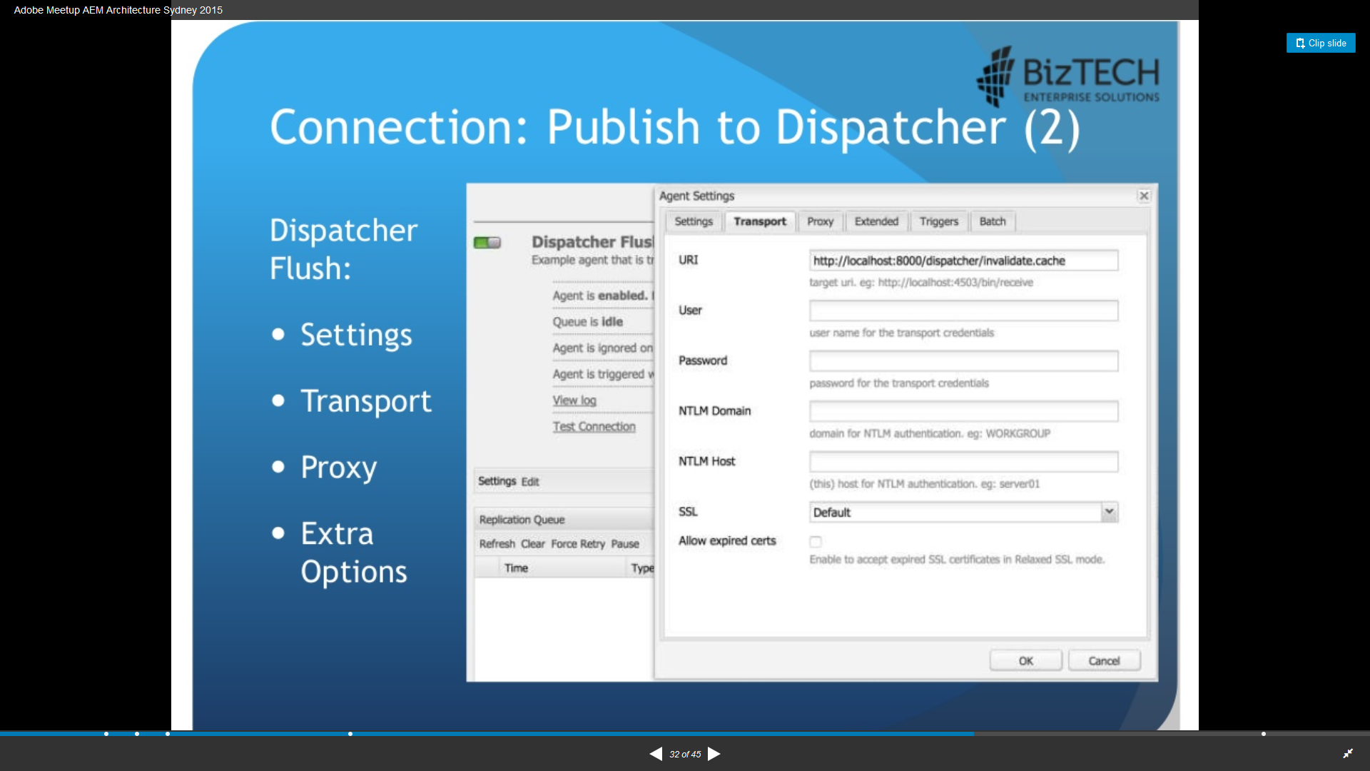

Slide 50
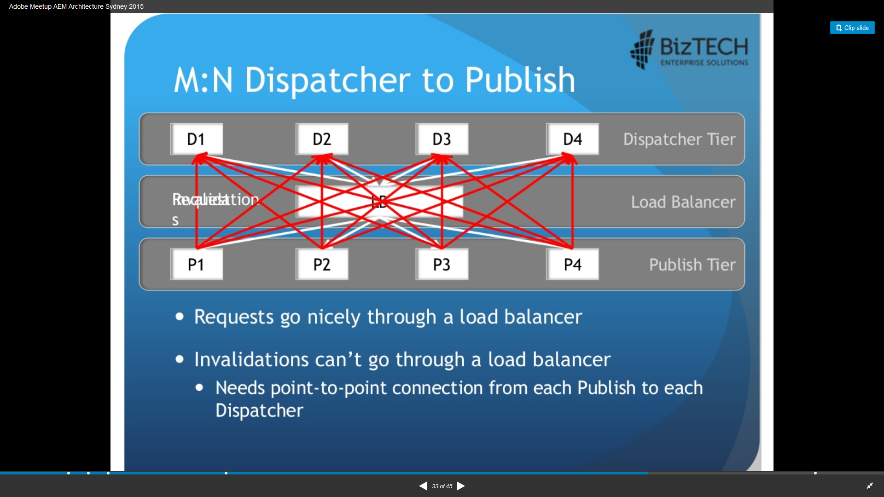

Slide 51
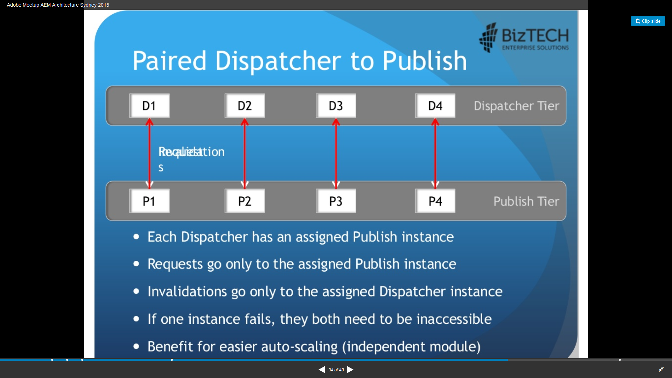

Slide 52
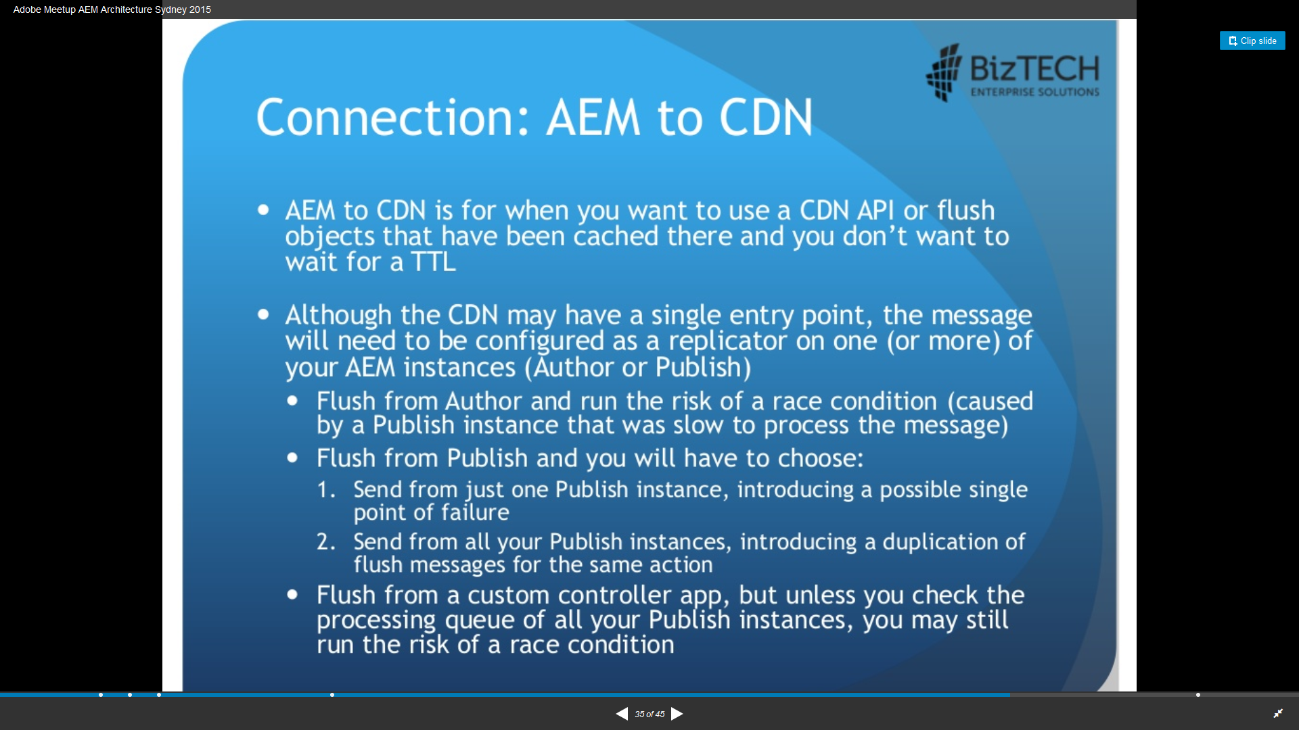

Slide 53
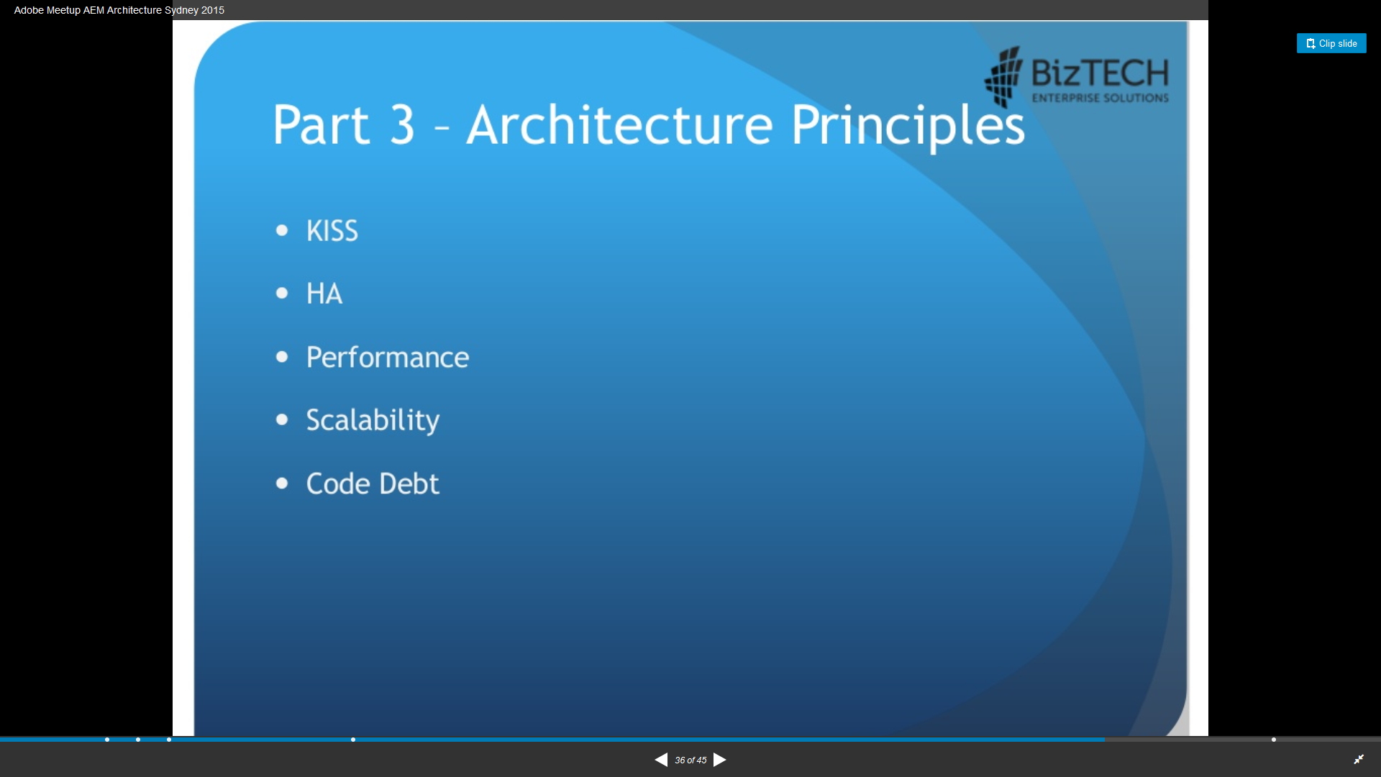

Slide 54
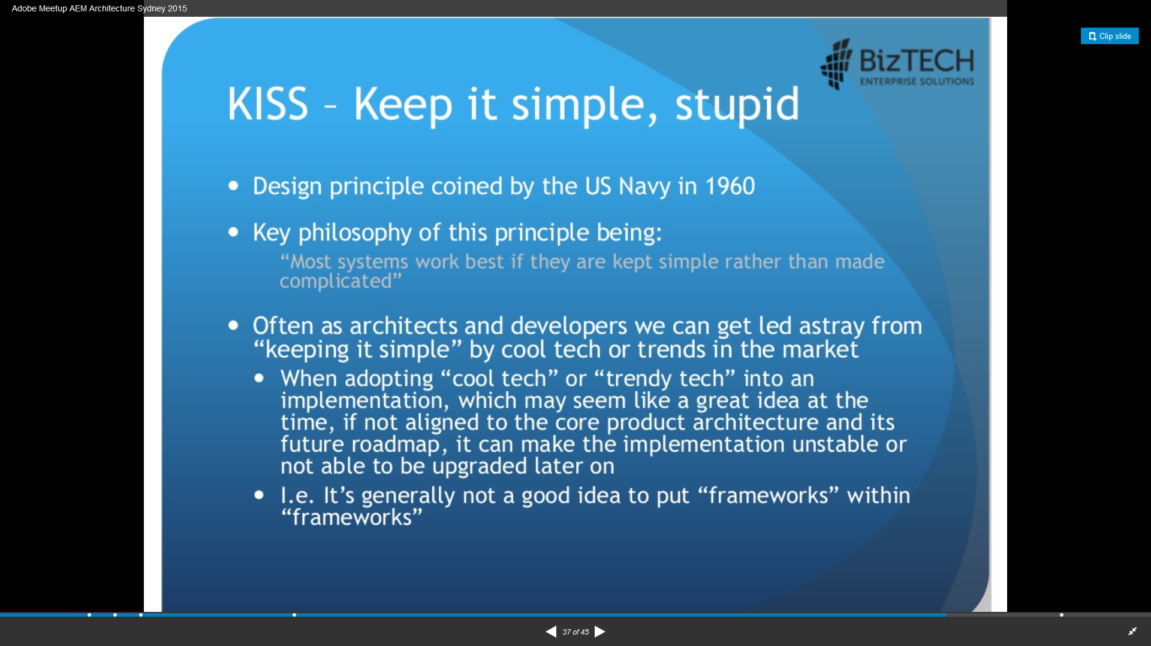

Slide 55
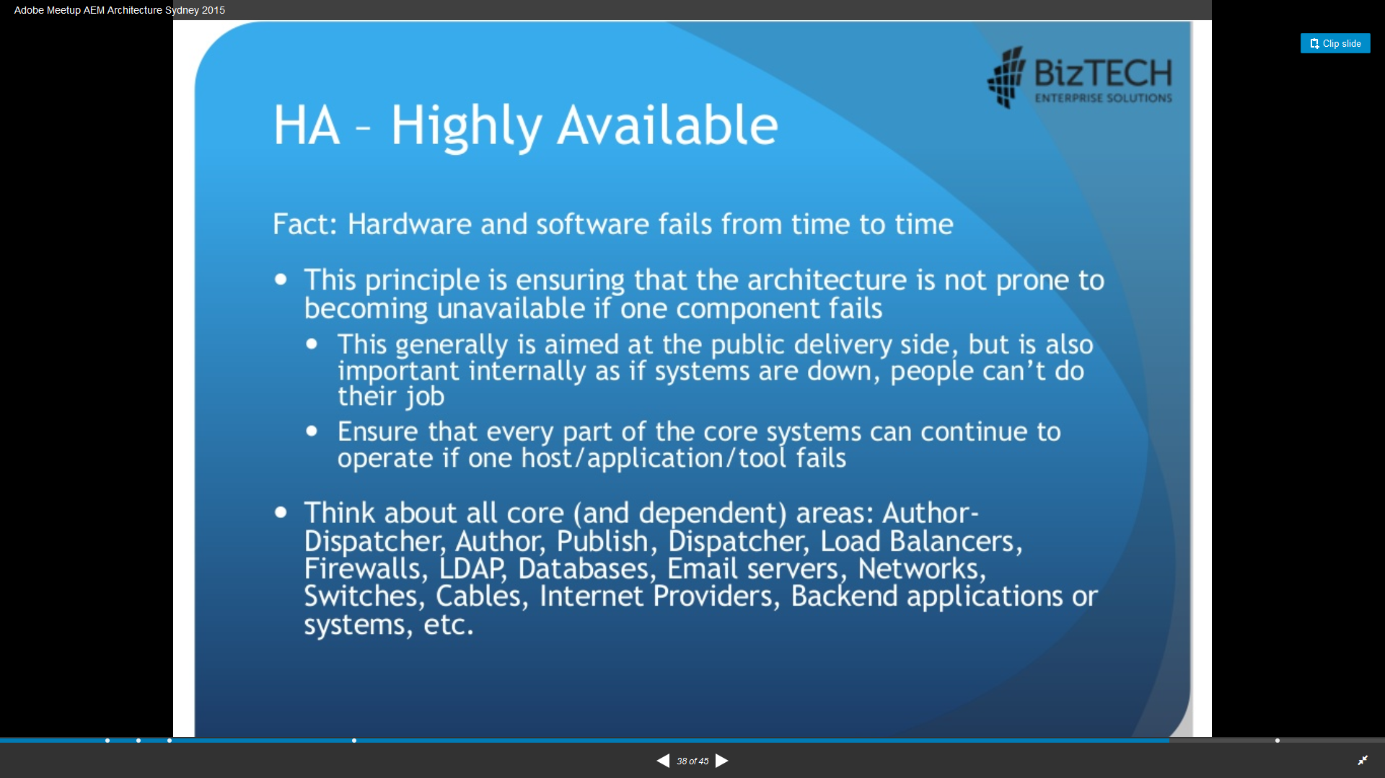

Slide 56
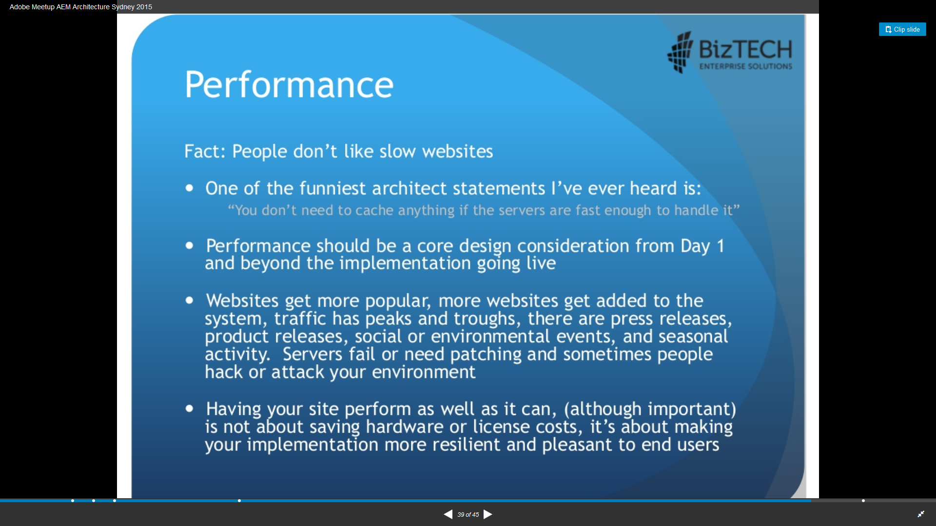

Slide 57
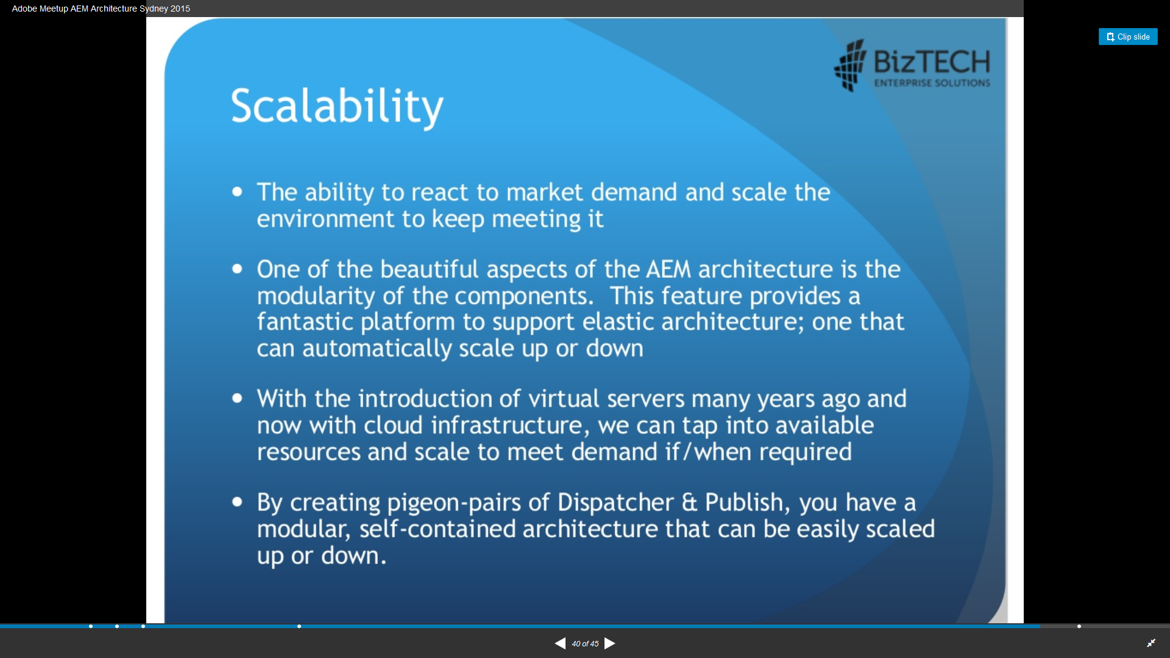

Slide 58
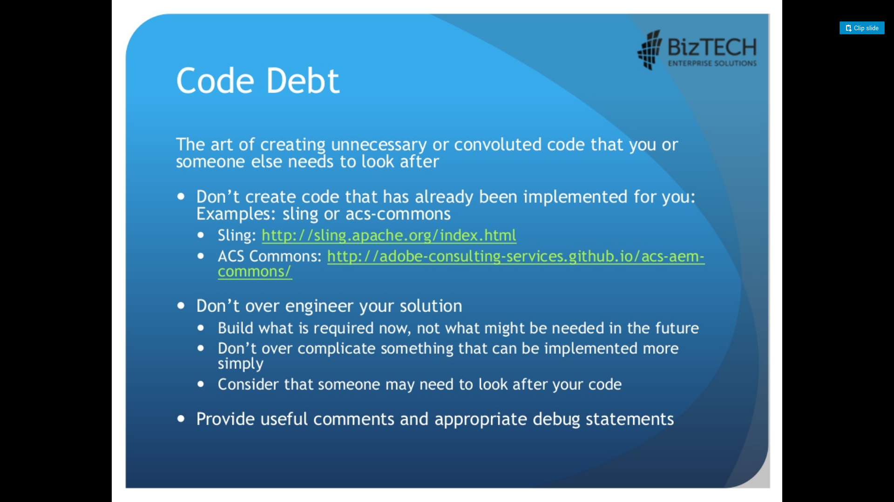

Slide 59
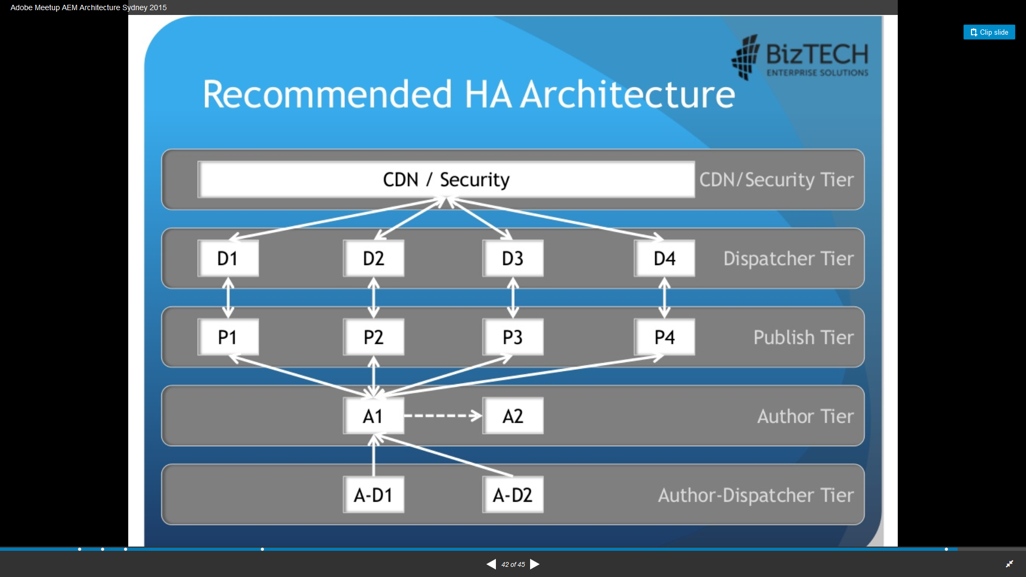

Slide 60
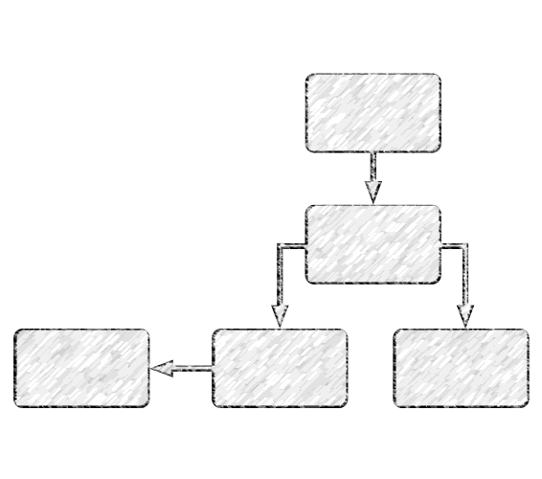
WORKFLOW
“the sequence of processes through which a piece of work passes from initiation
to completion”
WORKFLOW
Workflows enable you to automate activities with Adobe Experience Manager.
Workflows consist of a series of steps that are executed in a specific
order.
Each step performs a distinct activity based on the type of step and input

Slide 61
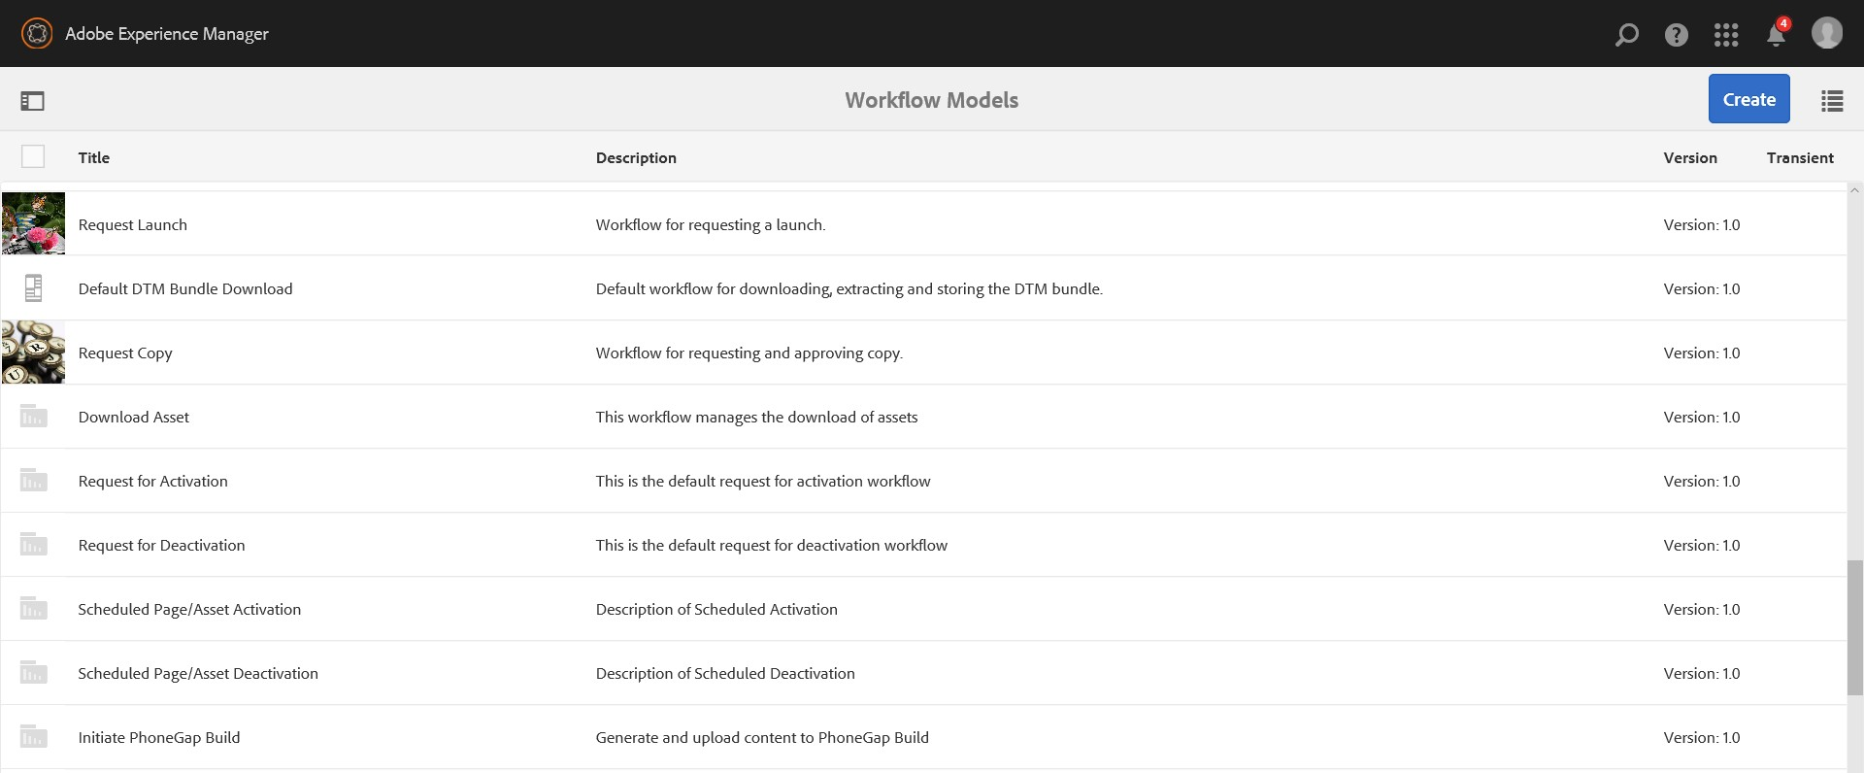
WORKFLOW
You can have conditional execution and/or parallel execution
Pass data from one step to another step
Adobe Experience Manager offers many ‘Out of the Box’ workflows
http://localhost:8080/libs/cq/workflow/content/console.html
Adobe Experience Manager lets you create a custom workflow based on
WORKFLOW
business requirements

Slide 62
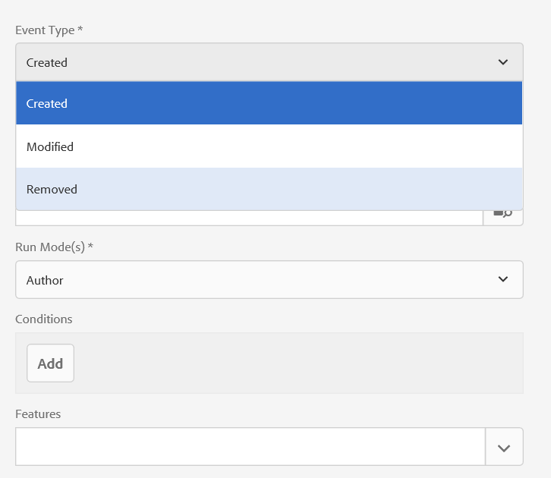
INVOCATION
Manual
Launcher
JCR Event Based
Node Created
Node Modified
Node Removed
AEM APIs
WORKFLOW

Slide 63




WORKFLOW PILLARS
Workflow
Workflow Model
Workflow Instance
Workflow Session
Each definition of a workflow is a Workflow Model
When a workflow model is started, a workflow instance is started
Session to process the payload
WORKFLOW
Workflow is the definition, execution and automation of business processes
The steps, Flow Start and Flow End. These steps are required and cannot be edited/removed.
Series of steps with actions, according to the set of procedural rules. Edit or delete this step, and add steps as required.
Make sure all the infrastructure and environment for the production are ready.
Make all the necessary pre- configuration required.
Deploy the code and create the required content
Workflow session is used manage the complete transaction of a workflow instance
Get JCR session from the workflow session when using a custom workflow step.

Slide 64




WHAT CAN BE DONE
Process Step
Goto Step
Participant Step
A Process Step executes an ECMAScript or calls an OSGi service to perform automatic processing.
The Goto Step allows you to specify the next step in the workflow model to execute, dependent on the result of an ECMAScript: true: The Goto Step completes and the workflow engine executes the specified step. false: The Goto Step completes and the normal routing logic determines the next step to execute.
The Goto Step enables you to implement advanced routing structures in your workflow models. For example, to implement a loop, the Goto Step can be defined to execute a prior step in the workflow, with the script evaluating a loop condition.
A Participant Step enables you to assign ownership for a particular action. The workflow will only proceed when the user has manually acknowledged the step. This is used when you want someone to take an action on the workflow; for example, a review step.
the user must have access to the page that is the workflow payload.
WORKFLOW
Container Step
A container step starts another workflow model that executes as a child workflow. This container can allow you to reuse workflow models to implement common
sequences of steps. For example a translation workflow model could be used in multiple editing workflows.
Dialog Participant
Dynamic Participant
Form Participant
Random Participant

Slide 65

EXAMPLE
Publish Workflow
An editor has to review the content - before a site administrator activates the page. A workflow that automates this example notifies each participant when it is time to perform their required work
The author applies the workflow to the page.
The editor receives a work item that indicates that they are required to review the page content. When finished, they indicate that their work item is complete.
The site administrator then receives a work item that requests the activation of the page. When finished, they indicate that their work item is complete.
EXAMPLE

Slide 66
WORKFLOW API
WORKFLOW API

Slide 67
WORKFLOW APIs
Interfaces
WorkflowSession
HasMetaData
PayloadMap
com.adobe.granite.workflow.exec
com.adobe.granite.workflow.model
Interfaces
WorkflowProcess
WorkItem
WorkflowData
Workflow
ParticipantStepChooser
DynamicParticipantExecutor
Participant
HistoryItem
InboxItem
Route
ScriptContextProvider
StepExecutor
WorkflowExternalProcess
WorkflowExternalProcessProxy
Interfaces
WorkflowModel
WorkflowModelFilter
WorkflowModelSerializer
WorkflowNode
WorkflowTransition
WORKFLOW APIS
com.adobe.granite.workflow
com.adobe.granite.workflow.metadata
Interfaces
MetaDataMap

Slide 68
CUSTOM WORKFLOW SERVICE
CUSTOM WORKFLOW SERVICE

Slide 69
CUSTOM PROCESS STEP
import com.adobe.granite.workflow.WorkflowException; import com.adobe.granite.workflow.WorkflowSession;
import com.adobe.granite.workflow.exec.WorkItem; import com.adobe.granite.workflow.exec.WorkflowData; import com.adobe.granite.workflow.exec.WorkflowProcess; import com.adobe.granite.workflow.exec.WorkflowData;
import com.adobe.granite.workflow.metadata.MetaDataMap; import com.adobe.granite.workflow.model.WorkflowNode;
CUSTOM PROCESS STEP
@Component(service=WorkflowProcess.class, property = {"process.label=My Workflow Process"}) public class CustomStep implements WorkflowProcess
{
public void execute(WorkItem workItem, WorkflowSession workflowsession,MetaDataMap args) throws WorkflowException { final WorkflowData workflowData = workItem.getWorkflowData();
final String type = workflowData.getPayloadType(); if (!StringUtils.equals(type, "JCR_PATH")) {
return;
}
Session session = workflowSession.adaptTo(Session.class); final String path = workflowData.getPayload().toString();
try {
Node node = session.getNode(path);
/* Write your custom code here. */
} catch (Exception ex) {
/* Use this block for Exception Handling. */
}
}
}
13

Slide 70
CUSTOM PARTICIPANT STEP
import com.adobe.granite.workflow.WorkflowException; import com.adobe.granite.workflow.WorkflowSession;
import com.adobe.granite.workflow.exec.WorkItem; import com.adobe.granite.workflow.exec.WorkflowData; import com.adobe.granite.workflow.exec.WorkflowProcess; import com.adobe.granite.workflow.exec.WorkflowData;
import com.adobe.granite.workflow.metadata.MetaDataMap; import com.adobe.granite.workflow.model.WorkflowNode;
@Component(service= ParticipantStepChooser.class, property = {"process.label=My Participant Workflow Step"}) public class MyDynamicParticipant implements ParticipantStepChooser {
CUSTOM PRATICIPANT STEP
public String getParticipant(WorkItem workItem, WorkflowSession workflowSession, MetaDataMap args) throws WorkflowException {
WorkflowData workflowData = workItem.getWorkflowData(); if (workflowData.getPayloadType().equals(TYPE_JCR_PATH)) {
// Write your custom code here.
String path = workflowData.getPayload().toString();
String pathFromArgument = args.get("PROCESS_ARGS", String.class);
if (pathFromArgument != null && path.startsWith(pathFromArgument)) { return "admin";
}
}
return "administrators";
}
}
14

Slide 71
KEY WORKFLOW ELEMENTS
Payload
Typically a path in a repository
you can add the status or other data associated with payload (ex: DAM update Asset)
WorkItem metadata
can store info related to an individual step
most useful for steps which do not complete immediately(participant step, external process)
Workflow metadata
useful for populating when a workflow starts, and sharing amongst different workflow steps
can be updated in a step workItem.getWorkflowData().getMetaDataMap().put(“somekey”,”someValue”);
can be retrieved on subsequent steps workItem.getWorkflowData().getMetaDataMap().get(“somekey”,String.class);
KEY WORKFLOW ELEMENTS

Slide 72
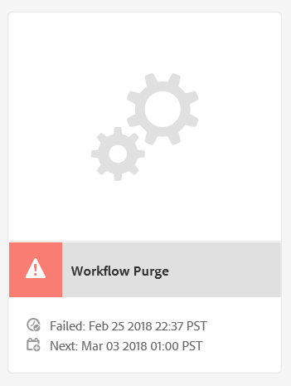
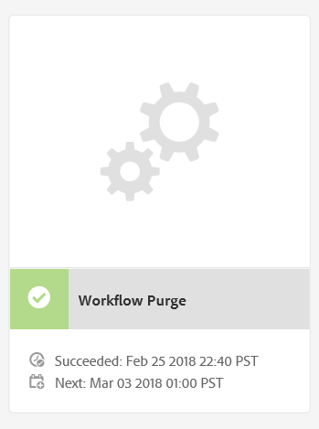
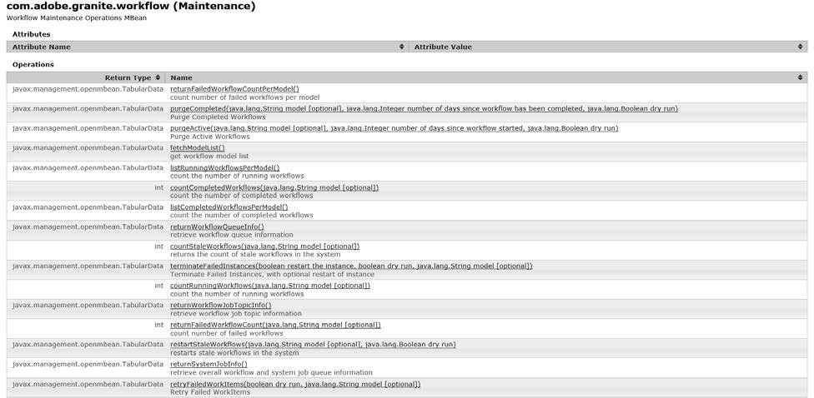
WORKFLOW MAINTENANCE
WORKFLOW PURGE
It’s important! To clean old workflow instances from the system
Clean up completed and aborted workflows on a regular basis.
Configure Weekly maintenance window
STALE WORKFLOWS
A running workflow no longer has a job
Workflow can be safely restarted in workflow console or jmx
WORKFLOW MAINTENENCE
SYSTEM CONSOLE
http://localhost:8080/system/console/jmx/com.adobe.granite.workfl ow%3Atype%3DMaintenance
http://localhost:8080/system/console/slingevent

Slide 73
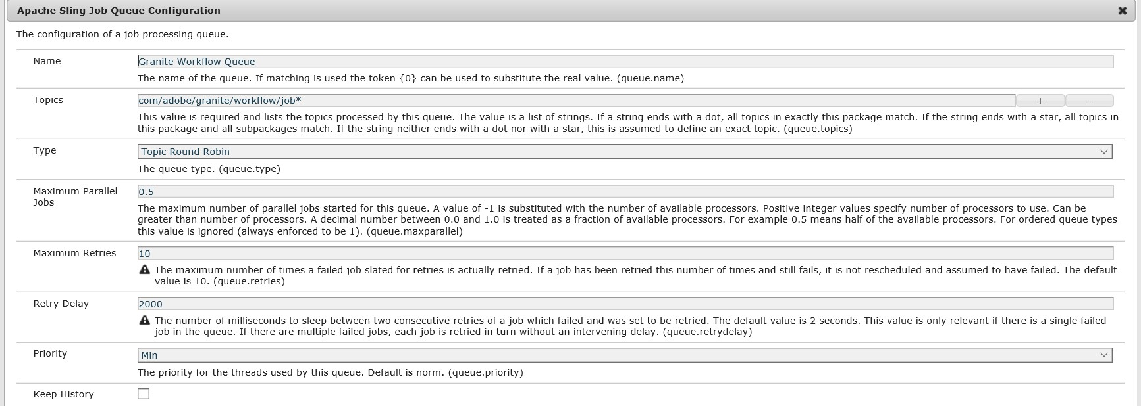
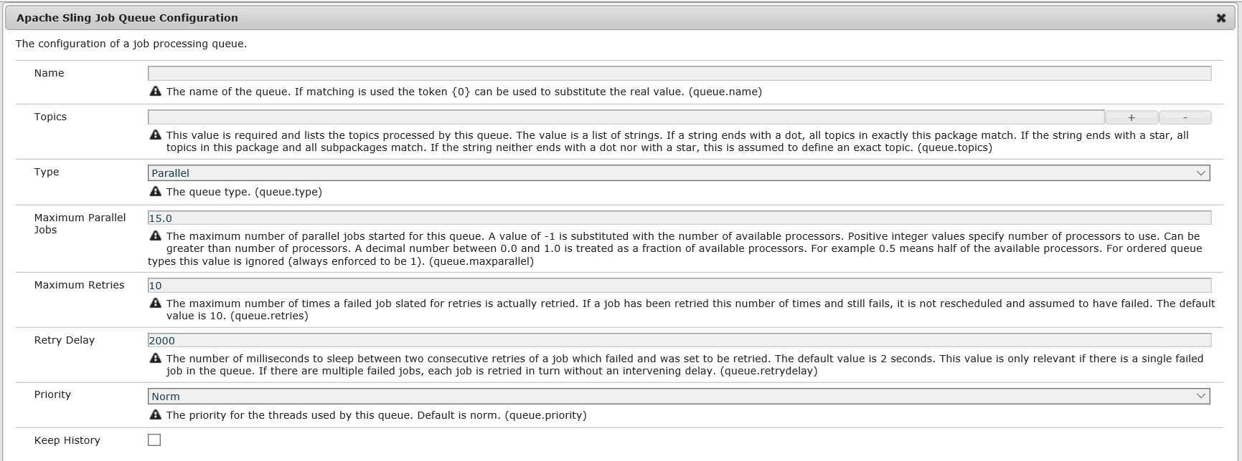
WORKFLOW THROUGHPUT
Limit number of threads used to execute workflows.
OOB its set to half the number of CPU cores and its not advised to change it
Can be configured per workflow or globally
GLOBALLY
Edit : ‘Granite Workflow Queue’
WORKFLOW THROUGHPUT
PER WORKFLOW
Create new Sling job queue

Slide 74
BEST PRACTICES
BEST PRACTICES

Slide 75
BEST PRACTICES
Transient Workflows
The runtime data related to the intermediate worksteps and also the trance of the workflow(if success) are not persisted in the JCR when they run
Transient workflows become persistent workflow
if an error occurs
Participant step or external process step is used Advantages
A reduction in the workflow processing time.
Significantly reduce repository growth.
No more CRUD workflows are required to purge.
In addition, it reduces the number of TAR files to compact.
Maintenance and Monitor
Do not forget to setup workflow purging and monitor for stale workflows.
ARCHITECTURE REVIEW
Sessions
The WorkflowSession can be adapted to either a JCR session or a Sling ResourceResolver. It is a best practice to use this adapt pattern to make changes to the payload instead of acquiring your own JCR Session or Resource resolver.
Creating a new sessions can result in parallel workflows colliding on the same payload.
Do not save this session.
Workflow will save the session when required
Workflow engine attempts to run as many steps together at one time as possible
Better and Efficient error handling
General
Do not edit any out of the box workflows or launchers. Always clone the model and edit as necessary. ‘Override’ function is introduced in AEM 6.4 to address this.
21

Slide 76
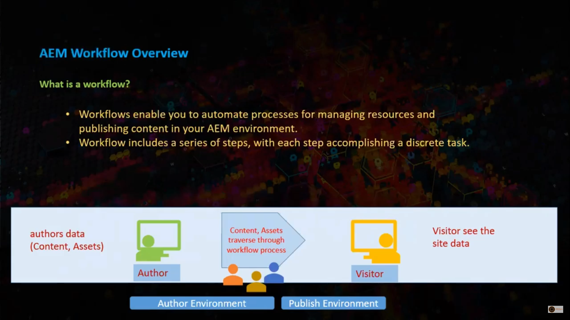

Slide 77


Slide 78


Slide 79


Slide 80


Slide 81


Slide 82


Slide 83


Slide 84


Slide 85


Slide 86


Slide 87


Slide 88


Slide 89


Slide 90


Slide 91


Slide 92


Slide 93


Slide 94


Slide 95
Introduction
AEM Workflows
AEM Workflows let you execute individual steps in a sequential order
AEM Workflows offer a variety of ways in which to mix automatic steps and human interactions.
They offer conditional execution and parallel execution.
You can pass data from one to step to another step.
You can pass data when you invoke the workflow.
You can invoke a workflow using Workflow Launcher
You can invoke a workflow using AEM APIs
AEM offers a number of out of the box workflow steps.
AEM lets you create a custom workflow to meet your business requirements

Slide 96
Agenda
Create a new workflow that activate AEM pages
How to invoke the workflow
How to check if the workflow is successful
How to invoke a workflow using workflow Launcher
How to create a custom workflow step
Types of workflow steps you can create
Managing data in your workflow
Monitor performance of workflows
Managing workflow throughput
Workflow Maintenance
Q/A

Slide 97

Create a New Workflow
To create a new workflow:
Navigate to the workflow console: http://localhost:4502/libs/cq/workflow/content/console.html.
Click the New button that is located on the upper left side of the page.
Enter the title AEMExperts and then click OK.
Double click the workflow to view the model.

Slide 98

Create a New Workflow (continued)
Because we are making an automated workflow (no human interaction), delete 1st step.
Under the WCM Workflow section in sidekick, select Activate Page / Assets.
Click the Save button.
The new workflow should look like:

Slide 99
DEMO (Create the new workflow)
Build the AEMExperts Worflow

Slide 100

Invoke the Workflow
You can publish a page by invoking the AEMExperts workflow. To demonstrate, we will
make a change to the page located at:
http://localhost:4502/cf#/content/geometrixx/en/products/triangle.html
For simplicity, we will underline some text in the triangle.html page.
Once you make the changes and ready to publish the page, you can use the newly created workflow.

Slide 101
DEMO (Manually invoke the new workflow)
Manually invoke the AEMExperts Worflow

Slide 102
Using Workflow Launcher
Workflow launcher lets you automatically invoke a workflow based on conditions.
Conditions are based on changes to content located in the AEM JCR. For example – when a page is modified.
In this example, Workflow launcher is configured to invoke a workflow when content under /content/geometrixx is modified. The result is the AEMExperts workflow automatically published the page.

Slide 103
To configure Workflow Launcher to invoke a workflow:
Configure Workflow Launcher
Go to workflow console at http://localhost:4502/libs/cq/workflow/content/console.html.
Click the Launcher tab.
Click the Add button at the top left of the page.

Slide 104

4. Add the following information:
Configure Workflow Launcher (continued)
Event Type: modified
Node Type: nt:unstructured
Path: /content/Geometrixx
Workflow: AEMExperts
Description: Activates Geometrixx pages
Activate: leaved enabled
Exclude List: Leave empty
Run Mode(s): Author
5. Click OK.

Slide 105
DEMO
Configure Workflow Launcher

Slide 106
Creating a Custom Workflow Step using the Workflow API
You can create an AEM custom workflow step by using AEM Workflow APIs located in the com.adobe.granite.workflow.exec package.
A custom AEM Workflow step is implemented as a service within an OSGi bundle.
A custom Workflow step can be placed into a workflow model like out of the box steps.
This example creates a custom Workflow step that sends email messages.
To send email messages within a custom workflow step, you can use a
com.day.cq.mailer.MessageGateway instance.

Slide 107
DEMO (live coding)
Show How To create a custom workflow step

Slide 108
Types of Workflow Steps you can create
Process Step
Implement com.adobe.granite.workflow.exec.WorkflowProcess
Execute and complete
Auto-Advance
External Process Step
Implement com.adobe.granite.workflow.exec.ExternalWorkflowProcess
Primary use is calling another system, and waiting for response
Workflow engine polls your step for completion
Implement
execute()
hasFinished()
handleResult()

Slide 109
When do I save the session?
Acquire JCR session from workflow session
Granite WorkflowSession:
session = workflowSession.adaptTo(javax.jcr.Session.class);
CQ WorkflowSession (will be deprecated at some point)
session = workflowSession.getSession();
Use this session to process the payload – don’t acquire your own.
But…….
Do not save this session!
Workflow Engine saves session for you when required
More efficient and better error handling if you let the workflow engine save session
Engine attempts to run as many steps together at one time as possible

Slide 110
Managing data in your workflow
Payload
Typically a path in the repository
You can add status or other data associated with payload (ex: DAM Update Asset)
WorkItem metadata
Can store information related to an individual step
Most useful for steps which do not complete immediately (participant step, external process)
Workflow metadata
Useful for populating when a workflow starts, and sharing amongst different workflow steps
Can be updated in a step:
workItem.getWorkflowData().getMetaDataMap().put(“someKey”, “someValue”);
Can be retrieved on subsequent steps:
workItem.getWorkflowData().getMetaDataMap().get(“someKey”, String.class);

Slide 111
Behind the scenes…
WebDav upload of assets
Worklfow Engine processes
More Jobs are scheduled
as many steps as possible
and processed as needed
Workflow Launcher starts
Workflow engine is not
workflow from JCR Node
ified to process job
Workflow is finished
Added Event
Workflow Engine
creates Sling Job to process worklfow
Sling Job Queue has a job to execute!

Slide 112

Monitor performance of workflows
Workflow Stats http://localhost:4502/etc/reports/workflowreport.html
Details on number of workflows and duration
Links with breakdowns for individual workflows
Individual steps (grouped) are timed
Execution optimized, which skews results slightly

Slide 113


Monitor performance of workflows - continued
Sling Jobs Page http://localhost:4502/system/console/slingevent
Monitors what has happened
Monitors what is happening

Slide 114

Managing Workflow Throughput
Can limit number of threads used to execute worklfows
This can be configured globally for entire system, or per workflow
Globally: edit “Granite Workflow Queue”
Per workflow: create new Sling Job Queue
Edit “maximum parallel jobs”

Slide 115
Managing Workflow Throughput - DEMO
Show how to create a Sling Job Queue for a specific workflow
see documentation:
http://docs.adobe.com/docs/en/aem/6-0/deploy/configuring/performance.html#Concurrent Workflow Processing

Slide 116



Workflow Maintenance
Workflow Purge
It’s important! Clean old workflow instances from system
Configure weekly maintenance window
Stale Workflows
a running workflow no longer has a job in system
Workflows can be safely restarted in workflow console or jmx
Helpful utilities in Workflow Maintenance JMX bean:
http://localhost:4502/system/console/jmx/com.adobe.granite.workflow%3Atype%3DMaintenance

Slide 117
SEARCH
“Effective site search functionality on a company’s website is an increasingly important component of a successful digital strategy"
An easy journey for a customer can ensure:
Improved customer retention and loyalty, which comes as customers know they can find products more easily.
Improved branding, as improving user experience means
more customer satisfaction, and a better customer journey compared to competitor websites.
More than 59% of web users frequently use the website search box to navigate on a site
SSEARCH
More than 15% would
Increased site usage, as a better user experience means that
customers are more likely to spend more time on the site, and can boost the number of registrations and return visits.
actually rather use the search function than the hierarchical menu

Slide 118
WHAT IS SOLR
APACHE SOLR is an open source enterprise search platform which is based on APACHE LUCENE
WHAT IS SOLR
Solr enables you to create search engines easily for an application which can search against any content, files.

Slide 119






SOLR FEATURES
Advanced Full Text Search
Solr enables powerful matching capabilities including phrases, wildcards, joins, grouping and much more across any data type
+
Faceted Search and Filtering
Solr enables powerful faceting features support grouping and organizing your data in a multitude of ways
Flexible and Adaptable with easy configuration
Solr makes it easy to scale up and down with shard architecture. Solr bakes in replication, distribution, rebalancing and fault tolerance out of the box
+
FEATURES
+
•
Query Suggestions, Spelling and More
Standard based open interfaces – JSON, HTTP, XML
Solr uses and supports all the standards with REST APIs
Highly Scalable
Solr ships with advanced capabilities for auto-complete (typeahead search), spell checking and more
We help your digital marketing team provide real- time data and analytics that provide insight into user behavior.

Slide 120

CONNECTING TO SOLR & INDEXING
org.apache.solr.client.solrj.SolrClient org.apache.solr.client.solrj.impl.HttpSolrClient
org.apache.solr.client.solrj.SolrClient org.apache.solr.client.solrj.impl.CloudSolrClient
geared towards query-centric workloads, though also a good general- purpose client. Communicates directly with a single Solr node.
geared towards communicating with SolrCloud deployments. Uses already-recorded ZooKeeper state to discover and route requests to healthy Solr nodes.
SOLR API
•

Slide 121


QUERYING
org.apache.solr.common.params.SolrParams org.apache.solr.common.params.ModifiableSolrParams
org.apache.solr.client.solrj.SolrQuery
SOLR API
•

Slide 122

AEM – Queries and Indexing
Apache Oak allows different indexers to be plugged into the repository. By default, it has implementations
Lucene
type:lucene
Solr
AEM – QUERY & INDEXING
Caution:
Do not use an embedded Solr server in a production enviroment. It should be used only in a development enviroment.
Embedded
Remote
type:solr

Slide 123
AEM – SOLR
The following are benefits:
More Flexibility : Full control over the Solr document model
Better Utilization : Control over boosting specific fields in Solr document
More Run-time : Real time indexing is within your control
More Scalable : Helps when multiple sites (multi-region, multi-lingual) resides in the same instance
The following is a con:
Implementation effort is required
AEM – QUERY & INDEXING

Slide 125
Aspects to be considered
Common Features
Results
Advanced
Others
Full site / Free text search
Search binaries (pdf, images,…)
Faceted
Sort order
Multi-lingual
Module specific search
Filtering results
Caching results
Results Scoring
Auto suggest
Spell check, Auto correction
Popular & Promoted searches
Inactive / historical content
Assets Search
Pagination
Property / Field Based
Search with-
in search
Permission
based
Favorites &
ignored
Tracking &
Reporting
*Identify all applicable aspects for your use cases

Slide 126
Author vs. Publisher

Slide 127
Can have completely different set of requirements for search
Remember they serve very different purposes
Typically have separate designs, different index configurations
Search on Author integrates with Authoring UI Interfaces Search on Publisher integrates with published site UI

Slide 128
Typical activities in designing for search on Author
2. Create custom search predicates
Plan to develop custom search predicates if the identified requirements could not be met with available OOB predicates
1. Review search forms
Review the authoring search forms that would be used in the solution. Identify all the changes that would be required
4. Create / modify indexes
If required create new indexes and/or customize OOB indexes** to meet the requirements. For most cases OOB as-is or with minor customization would suffice for handling search on Author
3. Customize search forms
If any of the Authoring search forms requires change, make necessary changes## through the search forms editor available under Tools -> Operations
## The customized form gets saved under
/apps/cq/gu`i/content which can be packaged and deployed across environments
** To customize, disable the OOB definition, take a copy, and make the necessa`ry customization on the copy`

Slide 129
Typical activities in designing for search on Publisher
1. Identify all features needed
Collate all the search features needed – like free text search, auto-suggestion, spell check, … Each would require a different query and index. Take care to include all features required
2. Cover all Integrations with search
Analyze all touch points to identify all input conditions and output data. It could be centralized at global search or scattered across pages or a combination of boths
4. Identify indexes and services required
From the listing of the queries, identify the different index types** and the index configuration required. Also identify the services needed to deliver all the search features
3. List down all representative queries
Once you have the features and integration points covered, list down the query for all the representative scenarios##
# Having this list would greatly help with deciding on the services to build with maximum reuse
** The requirements might mandate one or more
types of index to be used in the solution

Slide 130
A closer look at the features
Following slides are presented from Publisher perspective. But some of
the aspects discussed may apply for Author as well

Slide 131
Authored list of terms
Auto Suggestion – Prompting the search term
Lucene index for suggestion
Values of one or more property can be
configured to be used as suggested terms
Update frequency
Path specific auto-suggestions
Analyzers for more control on suggestions
From Search History
Based on AEM Content

Slide 132
Spellcheck library
Auto Correction – Original term has no result, search an alternate
Lucene index for spellchecking
Values of one or more property can be configured to be for spell check
Path specific spellcheck has limitations
Closest match to list
(Authored or History)
Based on AEM Content

Slide 133
Search with-in search
Filtering the results further by another term
Perform new search with both terms in AND condition Client side logic? Full result set available + Ranking

Slide 134
Handling the results

Slide 135
Order by clause
Ordering the results
Influence the ranking
Apply boost on properties
Ranked on boost weightage
Based on value of property
Multiple order by | asc / dsc

Slide 136
Filtering the results
Applying additional conditions to query
New search with all conditions included – Fresh results Apply filtering logic on client side | Full result set available?

Slide 137
Paginate the result set – Can’t / Don’t fetch all the results
Fetch Content for 3 to 4 pages
Leverage API Features
More only if user navigates
Set GuessTotal in query
Cache on client, use from cache
Use offset and limit params
Total results count not accurate
Check more flag in response

Slide 138
Results based on user permission
Execute the query in the users JCR session
Do not use service / administrative session
Cached results could not be used if permissions are different

Slide 139
Some Advanced aspects

Slide 140
Popular and promoted search terms
Tracking searches to identify popular search terms
Promoted search terms – on a new product/service
Pre-fetch and cache results for popular/promoted search terms

Slide 141
Points on caching search results
Where to build this cache? On Author vs. on Publisher
Where to keep the cache? Publisher / Dispatcher / External Permission based results cache
Design of services based on cache characteristics

Slide 142
Favoring and ignoring specific results
Results common | favored & ignored items user specific
Storing favored, ignored results external to AEM
UI logic to filter out ignored and prioritize favored results

Slide 143
Multi-lingual in search
Single language results vs. mixed results
Language specific analyzers
Content organization vs. language code in metadata

Slide 144
Few other aspects

Slide 145
Workflow extracts text from binaries
Match based on content of binary files
Extracted text included in indexing
Not all binary types supported
Apache Tika to support wider range of file types

Slide 146
Scoring of results
Aggregators, analyzers and index rules applied on content
Set preferred properties -> Analyzed flag
Define relative boost values on properties appropriately

Slide 147
Promoting newer content
If new content needs to show up before older content?
Go for it if ordering by lastModified works
Design content/properties appropriately to handle it otherwise

Slide 148
Tracking usage of search
Important to track what users are doing in any serious project
Bringing in an analytics solution
Reports from analytics provides insight for future roadmap

Slide 149
Common perspectives

Slide 150
When?
A dangerous tool. Easily tempts to use it everywhere
Look for other options. Use it only when absolutely needed Fits for full text search, searching a large tree,…

Slide 151
When Not?
Find content within a small sub-tree
Like filtering under a node, fetch sub-menu items… Evaluate cost of tree traversal vs. using search

Slide 152
How?
Funnel all searches to come through a set well defined services
Return only needed size of result set in simple json format. Build logic in UI to deal with formatting of search results

Slide 153
How not?
Do not make query builder calls from all over
Do not format the results on the server Do not make it too chatty

Slide 154
| Introduction
| Configuration & Deployment
| Garbage Collection
| Tooling & Troubleshooting
' 2017 Adobe Systems Incorporated. All Rights Reserved. Adobe Confidential.

Slide 155




















DataStore
§ Apache Jackrabbit/Oak storage abstraction for blobs/binaries
Oak JCR
Oak Core
MongoMK
RDBMK
TarMK
DataStore
File
S3
Azure
' 2017 Adobe Systems Incorporated. All Rights Reserved. Adobe Confidential.

Slide 156
DataStore
§ Jackrabbit concept for storage of binaries
§ Support for 3 backends
§ File system (FileDataStore)
§ S3 (S3DataStore)
§ Azure (AzureDataStore)
' 2017 Adobe Systems Incorporated. All Rights Reserved. Adobe Confidential.
156

Slide 157
What s stored in the DataStore
§ Files and JCR binary properties with size greater than
§ SegmentNodeStore maximum of
§ 16384 bytes
§ Below that in-lined in the Segment store
§ minRecordLengthconfigured
§ Below that in-lined in the blob ID
§ DocumentNodeStore
§ minRecordLengthconfigured
§ Below that in-lined in the blob ID
' 2017 Adobe Systems Incorporated. All Rights Reserved. Adobe Confidential.
157

Slide 158
How content stored in the DataStore
§ The content stored (i.e. Blobs) are immutable and de-duplicated
§ SHA-256 digest generated from the content used as identifier (ID)
§ https://en.wikipedia.org/wiki/Content-addressable_storage
§ DataStore supports the following operations
§ Create
§ Update
§ Delete
§ Blob timestamp updated when re-uploaded
' 2017 Adobe Systems Incorporated. All Rights Reserved. Adobe Confidential.
158

Slide 159
What s stored in the NodeStore
§ The unique blob identifier (ID)
§ ID suffixed with length of the blob with a
# delimiter
§ 0bda75655493e6448cdc79a520008b910edd27d0d5319a35f34707d71a2b050f#81920
§ Acts as a reference to the underlying blob
§ Since de-duplicated the same blob and blob ID can be referenced from multiple node properties
' 2017 Adobe Systems Incorporated. All Rights Reserved. Adobe Confidential.
159

Slide 160
Creating a binary property
§ Node node = session.getRootNode().getNode"(/content/a"); Node fileNode = node.addNode"(filea,""nt:file)";
Node resNode = fileNode.addNode"(jcr:content,""nt:resource)"; resNode.setProperty"(jcr:mimeType,""application/pdf)";
File file =new File("data.pdf)";
FileInputStream stream =new FileInputStream(file;)
Binary binary =session.getValueFactory().createBinary(stream; ) resNode.setProperty"(jcr:data,"binary);
session.save();
' 2017 Adobe Systems Incorporated. All Rights Reserved. Adobe Confidential.
160

Slide 161
Reading a binary property
Node node = session.getRootNode().getNode"(/content/a/filea/jcr:content)"; Binary binary = node.getProperty"j(cr:data)".getBinary(;)
InputStream stream = binary.getStream(;)
' 2017 Adobe Systems Incorporated. All Rights Reserved. Adobe Confidential.
161

Slide 162

Creating a binary property
' 2017 Adobe Systems Incorporated. All Rights Reserved. Adobe Confidential.
162

Slide 163
Creating a binary property example
DataStore
' 2017 Adobe Systems Incorporated. All Rights Reserved. Adobe Confidential.
163

Slide 164
FileDataStore
§ 3 level directory structure created under the path covered with each directory from the 2 letter prefix sequentially
§ Blob with ID 0bda75655493e6448cdc79a520008b910edd27d0d5319a35f34707d71a2b050fstored as
§ ./repository/datastore/0b/da/75/0bda75655493e6448cdc79a520008b910edd27d0d5319a35f34707d71a2b050f
§ minRecordLengthby default 100 bytes but recommended to be 4096 bytes
§ FileDataStore is default blob storage for SegmentNodeStore with AEM 6.3
§ Segment store files memory-mapped and storing blobs inefficient
§ Better memory utilization with only nodes and non-binary properties
§ Less thrashing and better performance for large number of nodes
§ If the FDS is stored on NAS and performance slow then can evaluate a local caching wrapper available with
§ CachingFileDataStore
§ Prior to AEM 6.3 CachingFDSwhich uses Jackrabbit caching wrapper
' 2017 Adobe Systems Incorporated. All Rights Reserved. Adobe Confidential.
164

Slide 165
S3/AzureDataStore
§ Blobs stored in the container configured
§ minRecordLength16 KB by default
§ Both DataStores extend the local caching wrapper
§ AbstractSharedCachingDataStore
§ Prior to AEM 6.3 CachingDataStorewhich uses Jackrabbit caching wrapper
' 2017 Adobe Systems Incorporated. All Rights Reserved. Adobe Confidential.
165

Slide 166
Local Caching wrapper for DataStore
§ Local file system caching for blobs
§ Asynchronous uploads
§ Locally staged and then asynchronously uploaded to S3/Azure/NFS
§ Should be used with caution in the following scenario as asynchronous nature would have latency in uploads to the DataStore and Blob not found transiently thrown:
§ In clustered environments
§ On publish systems with binary-less replication
§ Some changes/improvements last release
§ Separate local directories for uploads/downloads which enable robust cache eviction
§ Enabled detailed statistics to help in optimization
' 2017 Adobe Systems Incorporated. All Rights Reserved. Adobe Confidential.
166

Slide 167
BlobStore (Introduced with Oak)
§ Chunking of binaries into 2 MB block
§ Supported backends
§ FileSystem - FileBlobStore
§ Mongo MongoBlobStore
§ RDB RDBBlobStore
§ Current recommendation is to use DataStore.
§ Performance a concern with native Mongo/RDBBlobStore
§ Legacy reasons for upgraded systems (CQ 5.6)
' 2017 Adobe Systems Incorporated. All Rights Reserved. Adobe Confidential.
167

Slide 168
| Introduction
| Configuration & Deployment
| Garbage Collection
| Tooling & Troubleshooting
' 2017 Adobe Systems Incorporated. All Rights Reserved. Adobe Confidential.
16

Slide 169
Topologies
§ Standalone/Clustered setups
A dedicated DataStore for each instance/cluster
§ Separate FDS or Separate S3/Azure container
§ Separate or same for Cold standby store for SegmentNodeStore
§ Shared
§ A little bit of a misnomer
§ Signifies DataStore shared among different/disparate repositories
E.g. An author and publish sharing the same DataStore
§ Shared FDS or Shared S3/Azure container
' 2017 Adobe Systems Incorporated. All Rights Reserved. Adobe Confidential.

Slide 170
Configuration
Configuring a DataStore for AEM/OSGi setups
§ SegmentNodeStoreService/DocumentNodeStoreService configuration org.apache.jackrabbit.oak.segment.SegmentNodeStoreService org.apache.jackrabbit.oak.plugins.document.DocumentNodeStoreService
§ customBlobStore = true
§ blobTrackSnapshotIntervalInSecs
§ blobGcMaxAgeInSecs
§ DataStore
§ FileDataStore (FDS) - org.apache.jackrabbit.oak.plugins.datastore.FileDataStore.config
§ S3DataStore (S3) - org.apache.jackrabbit.oak.plugins.datastore.S3DataStore.config
§ AzureDataStore (Azure) org.apache.jackrabbit.oak.plugins.datastore.AzureDataStore.config
' 2017 Adobe Systems Incorporated. All Rights Reserved. Adobe Confidential.

Slide 171
AEM Runmodes
In conjunction with the configuration files
§ SegmentNodeStore
§ FDS -crx3tar(AEM default)
§ S3/Azure crx3tar-nofds
§ DocumentNodeStore
§ crx3mongo/crx3rdb
' 2017 Adobe Systems Incorporated. All Rights Reserved. Adobe Confidential.

Slide 172

Configuration FDS Configuration parameters
§ path: The path of the data store. The default i<sAEM install folder>/repository/datastore
§ minRecordLength: The minimum size of an object that should be stored in the data store. The default1i0s0 bytes.
' 2017 Adobe Systems Incorporated. All Rights Reserved. Adobe Confidential.

Slide 173

Configuration S3 Configuration parameters
§ accessKey: The AWS access key
§ secretKey: The AWS secret access key
§ s3Bucket: The bucket name
§ s3Region: The bucket region
§ minRecordLength: The minimum size of an object that should be stored in the data store. The default1i6sKB
§ secret: Shared secret between instances sharing DataStore for binary-less replication
' 2017 Adobe Systems Incorporated. All Rights Reserved. Adobe Confidential.

Slide 174


Configuration Azure Configuration parameters
§ accessKey: The AWS access key
§ secretKey: The AWS secret access key
§ container: The container name
§ azureSas: Shared access signature token
§ azureBlobEndpoint: Azure blob endpoint
§ minRecordLength: The minimum size of an object that should be stored in the data store. The default1i6sKB
§ secret: Shared secret between instances sharing DataStore for binary-less replication
' 2017 Adobe Systems Incorporated. All Rights Reserved. Adobe Confidential.

Slide 175
Configuration DataStore Caching Wrapper
§ stagingSplitPercentage - Percentage of cache size configured to be used for staging asynchronous uploads. The default value is10%
§ Set stagingSplitPercentage = 0 for disabling asynchronous uploads
§ uploadThreads - The number of uploads threads that are used for asynchronous uploads. The default value1i0s
§ stagingPurgeInterval - Interval in seconds for purging finished uploads from the staging cache. The default value is 300 seconds
§ stagingRetryInterval - The retry interval in seconds for failed uploads. The default valu6e0is0 seconds
§ cacheSize: Size of the cache. The value is specified in bytes. The defau6lt4iGsB
§ path: The path of the local cache. The default <isAEM install folder>/repository/datastore
' 2017 Adobe Systems Incorporated. All Rights Reserved. Adobe Confidential.

Slide 176
Initialization
Along with the DataStore registration
§ Repository ID registration
§ JMX Mbeans registration
§ BlobTracker registration
' 2017 Adobe Systems Incorporated. All Rights Reserved. Adobe Confidential.

Slide 177
Initialization Repository ID
To enable identification of different repositories sharing the DataStore a unique repository ID is registered per repository
§ A marker file for each repository registered in the DataStore at
§ Root of the path for the FileDataStore e.g. ./repository/datastore/
§ METAfolder in the configured bucket for S3DataStore
§ Saved as a hidden property for persistence- :clusterConfig/:clusterId
§ Need to be reset if instances cloned
§ Use oak-run utility s resetclusteridcommand
' 2017 Adobe Systems Incorporated. All Rights Reserved. Adobe Confidential.

Slide 178
Initialization Mbeans
§ BlobStoreStats- Useful statistics for monitoring performance of the DataStore
§ Upload/Download rate
§ Upload/Download size
§ Upload/Download count
§ BlobGarbageCollection Mbean enabling DataStore GC and consistency check
' 2017 Adobe Systems Incorporated. All Rights Reserved. Adobe Confidential.

Slide 179




Initialization - DataStoreCacheStats
§ Hit count/ratio download cache
§ Hit count/ratio upload cache
§ Miss count/ratio download cache
§ Miss count/ratio upload cache
Parameters Do | wnloadCache | StagingCache
elementCountNumber of | files cached Pending file | uploads in cache
requestCountNumber of | files requested from cache | Number of file uploads requested
hitCountNumber of files | served from cache | Number of files uploaded asynchronously
hitRateRatio of hits to req | uests | Ratio of hits to requests
loadCountNumber of files | loaded when not in cache | Number of file requests from cache
loadSuccessCountNumber | of files successfully loaded | Number of file requests served from cache
loadExceptionCountNum | ber of load file unsuccessful | Number of file requests not in cache
maxWeightMax cache siz | e (bytes) Max cache siz | e (bytes)
totalWeightCurrent size of | cache (bytes) Current size | of cache (bytes)
totalMemWeightApproxim | ate size of cache in- memory (bytes) | Approximate size of cache in memory (bytes)
' 2017 Adobe Systems Incorporated. All Rights Reserved. Adobe Confidential.

Slide 180
S3DataStore S3 connector versions
§ AEM 6.1
§ Connector version com.adobe.granite.oak.s3connector1.2.x
§ Oak 1.2.12
§ AEM 6.2
§ Connector version com.adobe.granite.oak.s3connector 1.4.x
§ Oak 1.4.x
§ AEM 6.3
§ Connector version com.adobe.granite.oak.s3connector 1.6.x
§ Oak 1.6.x
Connector versions not be confused with Oak versions
§ Follow separate release cycles but signifies the branch/minor version of Oak embedded
' 2017 Adobe Systems Incorporated. All Rights Reserved. Adobe Confidential.

Slide 181
Timeline - Enhancements/Changes
§ AEM 6.0
§ minRecordLength - S3/FDS
§ Digest algorithm - SHA-1
§ AEM 6.1
100 bytes
§ SharedDataStore Yes (Special configuration with Oak 1.2.12)
§ minRecordLength S3/FDS 100 bytes
§ Digest algorithm - SHA-1
§ AEM 6.2
§ SharedDataStore
§ minRecordLength
Yes
S3/FDS
100 bytes
§ Digest algorithm - SHA-1
' 2017 Adobe Systems Incorporated. All Rights Reserved. Adobe Confidential.

Slide 182
Timeline - Enhancements/Changes
§ AEM 6.3
§ minRecordLength
§ S3/Azure 16 KB
§ FDS 100 bytes
§ Digest Algorithm SHA-256 (Oak 1.6.5)
§ BlobTracker
§ New caching wrapper
§ AzureDataStore
§ AEM 6.4
§ minRecordLength
§ S3/Azure 16 KB
§ FDS 100 bytes
§ Digest algorithm - SHA-256
§ Active deletion lucene blobs
' 2017 Adobe Systems Incorporated. All Rights Reserved. Adobe Confidential.

Slide 183
| Introduction
| Configuration & Deployment
| Garbage Collection
| Tooling & Troubleshooting
' 2017 Adobe Systems Incorporated. All Rights Reserved. Adobe Confidential.
31

Slide 184
Why Garbage Collection?
§ All references to a particular blob not known when deleting a particular node which contains that blob
§ Tracking references complicated and some sort of a reverse index from blob ids -> node ids needed
§ Another persistent and cluster aware data structure
§ Would adversely affect performance of crucial CUD (Create, Update, Delete) operations
' 2017 Adobe Systems Incorporated. All Rights Reserved. Adobe Confidential.
184

Slide 185
Pre-requisites
§ Compaction/cleanup mandatory before GC to remove stale references
§ Each repository registers itself in the DataStore
§ Creates a file repository-xxx-xxxxx-xxxxxxwith a unique identifier
' 2017 Adobe Systems Incorporated. All Rights Reserved. Adobe Confidential.
185

Slide 186
DataStore GC
§ On Initialization repository connects to the DataStore and registers
repository-1
Repository 1
DataStore
' 2017 Adobe Systems Incorporated. All Rights Reserved. Adobe Confidential.
186

Slide 187
DataStore GC
§ Repository uploads cached blob ids at a later time
repository-1
blob-1
Repository 1
DataStore
' 2017 Adobe Systems Incorporated. All Rights Reserved. Adobe Confidential.
187

Slide 188
DataStore GC Mark Phase
§ Repository starts the Markphase and adds a starting marker to the DataStore
repository-1
blob-1
Repository 1
markedTimestamp-1
DataStore
' 2017 Adobe Systems Incorporated. All Rights Reserved. Adobe Confidential.
188

Slide 189
DataStore GC
§ Repository add references on Mark phase completion
repository-1
blob-1
Repository 1
markedTimestamp-1
references-1
DataStore
' 2017 Adobe Systems Incorporated. All Rights Reserved. Adobe Confidential.
189

Slide 190
DataStore GC Sweep
§ Blob ids collected from the DataStore
repository-1
blob-1
Repository 1
markedTimestamp-1
references-1
DataStore
' 2017 Adobe Systems Incorporated. All Rights Reserved. Adobe Confidential.
190

Slide 191
DataStore GC Sweep
§ Use marked time for ascertaining age to delete blobs and clean up state to finish
repository-1
blob-1
Repository 1
DataStore
' 2017 Adobe Systems Incorporated. All Rights Reserved. Adobe Confidential.
191

Slide 192
Mechanism
§ 2 Phases
§ Mark
§ Retrieve all references stored in the repository by iterating over the node store
§ Mark the starting time by registering the starting timestamp
§ Create the file markedTimestamp-xxx-xxxxxx-xxxxxin the DataStore
§ Sweep
§ Prepare a candidate list of all garbage blobs by identifying blobs not referred
§ Delete all the candidates older than the configured age from the start time recorded above
§ Default is blobs older than 24 hours
' 2017 Adobe Systems Incorporated. All Rights Reserved. Adobe Confidential.
192

Slide 193
Shared DataStore
§ Sharedrefers to 2 different repositories sharing the same DataStore e.g. an author cluster sharing the same DataStore with a publish farm
§ Enables binary less replication as the binary already available in the DataStore
' 2017 Adobe Systems Incorporated. All Rights Reserved. Adobe Confidential.
193

Slide 194
Shared DataStore
§ Repository 1 connects to the DataStore and registers
repository-1
Repository 1
DataStore
' 2017 Adobe Systems Incorporated. All Rights Reserved. Adobe Confidential.
194

Slide 195
Shared DataStore
§ Repository 2 connects to the DataStore and registers
Repository 1
repository-1 repository-2
Repository 2
DataStore
' 2017 Adobe Systems Incorporated. All Rights Reserved. Adobe Confidential.
195

Slide 196
Shared DataStore
§ Repository 1 and 2 upload cached blob ids at a later time
Repository 1
repository-1 repository-2 blob-1
blob-2
Repository 2
DataStore
' 2017 Adobe Systems Incorporated. All Rights Reserved. Adobe Confidential.
196

Slide 197
Shared DataStore GC Mark Phase
§ Repository 2 starts the Markphase and adds a starting marker to the DataStore
Repository 1
repository-1 repository-2 blob-1
blob-2
markedTimestamp-2
Repository 2
DataStore
' 2017 Adobe Systems Incorporated. All Rights Reserved. Adobe Confidential.
197

Slide 198
Shared DataStore GC Mark Phase
§ Repository 1 starts the Markphase and adds a starting marker to the DataStore
Repository 1
repository-1 repository-2 blob-1
blob-2
markedTimestamp-2 markedTimestamp-1
Repository 2
DataStore
' 2017 Adobe Systems Incorporated. All Rights Reserved. Adobe Confidential.
198

Slide 199
Shared DataStore GC Mark Phase
§ Repository 1 and 2 add references on respective Markphase completion
repository-1 repository-2 blob-1
blob-2
Repository 1
markedTimestamp-2 markedTimestamp-1
Repository 2
references-2 references-1
DataStore
' 2017 Adobe Systems Incorporated. All Rights Reserved. Adobe Confidential.
199

Slide 200
Shared DataStore GC Sweep Phase
§ References collected from the DataStore
repository-1 repository-2 blob-1
blob-2
Repository 1
markedTimestamp-2 markedTimestamp-1
Repository 2
references-2 references-1
DataStore
' 2017 Adobe Systems Incorporated. All Rights Reserved. Adobe Confidential.
200

Slide 201
Shared DataStore GC Sweep Phase
§ Blob ids collected from the DataStore
repository-1 repository-2 blob-1
blob-2
Repository 1
markedTimestamp-2 markedTimestamp-1
Repository 2
references-2 references-1
DataStore
' 2017 Adobe Systems Incorporated. All Rights Reserved. Adobe Confidential.
201

Slide 202
Shared DataStore GC Sweep Phase
§ Use the earliest timestamp to ascertain age to delete blobs and clean up state to finish
repository-1 repository-2 blob-1
blob-2
Repository 1
Repository 2
DataStore
' 2017 Adobe Systems Incorporated. All Rights Reserved. Adobe Confidential.
202

Slide 203
Mechanism Shared DataStore GC
§ 2 Phases
§ Mark on each repository
§ Mark the starting time by registering the starting timestamp
§ Create the file markedTimestamp-xxx-xxxxxx-xxxxxin the DataStore
§ Retrieve all references stored in the repository by iterating over the node store
§ Store the references collected in the DataStore
§ Create the file references-xxx-xxxxxx-xxxxx in the DataStore
§ Sweep On a single repository
§ Collect all the references available from the DataStore and aborts if not missing from any repository.
§ Prepare a candidate list of all garbage blobs by identifying blobs not referred
§ Delete all the candidates older than configured age from the earliest start time recorded above (Default 24 hours)
' 2017 Adobe Systems Incorporated. All Rights Reserved. Adobe Confidential.
203

Slide 204
Mechanism Shared DataStore GC Important Note
§ When cloning publish instances intended to connect to the same DataStore (i.e. shared)
§ Reset the repository id (oak-run resetClusterId)
§ If a repository removed from sharing the DataStore
§ Manually remove the repository id
' 2017 Adobe Systems Incorporated. All Rights Reserved. Adobe Confidential.
204

Slide 205
DataStore GC Log Output
§ 11.04.2017 11:30:00.077 *INFO* [sling-oak-observation-1] org.apache.jackrabbit.oak.plugins.blob.MarkSweepGarbageCollector Starting garbage collection with markOnly [false] ....
§ 11.04.2017 11:32:40.513 *INFO* [sling-oak-observation-1] org.apache.jackrabbit.oak.plugins.blob.MarkSweepGarbageCollector Number blob references marked under mark phase of Blob garbage collection [2678506]
§ 11.04.2017 11:33:03.021 *INFO* [sling-oak-observation-1] org.apache.jackrabbit.oak.plugins.blob.MarkSweepGarbageCollector Length ids file retrieved from tracker 62939419
§ 11.04.2017 11:44:35.278 *WARN* [sling-oak-observation-1] org.apache.jackrabbit.oak.plugins.blob.MarkSweepGarbageCollector Delete [669806] blobs entries from the [727556] candidates identified. This may happen if blob modified time is > than the max deleted time (2017-04-10 11:30:00.000)
§ 11.04.2017 11:44:35.279 *INFO* [sling-oak-observation-1] org.apache.jackrabbit.oak.plugins.blob.MarkSweepGarbageCollector Blob ga collection completed in 14.59 min (875201 ms). Number of blobs deleted [669806] with max modification time of [2017-04-10 11:30:00.0
' 2017 Adobe Systems Incorporated. All Rights Reserved. Adobe Confidential.
205

Slide 206
BlobTracker
§ Retrieving available blob ids most expensive operation for larger DataStores during DataStore GC
§ BlobTracker added in AEM 6.3 to locally cache blob ids created
§ During GC this locally available information is used which greatly reduces the time for GC completion
' 2017 Adobe Systems Incorporated. All Rights Reserved. Adobe Confidential.
206

Slide 207
BlobTracker - Mechanism
§ Active writes for fresh blob ids into blobids/blob-[repositoryId].gen.process
§ On snapshot and initialization the active file gets renamed to .genand a new .processfile created
§ Regular snapshots are taken to merge all the generation (.gen) files to a .refs file and uploaded to the DataStore
§ During DataStore GC when blob ids requested all the .refs available in the DataStore are merged locally and ids returned from there
§ The deletes from GC are also synchronized to remove stale ids and a snapshot taken
' 2017 Adobe Systems Incorporated. All Rights Reserved. Adobe Confidential.
207

Slide 208
BlobTracker - Mechanism
Support for Shared DataStores or Clustered setups
§ The cached blob ids are local and hence have no information on blob ids created through other nodes in a clustered setup or different repositories in a shared setup. To enable synchronization of this information regular snapshot process
§ Regular snapshots from all repositories ensures all their information is captured
§ Interval configured by blobTrackSnapshotIntervalInSecsand by default is 12 hours
§ Interval also governed by blobGcMaxAgeInSecswhich is by default set to 24 hours. Which means with default setti the blob ids created within 12 hours may not be returned but which is Ok as only blobs older than 24 hours are to be deleted
' 2017 Adobe Systems Incorporated. All Rights Reserved. Adobe Confidential.
208

Slide 209
BlobTracker Coldstart
§ Coldstart problems if local ids not available or incomplete
§ On upgraded systems
§ Inadvertent removal of locally tracked files
§ Not fatal i.e. would not lead to data loss on running GC but would make GC less effective
§ Solution is to force retrieval of blob ids using the BlobGC Mbean
§ Execute checkConsistency
§ ExecutestartBlobGc (true, true) second parameter forces retrieval of blob ids
' 2017 Adobe Systems Incorporated. All Rights Reserved. Adobe Confidential.
209

Slide 210

BlobStoreTracker - continued
' 2017 Adobe Systems Incorporated. All Rights Reserved. Adobe Confidential.
210

Slide 211
Execution
§ Weekly maintenance task (Operations Dashboard)
§ Enabled by default at Saturday 1:00 AM
§ Can be configured to a different day and time
§ Though recommended to disable for shared DataStore, will most likely work as chances of repositories finishing mark phase within a few milliseconds remote
' 2017 Adobe Systems Incorporated. All Rights Reserved. Adobe Confidential.
211

Slide 212

Maintenance Task
' 2017 Adobe Systems Incorporated. All Rights Reserved. Adobe Confidential.
212

Slide 213

Maintenance Task
' 2017 Adobe Systems Incorporated. All Rights Reserved. Adobe Confidential.
213

Slide 214
Execution
§ Manually executing startBlobGcusing BlobGarbageCollectionMbean from JMX console
§ markOnly If only mark phase to be run for e.g. for shared DataStore scenario
§ Also, shows global statistics relevant for shared DataStore scenario
' 2017 Adobe Systems Incorporated. All Rights Reserved. Adobe Confidential.
62

Slide 215

JMX Console
' 2017 Adobe Systems Incorporated. All Rights Reserved. Adobe Confidential.
215

Slide 216
| Introduction
| Configuration & Deployment
| Garbage Collection
| Tooling & Troubleshooting
' 2017 Adobe Systems Incorporated. All Rights Reserved. Adobe Confidential.
216

Slide 217

Online Consistency check
Using the BlobGarbageCollection MbeancheckConsistency()operation
' 2017 Adobe Systems Incorporated. All Rights Reserved. Adobe Confidential.
217

Slide 218
Offline Consistency check
Use oak-run datastorecheckcommand
e.g.
java -jar oak-run.jar datastorecheck \
--store crx-quickstart/repository/segmentstore --consistency --dump . \
--fds org.apache.jackrabbit.oak.plugins.blob.datastore.FileDataStore.config
§ Additional options id, --refsto output all the blobids and the references from the node store
§ --refsoption adds the node path information from where the blob ids are referenced for Mongo
' 2017 Adobe Systems Incorporated. All Rights Reserved. Adobe Confidential.
218

Slide 219
Reset Repository ID
Use oak-run resetclusteridcommand
e.g.
java -jar oak-run..jar resetclusterid crx-quickstart/repository/segmentstore
' 2017 Adobe Systems Incorporated. All Rights Reserved. Adobe Confidential.
219

Slide 220
Backups
Backup should have the following sequence
§ Optionally execute DataStore GC
§ Ensure that DataStore GC does not run between the NodeStore and DataStore backup
§ Backup NodeStore
§ If S3 and asynchronous uploads enabled then wait for all uploads to finish
§ Check the DataStore cache stats Mbean to confirm all uploads finished
§ Backup DataStore
§ If FDS then copied to an appropriate location
§ If S3 then either enable versioning for auto backups on blob change or backup to a lower cost storage like Amazon Glacier
' 2017 Adobe Systems Incorporated. All Rights Reserved. Adobe Confidential.
220

Slide 221
Troubleshooting Missing blobs
Errors like this indicate missing blobs
§ java.lang.RuntimeException: Error occurred while obtaining InputStream for blobId [xxxxxxxxxxxxxxxxxx] at org.apache.jackrabbit.oak.plugins.blob.BlobStoreBlob.getNewStream(BlobStoreBlob.java:49)
§ Possible reasons
§ Lucene Indexing cycle > 24 hours - Blobs created could be deleted if Blob GC run mid-way
§ Inadvertent sharing of DataStore prior to AEM 6.1 (fixed with 6.2)
§ Cloned systems not having executed resetclusterid
§ Mitigation
§ Disable GC when running a full re-indexing cycle on very large repositories
§ Reset clusterId for cloned systems before starting
§ Identification
§ Run JMX BlobGC#consistencyCheck
§ oak-run tool datastorecheck command
' 2017 Adobe Systems Incorporated. All Rights Reserved. Adobe Confidential.
221

Slide 222
Troubleshooting Rapid DataStore growth
§ Possible Reasons
§ No DataStore GC for a while
§ Lucene indexes stored in the DataStore may cause repository growth disproportionate to the content
§ Enhancement in AEM 6.4 for active deletion of unused lucene blobs. With regularly scheduled deletes during the day the repository growth would be under check because of lucene blobs.
§ Mitigation
§ Ensure that DataStore GC is enabled and run weekly
§ Can also increase DataStore GC frequency (say bi-weekly) and schedule during off peak hours for periods when large number of uploads requested
§ Ensure that revision clean-up enabled and working
' 2017 Adobe Systems Incorporated. All Rights Reserved. Adobe Confidential.
222

Slide 223
Troubleshooting GC Performance - Effectiveness
Too few blobs deleted / Space not reclaimed
§ Possible reasons
§ Revision garbage collection not executed
§ BlobTracker cold start problem
§ Blobs or older Node revisions not aged enough depending upon the age setting for Revision GC/Compaction and DataStore GC
§ Mitigation
§ Not recommended to change the age intervals on production systems
§ Specifically, for S3 check if versioning enabled because older versions if not purged can take up significant space
§ Define a policy to purge versions greater than 1 or purge versions older than a configured time
§ Identification
§ GC logs the candidates identified as garbage and the number of blobs deleted
§ Check with the oak-run datastorecheck utility
' 2017 Adobe Systems Incorporated. All Rights Reserved. Adobe Confidential.
223

Slide 224
Troubleshooting
GC Performance
Slow
GC finishes in days
§ Possible Reasons
§ Large repository size
§ DataStore GC executed for the first time or after a long gap
§ Identification
§ GC has info level logs for each phase and it is easy to identify the phase taking the longest time
§ Empirically, deletions could take the maximum time even spilling over 24 hours if large number of blobs to be deleted
§ Mitigation
§ Regular DataStore GC
§ Mark phase (collection of blob references used) can affect general repository performance critically so, should be scheduled during off-peak hours
§ Sweep phase should not critically affect system performance so, Ok to have it continue if it spill over to normal working hours
GC performance proportional to repository/datastore size
' 2017 Adobe Systems Incorporated. All Rights Reserved. Adobe Confidential.
224

Slide 225
Upcoming Enhancements
§ Active deletion of lucene blobs
§ Help in resolving lot of rapid DataStore growth problems due to lucene indexes
§ Enhancements to the oak-run datastorecheckcommand
§ Missing blobs reporting node paths from which referenced to make it easier to restore and resolve problems
§ CompositeDataStore (wishlist) -
§ Separate storage for binaries (e.g. lucene)
§ Archival storage for automated backup & restore
' 2017 Adobe Systems Incorporated. All Rights Reserved. Adobe Confidential.
225

Slide 226
References
§ Oak Documentation - http://jackrabbit.apache.org/oak/docs/plugins/blobstore.html
§ AEM DataStore Documentation - https://docs.adobe.com/docs/en/aem/6-3/deploy/platform/data- store-config.html
§ Oak Run Readme - https://github.com/apache/jackrabbit-oak/tree/trunk/oak-run
' 2017 Adobe Systems Incorporated. All Rights Reserved. Adobe Confidential.
226

Slide 227
BACKUP
Why backup
Storage elements
Planning for backup
Online backup
Offline backup
Other approaches

Slide 228
Why Backup
Typically there is enough redundancy of the AEM instances to fallback on when a server fails
Author is configured in primary/standby mode – standby can be used in case the primary fails
Publish is configured as a set of farms with multiple publish instances in each farm. Other instances acts as fallback when a publish instance fails.
But
Standby author is in near real-time sync with primary. If primary gets
corrupted, standby also gets corrupted because of this near real-time sync
All publish instances across farms are kept in sync. When a user (maliciously or inadvertently) deletes a bulk of content, it gets deleted in all instances
We need backup to restore the system to a state as at some previous point in
time

Slide 229

Storage elements
Software &
Configuration
AEM software itself along with its configuration, hotfixes & service packs
Less frequently changed
Includes all folders under crx- quickstart except repository and logs folder
Custom Application(s)
Custom developed applications
that are deployed
Changes for every new version released
On installation, it gets stored as content or software configuration
Content - Nodestore
The repository tree which holds all the content created, its version history and audit logs
More frequently changed
Stored at repository/segmentstore under crx-quickstart
Content – Datastore
Optionally configured separate binary store for large assets
Changes when a large asset gets added or modified
Path configurable, can be shared with other instances
Logs
Gets generated under the logs folder
The split-up, no. of files, log level & path are configurable
Typically not of much value to be backed up
Search Indexes
Automatically generated under repository/index
Can be regenerated manually when needed
Can be skipped to optimize
space during backup

Slide 230

Planning for backup
Backup the primary author and at-least one publish instance. If spread across data centers, plan to backup one instance per data center
Decide on using online or offline backup. Offline backup requires downtime of the instance
Finalize how to split the backup. For example
Datastore can be backed up using a file copy program like rsync while the other elements can be backed up through online backup option (or)
Nodestore alone can be backed up using online backup and other content can be backed up using a file copy program
Decide what to exclude from the backup. Might want to exclude logs and search indexes from backup to optimize space
AEM backup takes a copy of everything under the installation folder. Organize the paths accordingly to exclude certain elements from backup

Slide 231
Offline backup
There are two approaches to do offline backup
The standard approach is to
Stop the AEM instance
Use a file copy program like rsync to take the snapshot of the AEM folder
Start the instance after the copy is complete
The other option is to block the repository writes
Execute the method blockRepositoryWrites on the mbean
“com.adobe.granite (Repository)” to block the repository
Use a file copy program to take the snapshot of the AEM folder
Execute the method unblockRepositoryWrites on the mbean “com.adobe.granite (Repository)” to unblock the repository
When using offline backup, take the snapshot of the AEM folder to the target path once before stopping or blocking the server. This way only the differential would get copied when taking snapshot after stopping the server

Slide 232
Online backup
Online backup creates a backup of the entire AEM installation folder
Format of the backup is decided based on the target path
If the target path is a file with .zip extension, backup is stored as a
compressed zip file
If the target path is a directory, snapshot of AEM installation is created in this target directory
Invoke the method startBackup on the jmx bean
“com.adobe.granite (Repository)” to start the backup
Or use backup tool at
http://<hostname>:<port-number>/libs/granite/backup/content/admin.html
A file named backupInProgress.txt will be present at the target path till the backup gets completed

Slide 233
Online backup – Other points
When creating backup to a directory
Taking the backup to the same directory where the previous backup is kept copies only the differential. This significantly improves performance
Do not use the zip format for backup
Requires twice the space needed for directory backup while in progress
The compression step impacts the performance of AEM and takes longer time to complete (use external compression tool if needed)
Does not take advantage of differential copy, when online backup is done to the same path
Backup specific directory
Specify the source path to take backup of a specific directory under AEM
Can be leveraged to take the backup of the nodestore more frequently

Slide 234
Other approaches
Don’t backup primary author. Backup the standby instead
Bringing down the standby does not impact the availability of AEM for authoring
Perform offline backup on the standby instance
This backup can be used to restore the AEM instance as primary. Make sure
to do the configuration changes needed before starting it as primary
Do not backup a publish instance
Applicable for smaller repositories
Backup only the author instance. Reactivate the content from the author the restore content onto the publish instance
Note that this would add a delay to the time needed to restore the publish
servers
Other aspects of the backup like frequency, rotation policy, storage policy, etc., are same as in
a standard backup process

Slide 235
COMPACTION
Why compaction
Online compaction
Offline compaction
Datastore cleanup
Compacting the standby instance

Slide 236
Why compaction
Content in AEM is stored in blocks of storage called segments which are immutable
Modifying or even deleting the content does not update or remove elements from the existing storage. It creates new storage elements
Since the data is never overwritten, the disk usage keeps increasing
AEM also uses the repository as storage for internal activities like
Temporary objects created during replication
Temporary assets created during rendition generation
Temporary packages built for download, workflow payloads, etc.
Running compaction removes these unreferenced objects which otherwise remains in the repository
It helps in reducing space, optimize backup and improve filesystem maintenance

Slide 237
Online compaction
We can run revision GC to run compaction when an AEM
instance is running
Revision GC can also be scheduled to be triggered automatically at a set frequency (default its set to run daily)
Execute the method startRevisionGC on the mbean RevisionGarbageCollection to invoke revision GC
However Adobe recommends running offline compaction periodically
Note that restarting the server releases references to old repository nodes held in an active session, thus helping to improve the efficiency of the online compaction process
Plan to restart the server regularly when relying only on online compaction

Slide 238
Offline compaction
Offline compaction requires AEM instance to be down when running compaction
Use the oak-run tool to perform offline compaction.
Perform the following steps to complete offline compaction
Log all the checkpoints in the repository before the run
Command: oakoak-run-<version>.jar checkpoints <AEM_BASE_FOLDER>/crx- quickstart/repository/segmentstore
Remove unreferenced checkpoints
Command: oakoak-run-<version>.jar checkpoints <AEM_BASE_FOLDER>/crx- quickstart/repository/segmentstore rm-unreferenced
Compact the repository
Command: oakoak-run-<version>.jar compact <AEM_BASE_FOLDER>/crx- quickstart/repository/segmentstore

Slide 239
Offline compaction - points to consider
When running offline compaction on primary author instance, stop the standby instance
When running on publish instance, plan to run it on one instance at a time or one farm at a time so that end users of the site are not impacted
Block the replication agents on author while the publish AEM instances are down for compaction
Monitor the replication queues so that there are no pending items before the server is brought down for compaction and the items that got queued are cleared after the servers are brought up
Take a backup of the instance before running compaction.
To block the replication agent, change its configuration to point to an unused port. Disabling the replication agent make it invalid and does not result in blocking its queue

Slide 240
Datastore Cleanup
Applicable when an external datastore is configured for large binary assets
The external datastore can be private to an instance or can be shared with other instances
Run the datastore garbage collection only when the instance has a
private datastore which is not shared with any other instance
Datastore garbage collection can be triggered manually or scheduled to run automatically at a set frequency
By default its configured to run weekly on Saturdays between 1 to 2 am.
To run datastore garbage collection manually, execute the method startDataStoreGC on the RepositoryManagement mbean, setting the parameter markOnly as false

Slide 241
Cleaning up of a shared Datastore
To run garbage collection on shared datastore use one of the following
approach
If all the AEM instances that share the datastore are identical clones
Run datastore garbage collection on one of the instance that shares the datastore
This would ensure all the stale assets gets deleted. Since the other instances are identical, there wouldn’t be an active reference from other instances to the deleted assets
If the AEM instances that share the datastore are not identical
Note the current timestamp when starting the process
Execute the method startDataStoreGC with markOnly flag set to true from all instances
Use a shell script or other means to delete all files in the datastore whose last
modified timestamp is prior to the timestamp noted at the start of the process
An author & publish instances are non identical. When we have a datastore shared between an author and its publish instances, its safe to run the datastore gc only on the author

Slide 242
Compacting the standby instance
Running compaction on primary does not compact the standby
In fact compacting the primary would increase the size of the standby after the sync
To compact the standby either
Allow the standby to fully synchronize with the primary after its compacted
Stop the standby and run compaction on the standby
Start the standby and allow it to again fully synchronize with the primary
Or clone the primary after compaction to create a new standby
instance from the compacted primary
Its better to create a new standby by cloning after compacting the primary. This would ensure that the starting size after compaction of the primary and standby are the same
Compacting the standby separately after synchronizing with the primary would result in twice the size for the standby as that of the primary

Slide 243
PURGING
Why purge
Version purging
Workflow purging
Audit log purging
Rolling purging strategy

Slide 244
Why purge
An author instance maintains all the history of actions done on AEM instance, retains all versions of the content created (automatically or manually) and holds an archive of all workflows executed which leads to
Repository becoming bloated
Size of the index created increases
Queries become slower which in turn results in overall performance degradation
UI becomes unrefined showing up unnecessary details
Purging is not applicable for publish instances.
Publish instance does not maintain audit logs or version history nor does workflows execute on publish instances

Slide 245
Version purging
Versions gets created automatically whenever a page or asset is activated
Users can also manually create versions of pages and assets
Versions can be purged based on
No. of versions
Age of the version
To manually purge version, use the utility at http://<host>:<port>/etc/versioning/purge.html
Version purging can also be configured to run automatically
Use osgi configuration at “Day cq wcm version purge task” to configure automatic version purging

Slide 246
Workflow purging
A new workflow instance gets created every time a workflow is launched (asset upload, publishing, etc.)
Once the workflow completes (successful or aborted or terminated), its archived and never gets deleted
Workflow purging needs to be done to clean up archived workflow
instances
Purging can be done based on
Workflow model
Completion status
Age of the workflow instance
To manually purge workflows, execute the operation purgeCompleted on the mbean com.adobe.granite.workflow (Maintenance)
Use osgi configuration at “Adobe granite workflow purge configuration”
to configure automatic workflow purging

Slide 247
Audit log purging
Audit logs gets created for every action that happens on the system (like creating a page, deleting a page, creating a version of the page, activating a page, uploading an asset…)
These logs gets created under the node /var/audit
Audit logs needs to be cleaned on regular basis to maintain the repository at an optimal size
Audit log purging can be configured based on
Type of action
Content Path
Age of the audit log
Use osgi configuration at “Audit log purge scheduler” to configure
automatic audit log purging

Slide 248
Rolling purging strategy
For some industries, regulatory reasons mandate maintaining workflows and versions for a higher period of time (we had a case to maintain audit logs and versions for 7 years)
For maintaining AEM optimally its advised to implement a rolling purge strategy
Design a retention policy combining the backup and purging so that all details can be restored when needed
Make sure there are at least 2 backups that has a particular audit
log entry or version or workflow instance
For example, have quarterly permanent backup’s and perform purging after the backup every 6 months

Slide 249
CLONING
Why to clone
How to clone
Preventing loss of content during cloning

Slide 250
Why to clone
Cloning is applicable for publish instances. You don’t typically
clone an author instance
Cloning publish instance is needed to
To fix a corrupted or failed publish instance
To increase capacity by adding additional publish instances

Slide 251
How to clone
Pull a running publish instance out of the load balancer
Shutdown this instance
Copy the complete AEM installation folder using rsync or any file copy program from this instance to the target server.
After the copy is complete, start the source instance and add it
back to the load balancer
Start the newly created instance
Update the configurations as needed
Typical configurations to be updated are the replication agents, dispatcher flush agents and other application specific configurations
Create new replication agent on author to replicate content to the new instance
Add the new instance to the load balancer

Slide 252
Preventing loss of content during cloning
Plan cloning at a time when activation / deactivation of content is not happening on author.
When cloning must be done during active hours, create the replication agent on the author pointing to the new instance as first step, before shutting down the source instance used for cloning
Check the replication queue that points to the source instance so that it has no pending items when its stopped
Block the replication queues that point to source instance and the new instance. Unblock them after the instances are started after cloning.
This would ensure the content activated / deactivated remains in the queues and gets replicated to the respective instance when it gets unblocked
Point the configuration to a unused port to block the queue. Disabling the replication agent would make it invalid and would not hold items activated / deactivated pending in its queue.

Slide 253
What maintenance do we need?
Tar Storage
Offline Compaction / Online Compaction
External Blob Storage
File and S3 Data Store Garbage Collection
AEM Maintenance
Version Purge
Audit Log Maintenance
Workflow Purge
Mongo Storage
Revision Garbage Collection (online)
Blob Garbage Collection

Slide 254
Tar Compaction (AKA Revision Cleanup) - Introduction
Background Info
Oak Segment Store only appends data, and updates references to the latest revision
Tar compaction is needed to delete old revisions.
Two types: Online and Offline
How it works
Compaction reclaims disk space used by old revisions
Broken up into 3 phases
Calculate if it needs to run
Rewrite the latest revision to new tar files – “compaction” step
Delete the old tar files

Slide 255
Tar Storage Offline Compaction
How to run
Download oak-run jar: http://repo1.maven.org/maven2/org/apache/jackrabbit/oak-run/
AEM6.0 – 1.0.x version of oak-run
AEM6.1 – Oak 1.2.x
AEM6.2 – Oak 1.4.x
AEM6.3 – Oak 1.6.x
Take a backup of the repository
Run the offline compaction command (next slide)

Slide 256
Tar Storage Offline Compaction Command
Linux
sudo -u crx nohup /usr/java/latest/bin/java -Dtar.memoryMapped=true -Doak.compaction.eagerFlush=true -server -Xmx30g
-Dcompaction-progress-log=5000000 -Dcompress-interval=150000000 -jar oak-run-*.jar compact /path/to/segmentstore >> oak-tar-compact-a0.log 2>>oak-tar-error-a0.log
Windows (omit the -Dtar.memoryMapped=true parameter)
java -Xmx30g -Doak.compaction.eagerFlush=true -server -Dcompaction-progress-log=5000000 -Dcompress- interval=150000000 -jar oak-run-*.jar compact D:\path\to\segmentstore >> tarcompaction.log
-Dtar.memoryMapped=true – only on Linux and UNIX
-Doak.compaction.eagerFlush=true – Prevents memory errors

Slide 257

Offline Compaction - Sample log output
Apache Jackrabbit Oak 1.4.13
Compacting crx-quickstart/repository/segmentstore before
Fri Oct 14 12:19:30 EDT 2016, data00000a.tar
Wed May 17 10:37:46 EDT 2017, data00001b.tar
Fri Oct 14 12:20:22 EDT 2016, data00002a.tar
............
Wed May 17 10:37:45 EDT 2017, data00011b.tar
Sun Jul 16 16:12:39 EDT 2017, journal.log
Fri Oct 14 12:19:24 EDT 2016, repo.lock
size 7.7 GB (7712731491 bytes)
-> compacting
-> cleaning up
-> removed old file data00074a.tar
-> removed old file data00073a.tar
-> removed old file data00072a.tar
….…
-> removed old file data00018b.tar
-> writing new journal.log: a838c3e9-613f-4095-abba- 939c437882e7:59384 root
after
Fri Oct 14 12:19:30 EDT 2016, data00000a.tar
Wed May 17 10:37:46 EDT 2017, data00001b.tar
.............
Wed May 17 10:37:46 EDT 2017, data00003b.tar
Wed May 17 10:37:45 EDT 2017, data00004b.tar
Mon Jul 17 11:11:28 EDT 2017, journal.log
Fri Oct 14 12:19:24 EDT 2016, repo.lock
size 6.4 GB (6385295920 bytes)
removed files [data00057a.tar, data00065a.tar, data00020b.tar, data00018b.tar, data00050b.tar, data00073a.tar, data00058a.tar, data00069a.tar, data00060a.tar, data00063a.tar, data00074a.tar, data00066a.tar, data00055a.tar, data00062a.tar, data00036b.tar, data00070a.tar, data00068a.tar, data00072a.tar, data00067a.tar, data00049b.tar, data00061a.tar, data00056a.tar, data00064a.tar, data00059a.tar]
added files [data00050c.tar, data00065b.tar, data00073b.tar, data00056b.tar, data00072b.tar, data00066b.tar, data00069b.tar, data00063b.tar, data00018c.tar, data00058b.tar, data00060b.tar, data00074b.tar, data00020c.tar, data00059b.tar, data00070b.tar, data00062b.tar, data00061b.tar, data00036c.tar, data00075a.tar, data00057b.tar, data00049c.tar]
Compaction succeeded in 21.76 s (21s).

Slide 258
Debugging Offline Compaction
1. Create a file logback-compaction.xml (in the same folder as the oak-run jar)
<configuration>
<appender name="STDERR" class="ch.qos.logback.core.ConsoleAppender">
<target>System.err</target>
<encoder>
<pattern>%d{HH:mm:ss.SSS} [%thread] %-5level %logger{36} - %msg%n</pattern>
</encoder>
</appender>
<logger name="org.apache.jackrabbit.oak.plugins.segment.Compactor" level="INFO"/>
<root level="warn">
<appender-ref ref="STDERR" />
</root>
</configuration>
2. Add to the compact command:
-Dlogback.configurationFile=logback-compaction.xml

Slide 259

Tar Storage Offline Compaction
How often do we run offline compaction?
At least every 2 weeks on a high write activity system
Otherwise, monthly
What happens if we don’t run it?
Oak’s performance will degrade
Disk usage will max out

Slide 260
Avoiding Pitfalls – Common Issues
Disable online compaction on AEM 6.2 and lower
Broken async indexing affects compaction
Check that last indexed time is recent to make sure indexing is working
JMX > IndexStats – async > LastIndexedTime
JMX > IndexStats – fulltext-async > LastIndexedTime
Make sure you have at least the size of segmentstore in free space

Slide 261

Tar Storage Online Compaction (AEM 6.3 and higher)
How to run
Schedule task via Touch UI
Done!
How it works
Runs automatically on schedule
If not completed in window (default 2am -5am), then it will pause
Next time it continues from where it left off
Full guide on online compaction:
https://docs.adobe.com/docs/en/aem/6-3/deploy/platform/revision-cleanup.html

Slide 262
Online Compaction – Sample Log Output
Scenario 1: Not enough changes in the repository to warrant a compaction:
org.apache.sling.event.impl.jobs.queues.JobQueueImpl.Maintenance Queue Starting job queue Maintenance Queue org.apache.jackrabbit.oak.segment.file.FileStore TarMK GC #1: started
org.apache.jackrabbit.oak.segment.file.FileStore TarMK GC #1: setting up a listener to cancel compaction if available memory on pool 'PS Old Gen' drops below 15%, 107.4 MB (107426611 bytes).
org.apache.jackrabbit.oak.segment.file.FileStore TarMK GC #1: available memory level 550.5 MB (550532136 bytes) is good, expecting at least 107.4 MB (107426611 bytes)
org.apache.jackrabbit.oak.segment.file.FileStore TarMK GC #1: estimation started org.apache.jackrabbit.oak.segment.file.FileStore TarMK GC #1: estimation completed in 3.152 ms (3 ms). Segmentstore size has
increased since the last garbage collection from 227.7 MB (227665920 bytes) to 541.0 MB (541002240 bytes), an increase of 313.3 MB (313336320 bytes) or 137%. This is less than sizeDeltaEstimation=1.1 GB (1073741824 bytes), so skipping garbage collection

Slide 263
Online Compaction – Sample Log Output
Scenario 2: Repository increased in size past threshold. Compaction is done
TarMK GC #2: started TarMK GC #2: …..
TarMK GC #2: estimation started
TarMK GC #2: estimation completed in 6.373 ms (6 ms). Segmentstore size has increased since the last garbage collection from 417.9 MB (417905664 bytes) to 844.2 MB (844169728 bytes), an increase of 426.3 MB (426264064 bytes) or 102%. This is greater than sizeDeltaEstimation=100.0 MB (100000000 bytes), so running garbage collection
TarMK GC #2: compaction started, …
TarMK GC #2: estimated number of nodes to compact is 442708, based on 442307 nodes compacted to 417905664 bytes on disk in previous compaction and current size of 418285056 bytes on disk.
TarMK GC #2: compaction cycle 0 completed in 52.96 s (52956 ms). Compacted ff940e56-3a69-4721-ab80-74210b7beae9.00000034 to 8ddf7c10- 1af6-41f8-aa99-6b750e09e00b.00000533
TarMK GC #2: ……
TarMK GC #2: compaction succeeded in 53.07 s (53072 ms), after 1 cycles TarMK GC #2: cleanup started.
TarMK GC #2: current repository size is 530.8 MB (530752512 bytes)
….
cleanup marking files for deletion: …….
cleanup completed in 1.584 s (1584 ms). Post cleanup size is 223.9 MB (223906816 bytes) and space reclaimed 306.8 MB (306845696 bytes). Removed files: ……
TarMK closed: …….

Slide 264
Tar Compaction
Offline compaction frees more space
Offline - keeps the latest revision only
Online - keeps revisions since two compactions prior
Compacting publish instances
Run during low traffic hours
Stagger across publish instances
Duration of compaction depends on
Repository size
System load
Activity patterns (reads vs. writes)
Hardware specifications

Slide 265
Offline vs. Online Compaction
Offline Compaction
AEM 6.0 – 6.3
Downtime required Cleans all old revisions Has to run to completion Runs faster
Bi-weekly
Online Compaction
AEM 6.3 and future versions
Keeps revisions since two compactions prior Only runs during maintenance window Speed is restricted by system activity
No downtime
Daily

Slide 266
Blob GC / Datastore Garbage Collection
How to run it
Default schedule: Weekly on Saturdays at 1AM
Start on demand: JMX > RepositoryManagement > startDataStoreGC
Runs to completion
Log messages:
Starting Blob garbage collection with markOnly [false] Collected (1024) blob references
….
Deleted blobs [……….]
….
Blob garbage collection completed in 4.569 s (4568 ms). Number of blobs deleted [6341] with max modification time of [2017-07-16 22:03:55.295]

Slide 267
Workflow Purge
How often?
Weekly
Default: Saturdays at 1 am
How it works
Deletes old workflow history nodes under /etc/workflow/instances

Slide 268

Workflow Purge
How to run it
Configure
Workflow Models to purge
Age of instances to purge
Multiple configurations allowed
Can be started manually via JMX console:
JMX > Workflow (maintenance) > PurgeCompleted()
Full guide on Workflow Purge:
https://docs.adobe.com/docs/en/aem/6- 3/administer/operations/workflows/administering.html#Regular%20Purging%20of%20Workflow
%20Instances

Slide 269
Workflow Purge – Log messages
*INFO* [Workflow Purge: 'DAM Workflows'] com.adobe.granite.workflow.core.mbean.WorkflowOperationsImpl Begin workflow purge with the following parameters:
dry run: false days old: 0
states: {COMPLETED, ABORTED}
models: {/etc/workflow/models/dam/update_asset/jcr:content/model ,/etc/workflow/models/dam-xmp-writeback/jcr:content/model} purge save threshold: {20} purge query count: {1000}
*INFO* [Workflow Purge: 'DAM Workflows'] com.adobe.granite.workflow.core.mbean.WorkflowOperationsImpl Cleaned up 1006 instances
*INFO* [Workflow Purge: 'DAM Workflows'] com.adobe.granite.workflow.core.mbean.WorkflowOperationsImpl Finished running Workflow Purge. Purged: 1006 items. Elapsed time (seconds): 0
*INFO* [Workflow Purge: 'DAM Workflows'] com.adobe.granite.workflow.core.mbean.PurgeScheduler Finished running Workflow Purge Configuration: DAM Workflows. Purged: 1006 items. Elapsed time (seconds): 0

Slide 270

Demo – Online/Offline Compaction - Workflow Purge

Slide 271
Version Purge
Background Info
Versions are stored under /jcr:system/jcr:versionStorage
jcr:content node references the version history by jcr:uuid
How it works
Retrieves the versions
Deletes old ones based on configurable rules

Slide 272
Version Purge
What actions create versions?
(De-)Activating / (Un-)Publishing pages or assets
Uploading or replacing assets
Creating a version of a page or asset manually via the UI

Slide 273

Version Purge
Version history node
Version nodes

Slide 274
Version Purge
How often do we run “Version Purge”?
Monthly
Runs until completion

Slide 275

Version Purge
How to run it - 3 ways
Scheduled Maintenance task
Weekly Maintenance Dashboard
OSGI Config: "Day CQ WCM Version Purge Task"

Slide 276

Version Purge

Slide 277

Version Purge
Auto-purge (on version creation)
OSGI Config: “Day CQ WCM Version Manager”
Purge Versions Tool
/etc/versioning/purge.html

Slide 278

Version Purge
Avoid pitfalls
Install the latest Cumulative Fix Pack (CFP)
Avoid running during business hours
Disable versioning on
Replication agents
WebDAV / Desktop App upload
Run before Blob GC or DataStore GC
See this article for details: https://helpx.adobe.com/experience- manager/kb/aem-version-purge-affects- performance.html

Slide 279

Audit Log Purge
Background Info
Audit logs are stored under /var/audit
How it works
Traverse audit logs
Deletes old logs based on configurable rules

Slide 280
Audit Log Purge
How often do we run “Audit Log Maintenance”?
Monthly
Runs until completion
Activities logged
Uploading assets
Modifying asset metadata
Creating, modifying and deleting pages
Publishing and Un-publishing content

Slide 281

Audit Log Purge
How to run it
Weekly Maintenance Dashboard
OSGI Config: “Audit Log Purge Scheduler”

Slide 282
Audit Log Purge
Avoid pitfalls
Schedule on a different day than version purge and workflow purge
Apply the latest CFP
Monitor logs for ERROR log message:
”Exception while purging versions”

Slide 283

MongoDB Revision Garbage Collection
Background info
Similar to TarMK, every write to MongoMK adds a new revision (similar to git or svn)
MongoDB “nodes” collection
Each document is either a node or “split” (older) revisions of a node
MongoDB “settings” collection
Stores “checkpoints” to point to revisions
Async indexing uses “checkpoints”

Slide 284
MongoDB Revision Garbage Collection
How it works
Skip Revision GC if any checkpoint is older than max revision age (default 24h)
Starting log message
VersionGarbageCollector Starting revision garbage collection. Revisions older than [2017-08-16 02:00:01.299] would be removed
Query for nodes marked for deletion
Delete documents
Query for “split” revisions
Delete documents
Completion Message
VersionGarbageCollector Version garbage collected in 36.89 min. VersionGCStats{ignoredGCDueToCheckPoint=false, deletedDocGCCount=499573, splitDocGCCount=687, intermediateSplitDocGCCount=62, timeToCollectDeletedDocs=13.63 min, timeTakenToDeleteDocs=23.16 min}

Slide 285
MongoDB Revision Garbage Collection
How often?
At least daily
Runs until completion
Activities that generate revisions
Anytime JCR Session.save() is called
Index updates

Slide 286

MongoDB Revision Garbage Collection
How to run it
Scheduled by default
Daily maintenance task

Slide 287
MongoDB Revision Garbage Collection
Avoid pitfalls
Run frequently
Decrease the maximum revision age to clean up more revisions
Set versionGCMaxAgeInSecs (DocumentNodeStoreService)
If indexing is stuck, it will break Revision GC

Slide 288
MongoDB Blob GC
Background Info
Default Oak/Mongo storage for binary files – when a DataStore isn’t configured
Not recommended – DataStores performs better
How it works
Collects references to blobs from nodes collection
Performs a mark and sweep in blobs collection

Slide 289
MongoDB Blob GC
How often?
Weekly
Activities that generate blobs
Uploading or saving binary files
Replications
Package uploads and installation

Slide 291
✓
Topics covered
Replication
✓
✓
✓
DataStore Garbage Collection
Tar PM Optimization
Workflow

Slide 292
Replication Tuning and
Monitoring
Optimizing replication

Slide 293
Monitoring Replication
Replication can be monitored using JMX
Each agent exposes an object
The objects expose:
If the agent is enabled
If the queue is blocked, paused or invalid
The number of entries in the queue
Timing information

Slide 294

Configure a replication.log
Why?
Keeps error.log from getting bloated
Isolates replication errors and warnings
How?
Add an Apache Sling Logging Logger:
Log File: logs/replication.log
Log Level: Info
Logger: com.day.cq.replication
Add an Apache Sling Logging Writer (for log rotation)
Log File: logs/replication.log

Slide 295


Replication monitoring via JMX And Log Configuration
DEMONSTRATION

Slide 296











Replication: Initializing and Queuing
Content is packaged
/var/replication/data Durbo
package
User activates
/content/geometrixx-outdoors/en/support
Sling Job Handler queues/stores the job
/var/eventing/jobs slingevent:Job
Replication AgentManager handles the event
OSGi
event is fired

Slide 297







Replication: Processing Jobs
Read job from queue
Sling Job Handler
/var/eventing/jobs
slingevent:Job
node
Process the job through the correct TransportHandler
ERROR: Queue stuck

Slide 298


Replication: Troubleshooting
The queue can get stuck if:
The Job Handler fails.
Error while sending the data.
Failure to create Durbo package from /var/replication/data
Issue in class loading, network malfunction, etc.
The receiving end fails to respond.
Publish instance is experiencing high traffic or is unstable.
The receiving end fails to import / receive the replication during transport. For example:
Failure to read the durbo package
Failure to save/import the content

Slide 299
Optimizing Replication
Optimizations:
Enable “File Storage” of replication durbo packages:
Go to http://host:port/system/console/configMgr and login as admin
Find “Adobe Granite Replication Content Factory” and click Edit
Check the “replication.content.useFileStorage.name” checkbox and Save
Set the connection timeout and socket timeout in the agent Extended configuration to avoid socketConnect and socketRead hang situations.
socketConnect can be 30 seconds = 30000
socketRead timeout can be 10 minutes = 600000

Slide 300


Optimizing Replication

Slide 301
Optimizing Replication
Optimizations:
In the “Triggers” tab of the replication agent:
“No Status Update” - if you do not need a status to track that the replication happened.
“No Versioning” - if you do not need versions of the pages or assets generated on activations.

Slide 302


Optimizing Replication

Slide 303
DataStore Garbage Collection
Reducing disk space usage

Slide 304
What is the DataStore?
The DataStore (default implementation):
Stores binary JCR properties > 4KB (default).
Only allows files to be added.
Stores files under crx-quickstart/repository/repository/datastore.
Files are referenced by the JCR internal node record (persistence manager bundles).

Slide 305
How does the DataStore work?
A unique id is generated from contents of the file.
The id is used for the filename.
The datastore directory structure is built like this:
datastore/{1st 2 chars id}/{2nd 2 chars id}/{3rd 2 chars id}/{id}
E.g. datastore/a2/b9/86/a2b98676377b947244bb954769def9b4fd625daa
Due to this, files are stored uniquely so the same file will only be stored once.

Slide 306




DataStore Example
User uploads the same image to two different locations
Upload
AEM.png
Upload

Slide 307







DataStore Example
JCR Node:
/content/dam/AEM.png/renditions/original/jcr:content/data property
JCR Node:
/content/dam/geometrixx- media/AEM.png/renditions/original/jcr:content/data property
repository/repository/datastore
a2
b9
86
a2b98676377b947244bb954769def9b4fd625daa

Slide 308
How does DataStore GC work?
DataStore GC (Garbage Collection) is the only way to delete DataStore files.
How does it work?
“Scan” Phase
Read all nodes in the JCR
Update the timestamp of each of the referenced datastore files.
“Delete” Phase
Find all files with timestamp older than when it started the scan phase and deletes them.

Slide 309
DataStore GC: Avoiding common Pitfalls
Before running DataStore GC, make sure:
You have a backup of the datastore directory
No issues with setting timestamps (this especially applies of your datastore is
on a network storage).
Date and time is in sync between network storage and CQ server
CQ5.3 or 5.4 with CRX2.2 - at least hotfix 2.2.0.70.
CQ5.6.1 - do *NOT* use stopDataStoreGarbageCollection in JMX to stop the
GC process.

Slide 310
DEMONSTRATION How to run DataStore GC

Slide 311
DataStore GC
This error means you are missing a file from your datastore: “DataStoreException: Record not found”
If you see that error then do not run datastore gc until you have restored the missing files.
To identify all missing files:
Go to /crx/explorer/index.jsp and login as admin (/crx/index.jsp CQ5.4 and earlier).
Browse to "Repository Configuration" => "Check Repository”.
Check the "Data store consistency check" box.
Click “Run”
This will output a list of nodes referencing the missing files along with the path of the missing file.
Since the files are unique, you can copy the missing files over from any other AEM (CQ) instances that the same file.
See this article for more details:
http://helpx.adobe.com/crx/kb/DataStoreGarbageCollection.html

Slide 312
How to run DataStore Consistency Check
DEMONSTRATION

Slide 313
Tar Persistence Manager
Optimization

Slide 314
Part 2: Topics Covered
TarPM Optimization
What is the TarPM & TarPM optimization?
Best practices for maintaining AEM Instances
Tips and tricks for proactive things to monitor
Tips and tricks for reducing downtime & Speed up the process
Workflow Monitoring
Supported Features
Best practices for maintaining AEM Instances.
Tips and tricks for proactive things to monitor

Slide 315









What is TarPM?
CRX Stores nodes and properties as one entity (bundle) in data tar file using Tar Persistance Manager (Tar PM).
Tar PM model is append only.
<cq_home>/crx-quickstart/repository/workspaces/crx.defa
data_00000.tar
data_00001.tar
Bundle 01
Bundle 02
Bundle 03
Bundle 04

Slide 316








What is TarPM Optimization?
Tar Optimization is a process which cleans up the old unreferenced data to improve the overall performance & reduce disk usage.
data_00001.tar
bundle01
D_{b}e_{u}le_{n}te_{d}s_{le}o₀ld₂
data tar file.
data_00003.tar
bundle03
bundle03
bundle04
TAR OPTIMIZATIO N
Unuse d data
bundle04
data_00002.tar
bundle11
bundle11
D_{b}e_{u}le_{n}te_{d}s_{le}ol₁d₂
bundle14
data tar file.
bundle13
bundle14

Slide 317


Data Tar file location.
Default storage location of data tar files are
<cq_home>/crx-quickstart/repository
workspaces
crx.default
data_00004.tar data_00005.tar
version
data_00000.tar data_00001.tar
tarJournal
data_00010.tar data_00011.tar data_00012.tar
data_00013.tar

Slide 318
Best practices for maintaining AEM Instances
Regularly run tar optimization during the low usage hours of your system.
Automatic Schedule:-
By default CRX automatically runs Tar PM optimization in midnight between 2 AM to 5 AM.
To reconfigure a scheduled optimization add a param autoOptimizeAt to PersistenceManager element at repository.xml and workspace.xml.
<PersistenceManager class="com.day.crx.persistence.tar.TarPersistenceManager">
<param name="autoOptimizeAt" value="01:00-04:00" />
</PersistenceManager>

Slide 319

Best practices for maintaining AEM Instances
Manually execute TarPM optimization from JMX console

Slide 320

Best practices for maintaining AEM Instances
Manually by creating an optimization file “optimize.tar” in the desired workspace folder.

Slide 321

Tips and tricks for proactive things to monitor
From JMX console monitor
TarOptimizationRunningSince:- The timestamp when the current Tar PM optimization was started, or 0 if currently not running.
TarOptimizationWork:- The remaining optimization work in KiloBytes.
TarOptimizationRate:- TarPM optimization rate in KB/sec.

Slide 322
How to monitor Tar Optimization via JMX client
DEMONSTRATION

Slide 323

Tips and tricks for reducing downtime & Speed up the process
Configure the TarOptimizationDelay property:- Number of milliseconds to sleep after
optimizing one transaction.
Load the index files into the buffer cache every few minutes, from both the crx.default and the version directory.
cat <cq_home>/crx-quickstart/repository/workspaces/crx.default/index*.tar > /dev/null”
cat <cq_home>/crx-quickstart/repository/version/index*.tar > /dev/null”
To enable Index in memory option refer
http://dev.day.com/docs/en/crx/current/administering/persistence_managers.html#Configuring the indexInMemory Property

Slide 324
Common Pitfalls to Avoid
Scheduling tar optimization to run during the heavy usage hours of your system.
If you are optimizing tar files in a cluster, you need to ensure that the Tar optimization time are set to the same value on all cluster nodes.
Do not run tar optimization while you are backing up instance.
Do not run tar optimization when datastore garbage collection is
running.
Don’t ignore the message “File not found” exception when tar optimization is running. Please contact daycare.

Slide 325
Workflow Monitoring
Workflow maintenance and Purge Obsolete Workflow Data

Slide 326
Workflow Purge
Workflows enable you to automate Experience Manager activities.
Workflows events generate archived data.
This data can quickly grow over time as workflows are processed.
Purging this data on a regular schedule improves system performance.
In AEM(CQ) 5.6 the Workflow JMX MBean support has been added in
order to maintain workflow system.

Slide 327

Best practices for maintaining AEM Instances
Regularly run workflow purge to avoid the problems associated with a large volume of data.
Using user interface through Felix console
Using CURL
Creating a JMX client that uses
Workflow Mbean
http://helpx.adobe.com/cq/kb/ workflow-monitor-via-jmx.html

Slide 328

Tips and tricks for proactive things to monitor

Slide 330
Establish the objectives
Be clear on why you are doing what you are doing…
As-is vs. clean up vs. rewrite
List down all the objectives
Classify them into primary (must achieve) vs. secondary (nice to achieve)
Assign priority to each objective in primary and secondary (greatly aids in decision making during execution)

Slide 331
Plan

Slide 332
Finalize the target version
Obviously to the latest version available right?
No… not always…
How stable is the latest version?
When is the next version due? Can we wait, especially when we need some of the features coming in the next version
Or to be safe, should we always migrate into version (latest – 1)?
Give due consideration to decide on the target version you wish to migrate
your AEM into…

Slide 333
Assess your current state
Document your current state if you don’t have one already
Topology of current deployment
Infrastructure details
OS and software version on the environment
Content repository size and sanity assessment of the content
OOB & custom components and services used by the application
Configurations and customizations done if any
User and usage volumes
Constraints and limitations in the current application
….

Slide 334
Define target topology
Your objectives might require a different deployment topology than your current one
Include all components when defining target topology – including integration, interface mechanisms with any third party systems, …
Validate the infrastructure for the target topology
Validate compatibility of OS and software's for target AEM version
Arrive at the hardware, OS and software upgrade/update requirements as needed

Slide 335
Agree downtime requirements
Approach to migration depends on downtime duration availablity
Downtime of the systems for users vs. authoring downtime (Freeze on authoring)
Application could be generating UGC content
How much of content gets cached?
Can the application be served by content in dispatcher cache while the migration of AEM repository is happening?

Slide 336
Finalize the approach
Now define the approach for migration
In-place upgrade vs. fresh install
Fresh install is more involved but would be required if the objective is to cleanup content or to change the deployment topology
In-place upgrade becomes more suitable if content is retained as-is with revision history and audit logs intact
Decide on fresh authoring vs. automated content migration in case of fresh install.
Could be some content are to be auto migrated while others are freshly authored

Slide 337
Prepare

Slide 338
Prepare for migration
Build the pieces needed to perform the migration
Get ready the infrastructure with OS and software's as needed for the target state
Update & validate the code build for the target environment
Create all the scripts and commands needed for migration and validate them
Detail out the steps to migrate each of the components (Author, Publish, dispatcher)
Create a process document with a checklist – which aids the execution of migration. Let this cover all the
steps – all pre-migration activities, migration steps and all post migration activities
Cover the testing to be done post migration and establish criteria to measure the success of migration
Include rollback, fallback procedures and create scripts & commands needed for invoking rollback

Slide 339
Test & Validate
Perform a test migration
Preferred to clone the production instance and perform test migration on it
Follow the process as documented in the previous step. Update the document to reflect reality
Do not assume any step as trivial. Execute each step and validate it
Perform post migration testing and validate the success criteria
Has all objectives set for the migration achieved?
Application functions and performs in the target environment as expected
Is the migration performed within the downtime limit agreed
Perform rollback and validate the rollback procedure

Slide 340
Tweak and retest – if needed
Accommodate changes and tweaks needed and redo test migration
Do not hesitate to go back to preparation step if needed to tweak the migration process
Update the migration process document and checklist to reflect the tweaked process
Redo the migration from the beginning
Essential to have a full end-to-end cycle done on test for the same to be repeated in production
Make sure you have a proven process, that’s documented which can be followed in prod for successful
migration

Slide 341
Redefine development, Operations and DevOps processes
Test migration is successful… You are sure of rolling it out in production
Time to align development, operations and devops processes for the new version
All lower environment can be migrated to new version
Maintenance procedures shall be updated for the new version
Assess the release cycles and plan for new releases in the newer version

Slide 342
Train your stakeholders
Time to get all stakeholders excited about the new version
This is an essential part of migration that often gets overlooked
Include business team, developers, technical support, administrators and operations staff
Its not always a classroom training… self exploration, going through the documentation or video based… any such mechanism can be used for training
Remember… this is an important step to bring everyone onboard
Also this helps individual teams to prepare their work and innovate based on new version

Slide 343
Finalize cutover date
On what date should be migration be complete and cutover done?
We know the migration should be complete by year end. But performing the migration on Dec 31st is not a good idea
You might have to choose a non-peak day and off-peak hours to perform your migration
Consult key stakeholders and agree on the migration period and cutover date
Agree on authoring freeze period if needed and cutoff access to authors during authoring freeze
Communicate the timelines and implication in advance to all stakeholders

Slide 344
Socialize the fallback options
Things going wrong is not always your mistake, but not planning for it is definitely yours
Unexpected things do happen at unexpected time
Not sufficient to keep your fallback options ready, its equally important to socialize it with all stakeholders
Keep the key decision makers well informed of implication of each of your fallback option so that they can take quick decisions if and when needed

Slide 345
Perform

Slide 346
Migrate
And… here you go…
Follow the document tested and validated
Avoid temptation to do any experiment or take any deviation
Stick to the tested process
If something goes wrong, access it quickly and kick off the appropriate fallback process
Hopefully everything goes fine… well you are not fully there yet!!!
Time to kick start the testing process

Slide 347
Test and certify the migration
Perform all the testing and certify the success of the migration
Conduct the functional and performance test of the application
If you have crunched time window, you could perform a quick sanity test and declare the migration
complete while continuing to perform elaborate testing
Validate the application to tick off for each of the objective achieved
Certify the success of migration after all the testing is complete

